Slide 1
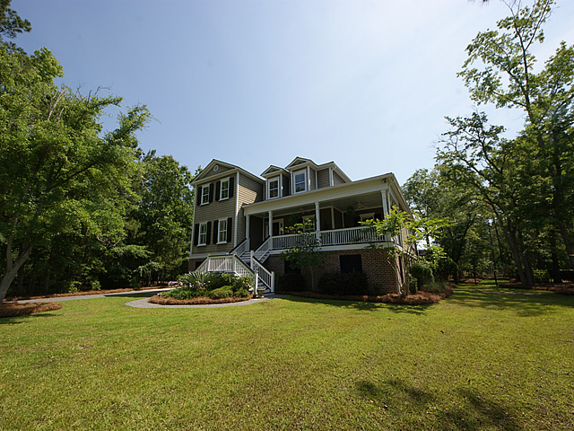
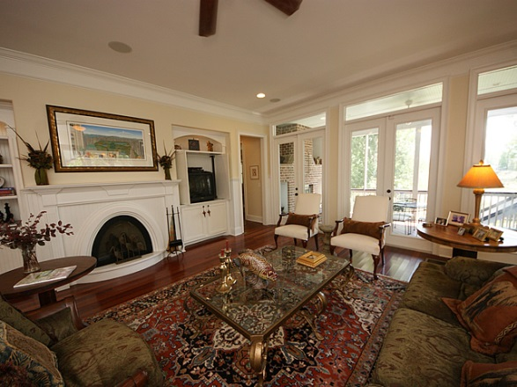
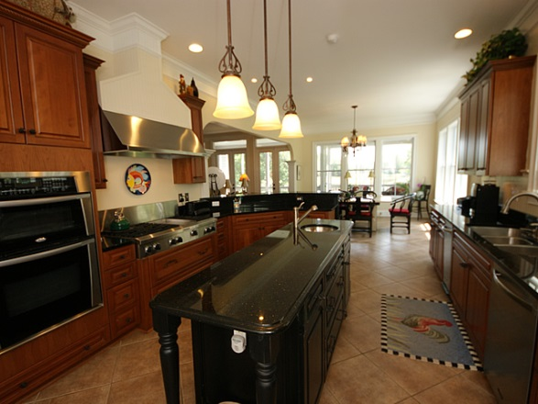
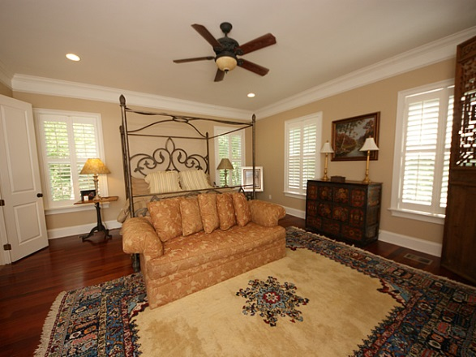
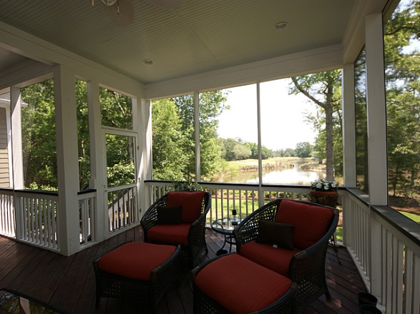
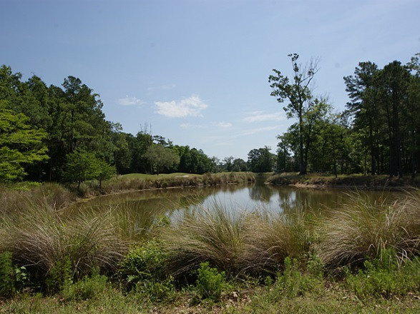



1509 Rivertowne Country Club, Mt Pleasant
Large Wooded Lot in RiverTowne…
A Must See!
Cradled in a rich natural setting in the heart of the exclusive Parker's Landing section of RiverTowne Country Club, this magnificent residence overlooks a pond and the 14th hole of the Arnold Palmer signature golf course. Superbly appointed with an elegant decor, this pristine 4730 square foot custom built home of the finest quality finishes offers 5 bedrooms 4 & 1 baths. Home features an open floor plan containing a large family room with gas burning fireplace, custom cabinetry, and beautiful Brazilian cherry hardwood floors.
Asking $873,000
MLS# 1325183
4,730 SqFt
5 Bed/4½ Baths
Pond Lot
Don Dawson
3040 Highway 17 North • Mount Pleasant, SC 29466
843-514-0452 • ddawson@carolinaone.com
www.TeamDawsonSC.com

