Slide 1

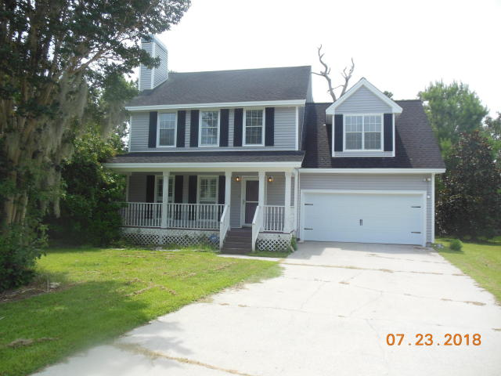
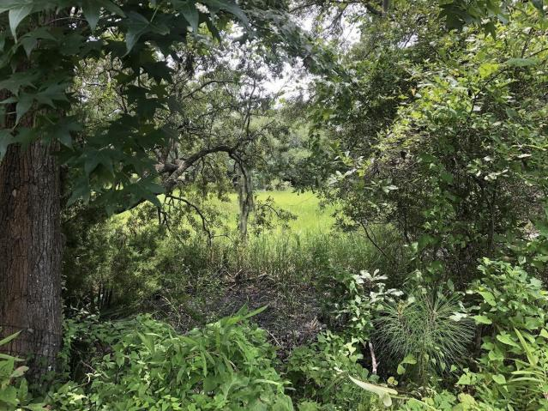
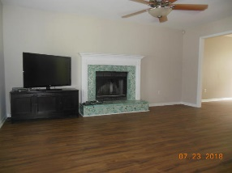
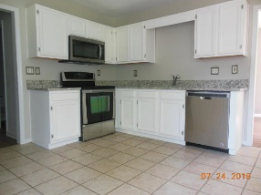
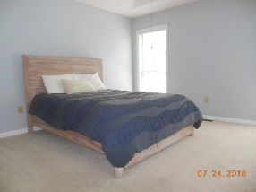
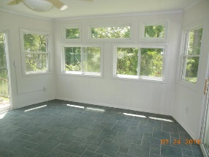
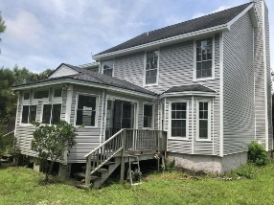
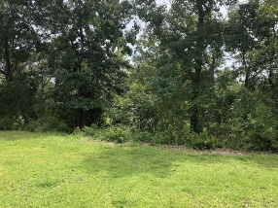


Open House from 2-4pm Sunday October 28th
Lender credit and decorating allowance available!
Michael Moseley
REALTOR, ABR
(843) 442-0959
michaelsmoseley@gmail.com
1509 Tidal Pointe| Mount Pleasant | MLS# 18020751 | $399,900
Brand New Flooring!
Looking for a 4 bedroom in Mt. Pleasant over 2000 square feet?
Close to beaches and downtown Charleston? How about on the marsh too? Well, this is it! This home features some recent renovations, including: new vinyl siding, granite counters in kitchen, updated upstairs hall bathroom with new vanity and tile floors, new garage door, and updated appliances. Upon entering you will notice the gleaming wood laminate floors that accent the living room, dining room and hallways. The kitchen, as mentioned, has new granite counters, new dishwasher and microwave, and freshly painted cabinets. Off the kitchen is a large sunroom, perfect for your morning coffee or afternoon cocktail. The master bedroom is equipped with tray ceiling and dual closets, while the master bathroom has separate shower and garden tub. Enjoy nature in your backyard as it features mature trees and a marsh view! Other bonuses include: low HOA payments, lots of natural light throughout home, and close to shopping and 526.
This home has it all, the only thing missing is YOU!!
Century 21 Properties Plus | 118 W Richardson Ave | Summerville, SC 29483

