Slide 1
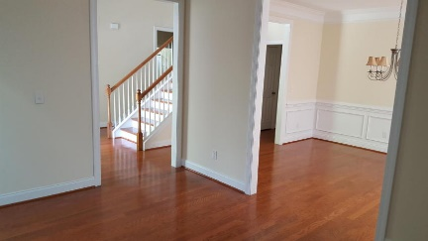
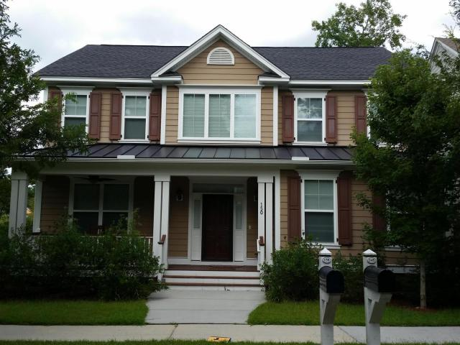
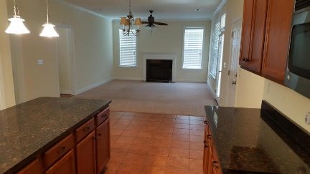
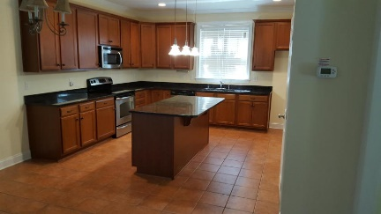
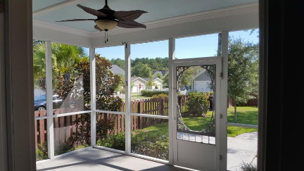
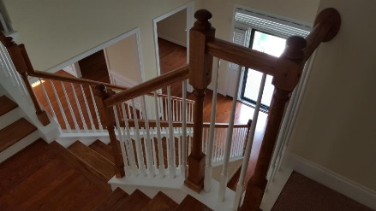
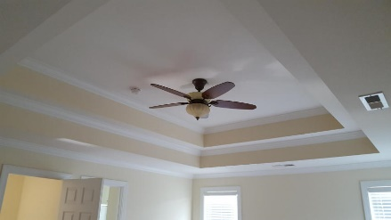
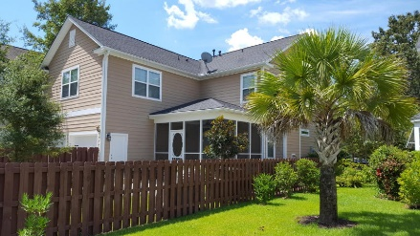
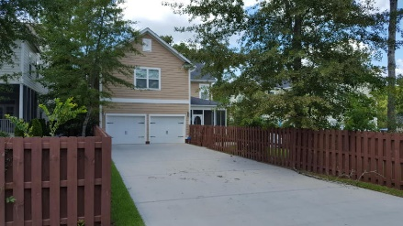


Brokers' Open House, 9/1 from 9-5
$50 Gas Card Drawing
150 Donning Drive
The Ponds ~ Summerville ~ MLS# 16022540 ~ $370,000
Beautiful floorplan with tons of space to be together and 4 separate world in which to be private. Walk into a light-filled foyer with a grand staircase. First floor boasts a formal living room, formal dining room, kitchen/great room with a fireplace. The kitchen also boasts a huge island. On the other side of the stair case is a full bath with a bedroom/study. Take the grand staircase upstairs; to the left is the master bedroom with a huge closet and bath, and trey ceiling. It is completely separate from the secondary bedrooms, which are on the other side of the staircase. This side has two bedrooms split by a Jack-n-Jill bath. Down the hall is the separate laundry room with a huge finished FROG with two closets everywhere. Screened back porch and a patio. Very low maintenance yard.
Susan Woodworth Kraber
Mobile - (843) 779-9655
susankraber1@gmail.com
ERA Wilder Realty, 125-F Wappoo Creek Dr, Charleston, SC 29412

