Slide 1
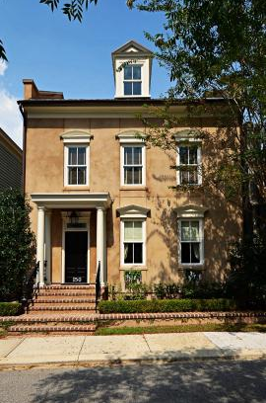
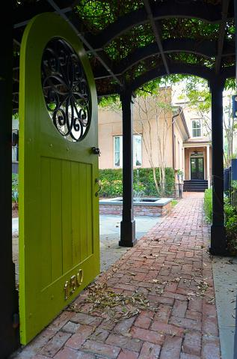
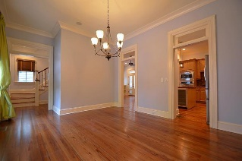
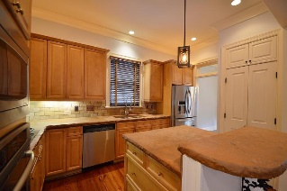
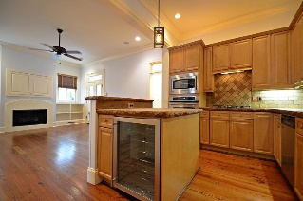
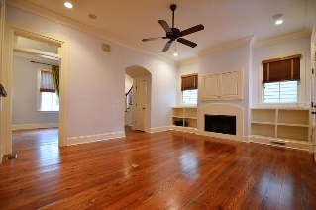
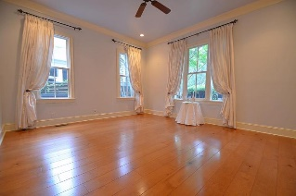
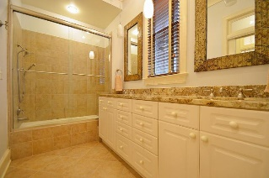
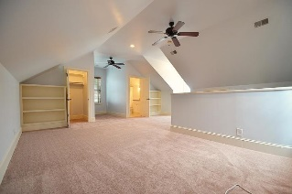
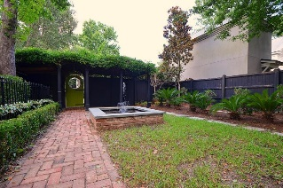
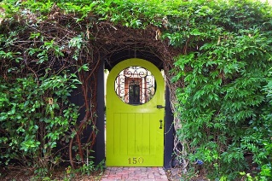

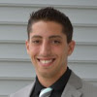

150 Ionsborough St Ion Mount Pleasant, SC 29464 MLS# 18020400 $850,000
Just Listed
+
Open House
Saturday, March 24th 11-1
Open House ~ Thursday, July 26th ~ 6-9pm
Welcome home to a true classic.
Enjoy the relaxation of your afternoons in the thoughtfully designed backyard with pond. Plenty of room for entertaining inside and out this home offers a large dining room, large kitchen and master suite located on the first floor. The pine floors are freshly redone on the entire first floor. The flow and design is what makes you feel at home the minute you walk through the front door.
The location makes it perfect for dining, shopping, and close to downtown only a 7 minute drive. Look no further. The charm and character you are looking for is here.
Andrew Sorrentino
(843) 371-6218
andrew.sorrentino@agentowned.com
Kelly Rozier
(843) 209-3129
kelly.rozier@agentownedrealty.com
The AgentOwned Realty Co | 902 Savannah Hwy | Charleston, SC 29407
Real Estate • Mortgage • Insurance
www.AgentOwned.com

