Slide 1


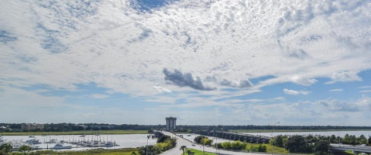
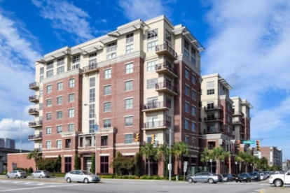
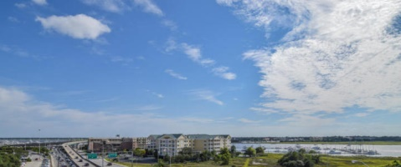
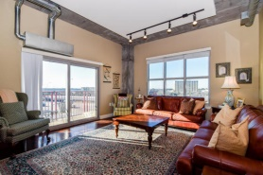
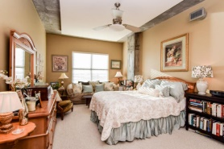
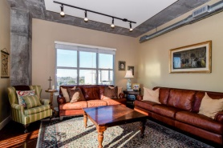
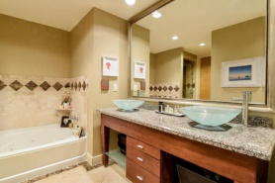
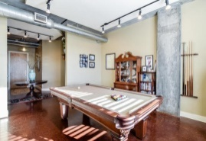
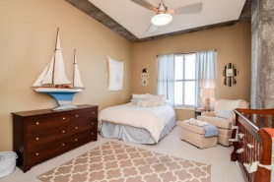
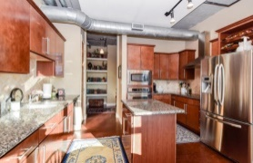
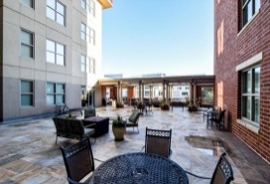
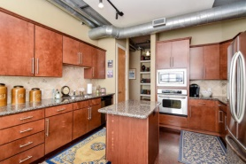
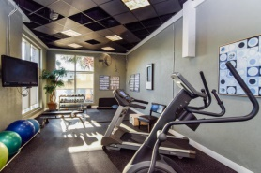


Roomy with a View!
150 Bee Street #503
Bee Street Lofts - Charleston
MLS# 15001555 - $575,000
This is an amazing 2 Bedroom, 2½ Bathrooms condo! 2,030 square feet with amazing westerly views of the Ashley River from the 5th floor. Bee Street Lofts is at the hub of Charleston County; conveniently located to the hospitals, the new Horizon Project development, Brittlebank Park, Joe Riley Stadium, and all of the area beaches.
This is an extremely secure building. Enter through the gated garage and park in one of two deeded parking spaces on the first floor just beside the main elevator. The building has a gym, tv/reading lounge, and 2 large courtyards on the third floor for grilling and socializing.
As soon as you enter unit 503, you will be amazed by its views and its spaciousness. Features include 10' ceilings, granite counter tops in the kitchen and baths, travertine tile on the bath floors and surrounds, and GE profile stainless steel appliances.
This is a must see for anyone wanting to live downtown with river views convenient to all Charleston has to offer. There is an onsite manager and maintenance staff.
This part of the Charleston Peninsula will only get better in the near future as the Horizon Project takes off, creating a new and exciting multi-faceted segment of the city between Bee Street Lofts and Joe Riley Stadium.
Lee Lindler
leel@goldenbearrealty.com
www.GoldenBearRealty.com
Golden Bear Realty | 654 Coleman Blvd, Suite 100 | Mt Pleasant , SC 29464
Cell (843) 637-0803 | Office (855) 725-5890 | Fax (561) 721-3311

