Slide 1


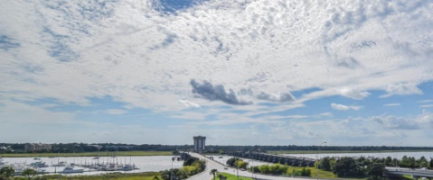
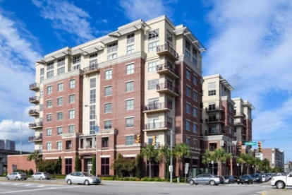
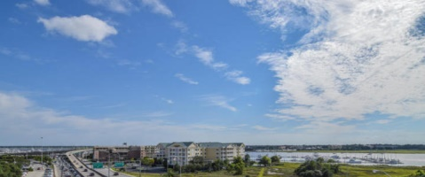
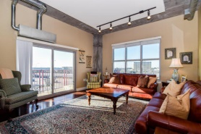
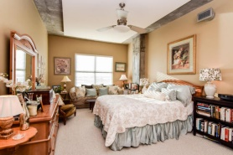
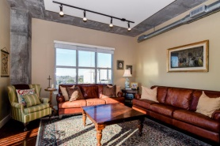
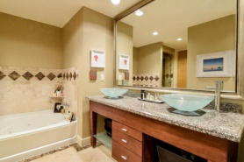
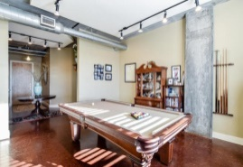
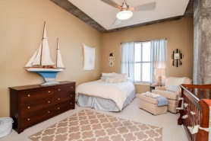
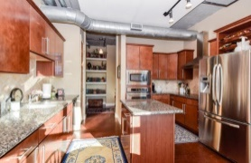
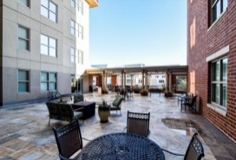
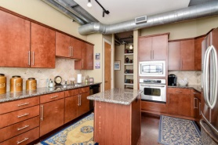
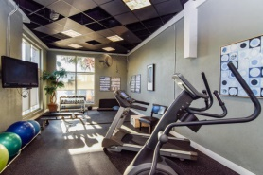


Major Price Reduction! Roomy with a View!
150 Bee Street #503
Bee Street Lofts - Charleston
MLS# 15001555 - $475,000
This amazing condo is priced to sell!
2030 square feet with amazing westerly views of the Ashley River from the 5th floor. This unit features dual masters, two full and one half bathroom, large living room, dining room, large laundry room, built in shelving and wine rack, GE Profile stainless steel appliances, and more. All countertops are granite, and the bath floors and surrounds are travertine.
Bee Street Lofts is the hub of Charleston County; convenient to the hospitals, the new WestEdge development, Brittlebank Park, Joe Riley Stadium, I-26 and the airport, and all of the area beaches. This is an extremely secure building. Enter through the gated garage and park in one of two deeded parking spaces on the first floor just beside the main elevator.
This is a must see for anyone wanting to live downtown with river views convenient to all Charleston has to offer. There is an onsite manager and maintenance staff.. This part of the Charleston Peninsula will only get better in the near future as the WestEdge community takes off, creating a new and exciting multi-faceted segment of the city between Bee Street Lofts and Joe Riley Stadium.
Lee Lindler leel@goldenbearrealty.com
www.GoldenBearRealty.com
Golden Bear Realty | 654 Coleman Blvd, Suite 100 | Mt Pleasant , SC 29464
Cell (843) 637-0803 | Office (855) 725-5890 | Fax (561) 721-3311

