Slide 1
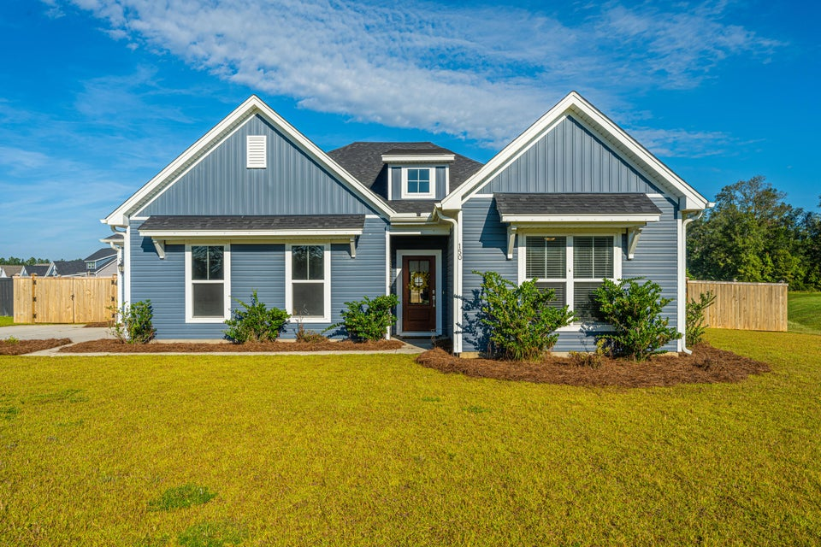
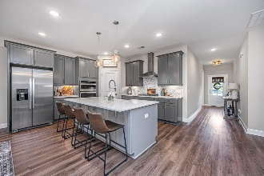
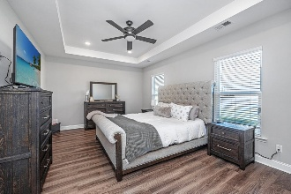
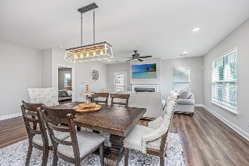
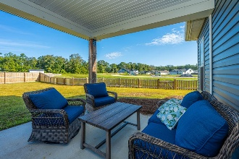
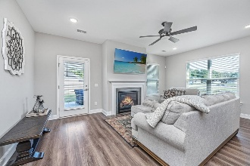
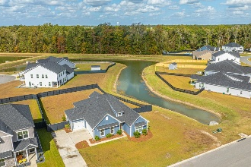

150 Darby Meadow Lane Timothy Lakes · Ridgeville, SC 29472 · MLS# 25000243 · $450,000
The Only Deep Water Home On Daniel Island
Agent Open House
Sunday January 12th 1pm to 3pm
Welcome to 150 Darby Meadow Lane in Timothy Lakes. This gorgeous One-Story home with a 3 Car Garage (side entry) located on a corner .33/Acre Pond Lot is now available. Better than building new as this home comes with a privacy wood fence, ceilings fans, garage door openers, gutters, front yard irrigation, etc..... - it is truly turnkey. Are you Looking to get out of the city and away from traffic with a little bit of elbow room, you need to check out Timothy Lakes. Upon entering this home, you are welcomed to a proper foyer and 9ft smooth ceilings. This split floor plan has 2 secondary bedrooms and a full bath to the right of the foyer. Proceed down the foyer to the very open living concept. The gourmet kitchen offers upgraded cabinets, stainless steel appliances including a gas cooktop and hood, Quartz countertops, Farmhouse Sink, Tiled Backsplash, Pendant Lighting, and an oversized counter height island. The living/dining room combination is very spacious and defined with upgraded light fixtures. The main focal point is the gas log fireplace. The primary suite is to the left of the living room. Complete with a tray ceiling, recessed lighting and a ceiling fan. The ensuite offers an extended dual raised vanity, a garden tub, a separate water closet, linen closet and a Tiled Shower with a Rain Shower Head and Frameless glass. The 2 Car Garage and the 1 Car Garage both have electric garage door openers. When entering the home from the garage, you have the flex drop zone area with cubbies and hooks for your belongings! The laundry room is to the left of the drop zone. Outback you will enjoy evenings or rainy days on your covered porch. The entire backyard has been completely fenced in. Don't delay, make this your new home for this new year 2025.
Nickole Samios
(843) 330-4136
nickole@carolinaone.com
Carolina One Real Estate
900 N Main St
Summerville, SC 29483
www.summervillesouthcarolinahomes.com

