Slide 1
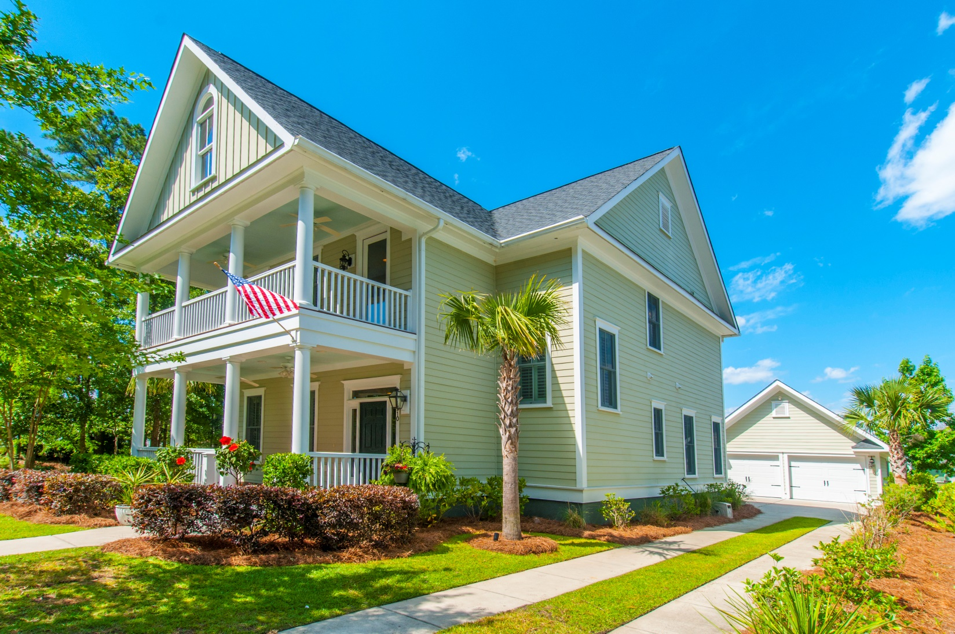
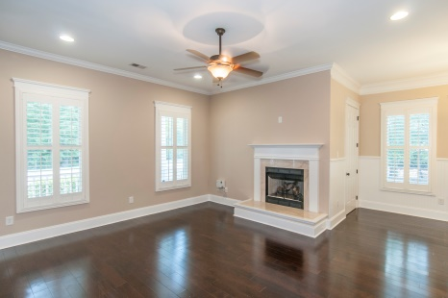
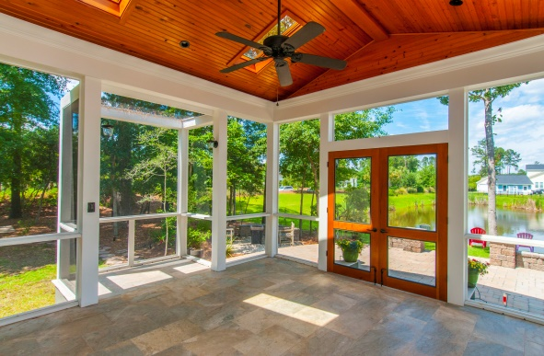
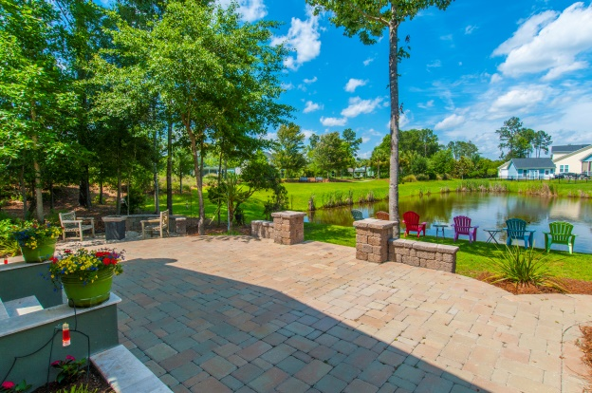
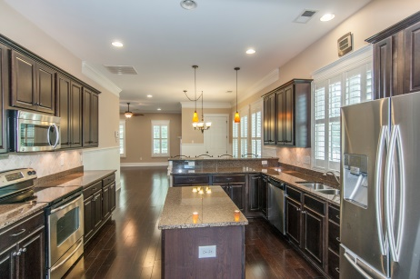


“Premier Community, Pond Lot, Outside Splendor, More…”
1510 Crane Creek Drive
Mt Pleasant, SC 29466
$550K
Ask about
incentives
Great location, Wonderful custom outside living spaces…
Walk to the pool & amenities
Custom high-end Porch, patio
Stocked pond setting
Walkable to excellent schools, future library
3051 SF, 4BR, 3.5BA
Custom plantation shutters throughout
Master suite downstairs
Custom shelves, desk, fridge in loft/media
And the hidden closet!
STEVE ROWE
,Realtor®
Retired Military. Active Agent.
(843) 303-7438
srowe@carolinaone.com
www.SteveRoweHomes.com

