Slide 1
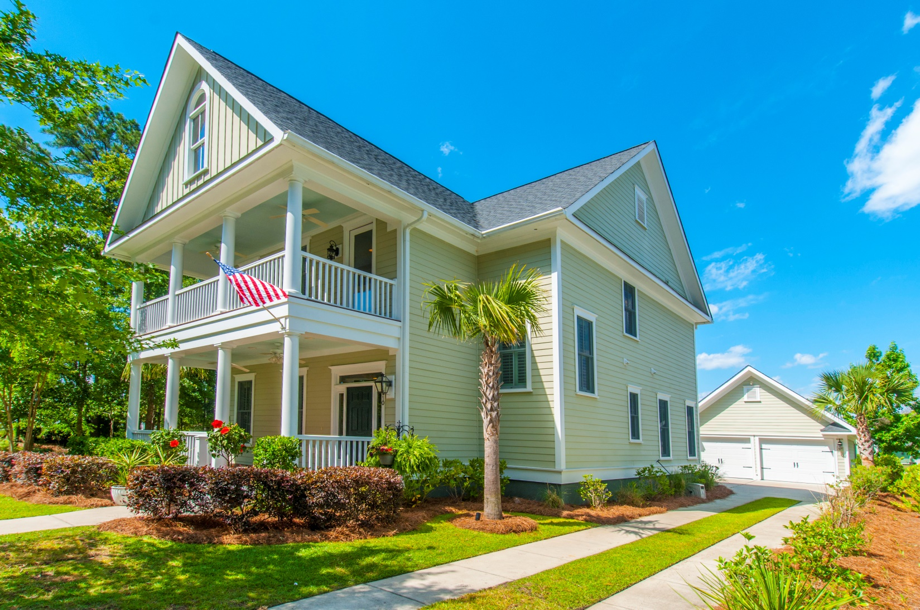
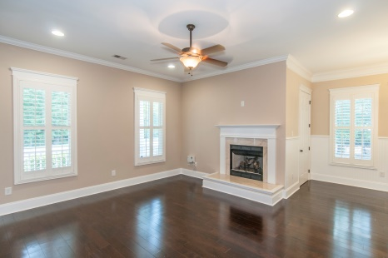
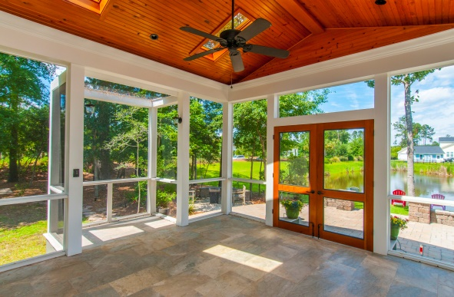
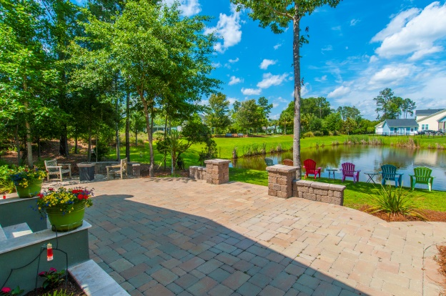
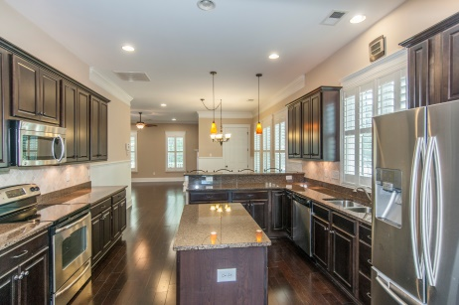


“Premier Community, Double Lot, Pond, More…”
1510 Crane Creek Drive
Mt Pleasant, SC 29466
VALUES
Just Reduced Big. Move
in during August!
Home on 1 lot w/porch/patio/fire pit/pond lot value appx $560K;
Sep buildable lot (your private park) appx $100K
$609,500
Great location, park-like private lot, custom outside living spaces…
Walk to the pool & amenities
Special, unique private side yard/park
Porch, patio, fire pit, pond setting
Walkable to excellent school, future library
3051 SF, 4BR, 3.5BA
Custom plantation shutters throughout
Master suite downstairs
Custom shelves, desk, fridge in loft/media
STEVE ROWE
,Realtor®
Retired Military. Active Agent.
(843) 303-7438
srowe@carolinaone.com
www.SteveRoweHomes.com

