Slide 1
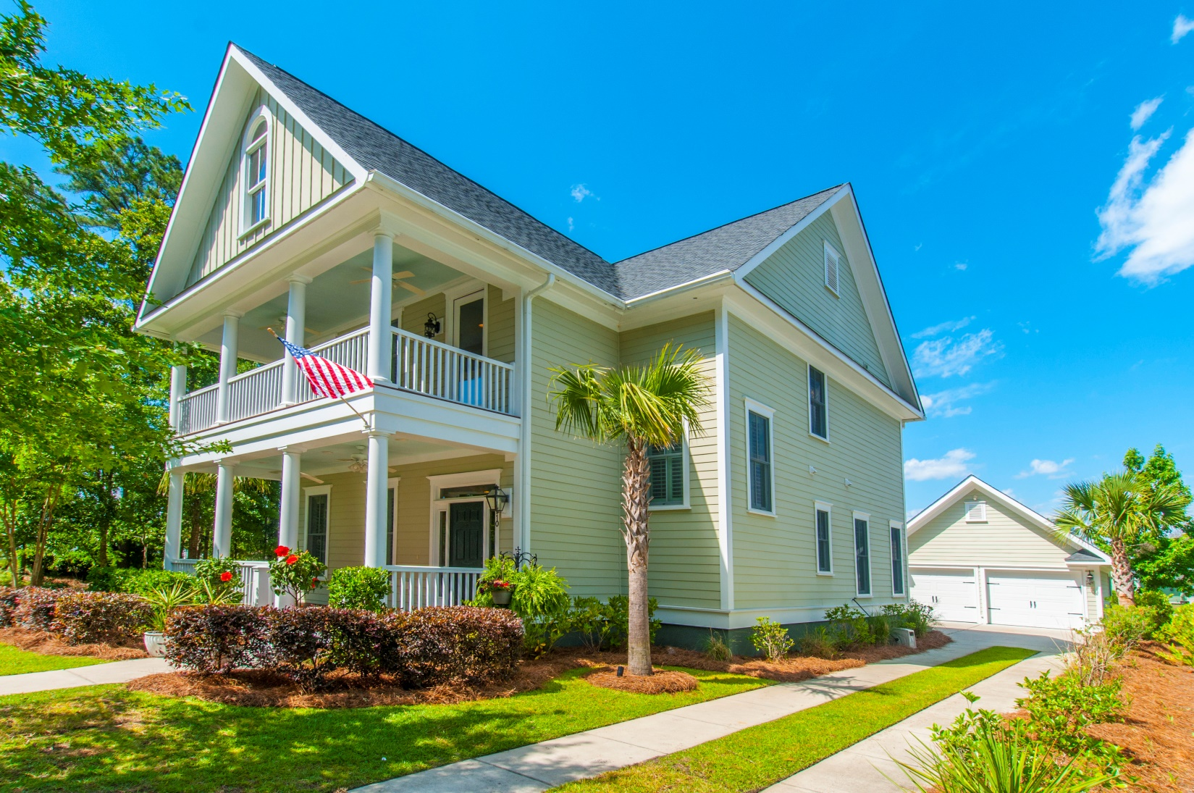
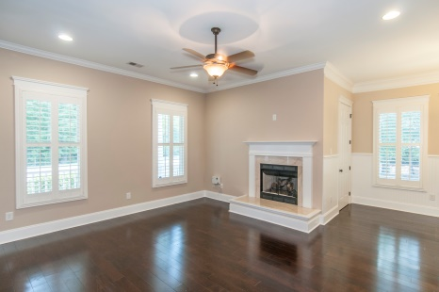
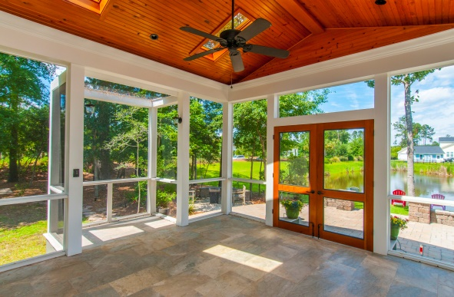
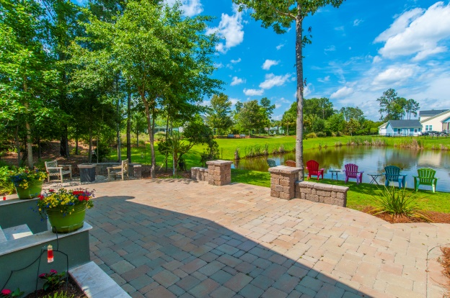
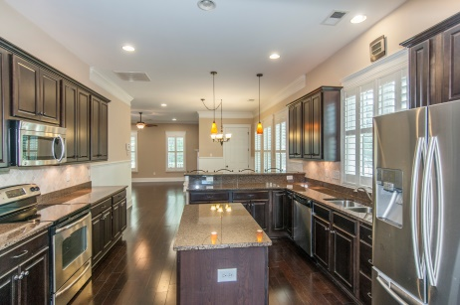


“Premier Community, Pond Lot, Custom Outside Spaces, More…”
1510 Crane Creek Drive
Mt Pleasant, SC 29466
$$535K
Buyer incentives available
Great location, wonderful custom outside living spaces…
Walk to the pool & amenities
Custom porch w/grilling area integrated
Big custom paved patio, pond setting
Walkable to excellent schools, future library
3051 SF, 4BR, 3.5BA
Custom plantation shutters throughout
Master suite downstairs
Custom shelves, desk, fridge in loft/media
STEVE ROWE
,Realtor®
Retired Military. Active Agent.
(843) 303-7438
srowe@carolinaone.com
www.SteveRoweHomes.com

