Slide 1
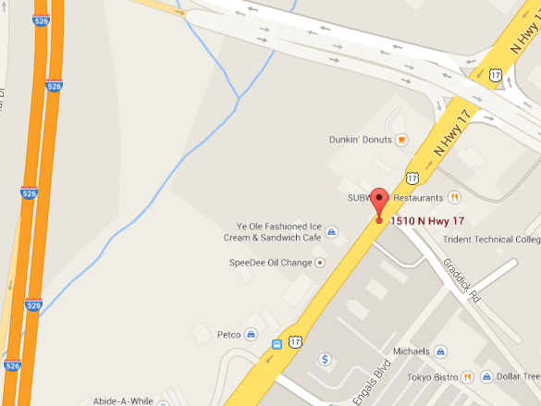
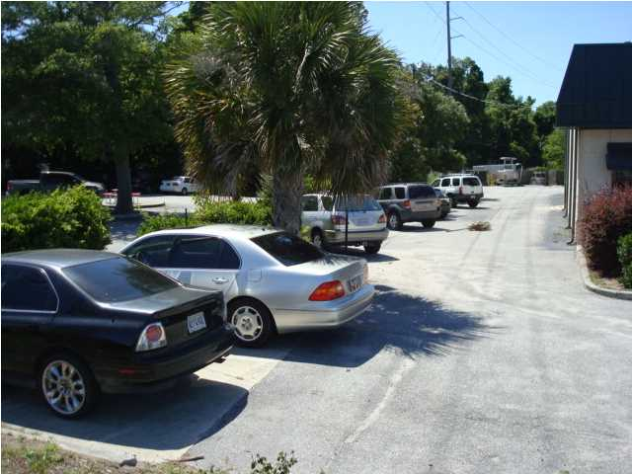
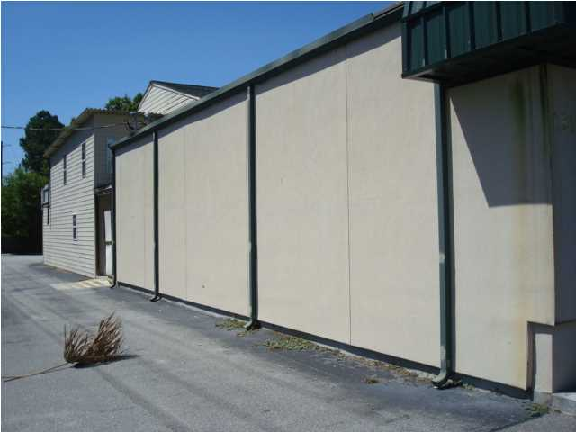
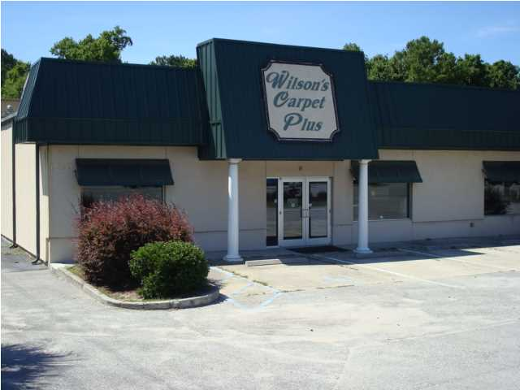
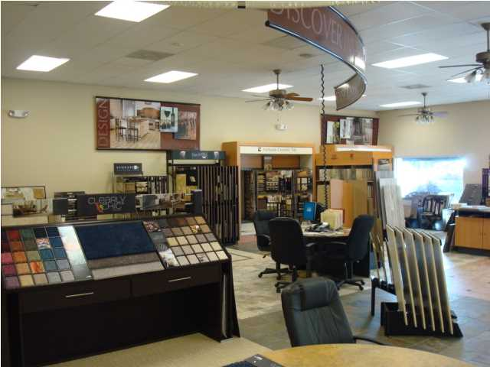
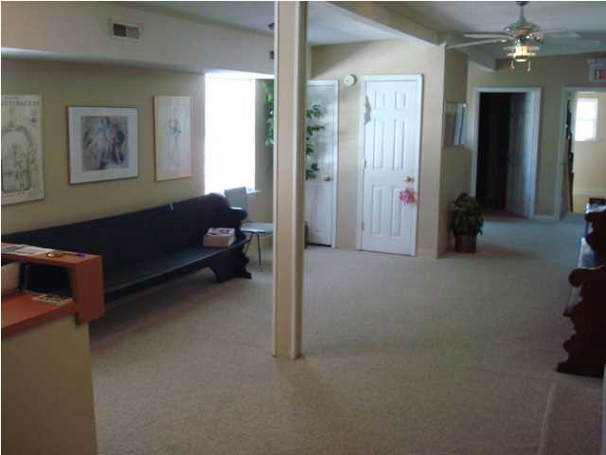
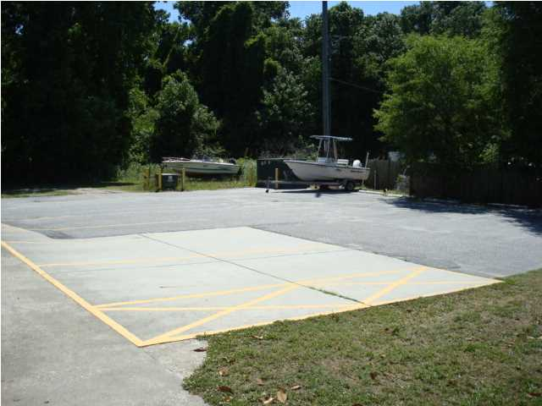
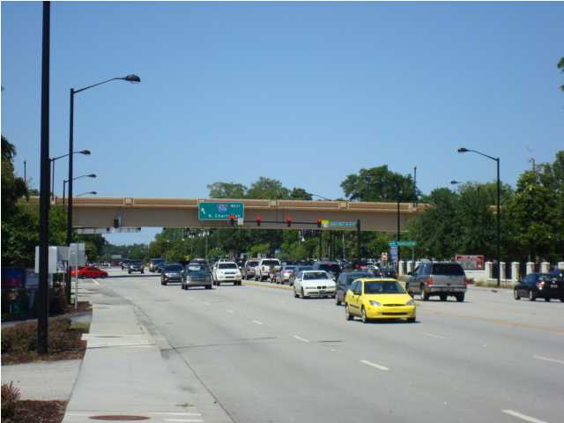
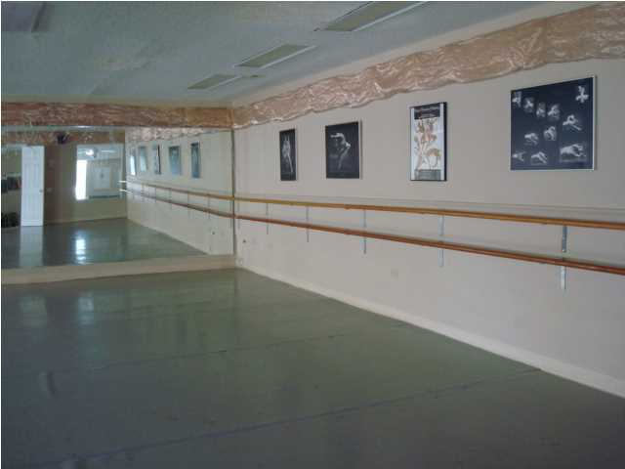
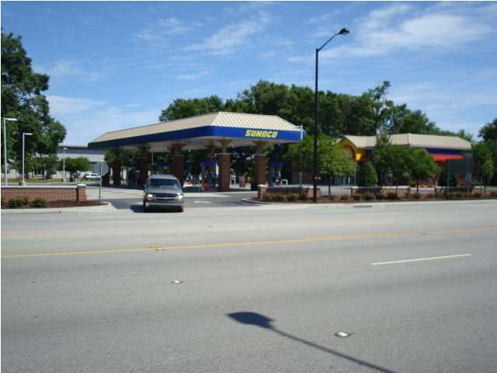
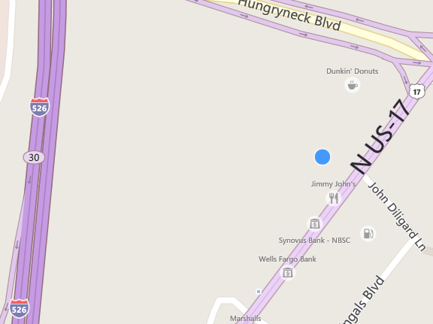
1510 Hwy 17 N, Mt Pleasant, SC 29464 Sale - $1,575,000 | Lease - $18/sf NNN
SALE · LEASE · LEASE/PURCHASE
LEASE MLS# 1415488
SALE MLS# 1414766
8,595 sq. ft.
6,033 1st Floor/2,560 2nd Floor
Located only 500’ from I-526 Ramp in Central Mount Pleasant
Highly visible freestanding retail property with 6,035 sq. ft. 1st floor and 2,560 sq. ft. 2nd floor in a high traffic retail area. 1st floor includes open showroom, offices, 2 restrooms, break room and an approximately 600 sq. ft. storage area. 30 designated parking spaces available in front, left side and rear of the building, plus, additional parking on grass in rear of property. 2 entrances from Hwy 17 North allow easy access/egress. 2nd floor is currently leased and configured for a dance studio and is well suited for art, dance, photography, etc. studio. This space can be easily reconfigured for an office user. Current owner has replaced siding, installed 4 new HVAC units, upgraded interior electrical and renovated the interior over the last 6 years. Property in the county but could be annexed into Mt. Pleasant if desired by new owner. Owner is willing to lease the property...Sell the property or enter into a lease/purchase with tenant occupying now and purchasing at a later date. Property taxes are $10,951.17 and current insurance at $4,308.90. Zoned General Commercial
Rick Willis
843-327-3017
rwillisteam@gmail.com
The Group, LLC

