Slide 1
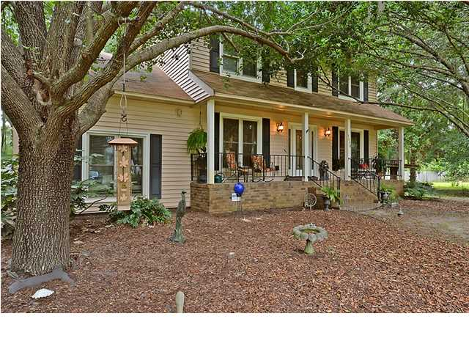
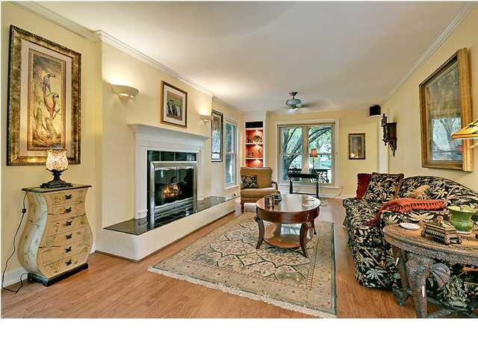
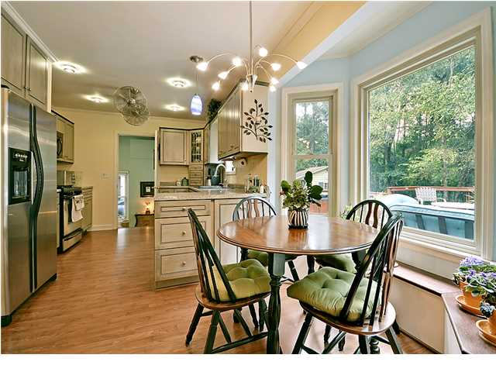
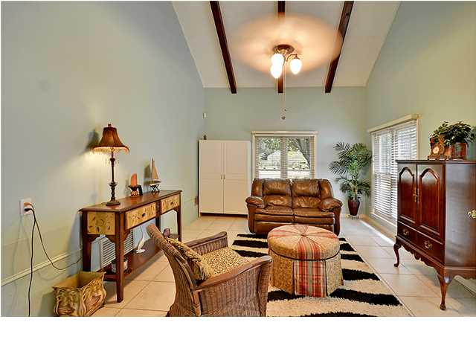
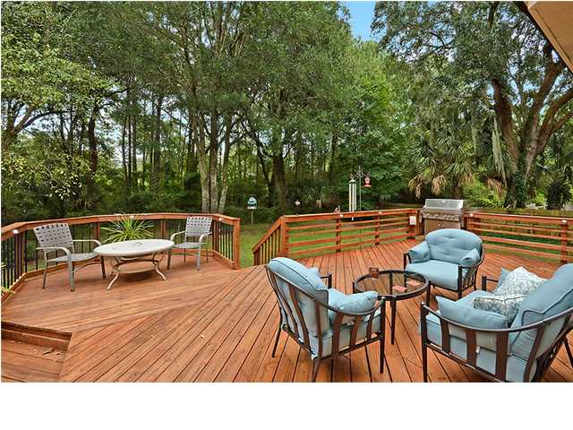


SECLUDED AND DISTINCTIVE!!
1510 N Lakeshore Dr
Palmetto Fort
Mount Pleasant
MLS# 1408939
$343,900
AWAY FROM THE MADDENING CROWDS! A detached Country Style Home with a full front porch is situated on a quiet tree lined street, surrounded by a large (.44 acre) fenced yard, located very close (5 miles) to the beach and close to schools and shops. This Exclusive home offers 3 spacious bedrooms and a large private bathroom upstairs with ample closets for storage. There are several large rooms on the main floor including a flex room that may be used as the spacious master bedroom. With distinctive ceramic flooring, a modern updated bathroom, all other rooms on the main floor are appointed with beautiful laminate wood flooring including the valuable and colorful family room with a popular wood burning fireplace, a classic formal dining room, the family-sized country kitchen is appointed with beautifully crafted antique cabinets, built-in upgraded appliances (gas range, dishwasher, built-in microwave), eating area with a large bay window allowing panoramic views of the back yard. There is a private French door to an awesome multi-level deck and relaxing hot-tub for outside enjoyment, included for the handyman is a detached workshop equipped with heat/AC, water. The main home is equipped with Florida Heat Pump (water to air) and is considered very efficient.
Please note that this home is not located in the City of Mount Pleasant (lower taxes), there is no HOA and the current flood insurance policy is transferable. The current cost is $680.00 annually. The surrounding area is being developed by National Builder. The Values will be increasing. This is the perfect time to purchase this Unique Home. Age, sqft, taxes, schools, and acreage are approx. buyer to verify.
Bill Everett, Jr
Broker
Office 843-767-7777
Direct 843-693-8539
Fax 843-576-5352
RE/MAX Pro Realty, 9209 University Blvd, Charleston, SC 29406

