Slide 1
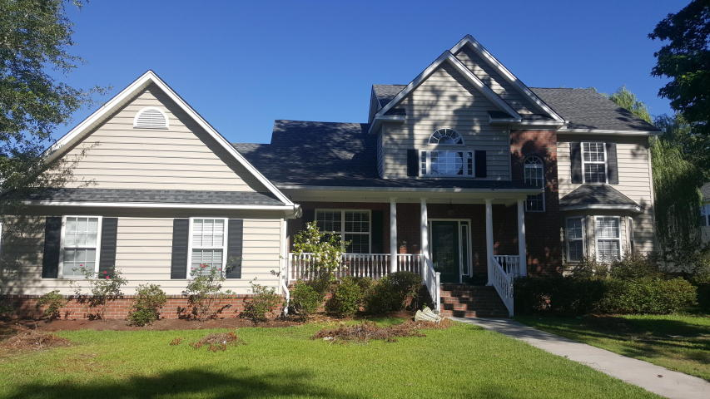
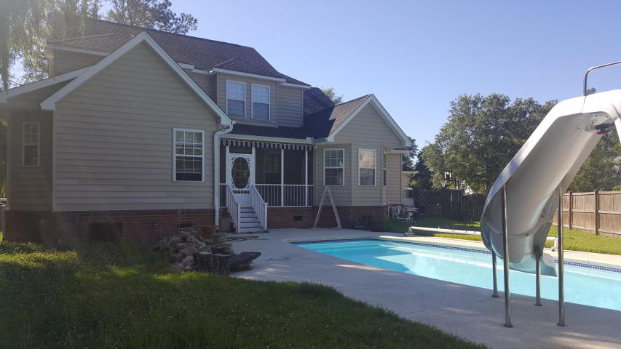

1510 Sterling Oaks Drive
Sterling Oaks ~ Moncks Corner ~ MLS# 17014861 ~ $309,000
Open House
Saturday, 6/10 from 2-5 & Tuesday, 6/13 from 5-7
3149 sq/ft plus with 5 bedroom - 4 bathroom
In ground pool
Needs some TLC
Haydee Irizarry
(843) 261-7152
haydee.irizarry@agentownedrealty.com
AgentOwned Realty Co. Premier Group, Inc. | 141 A N. Main St | Summerville, SC 29483

