Slide 1
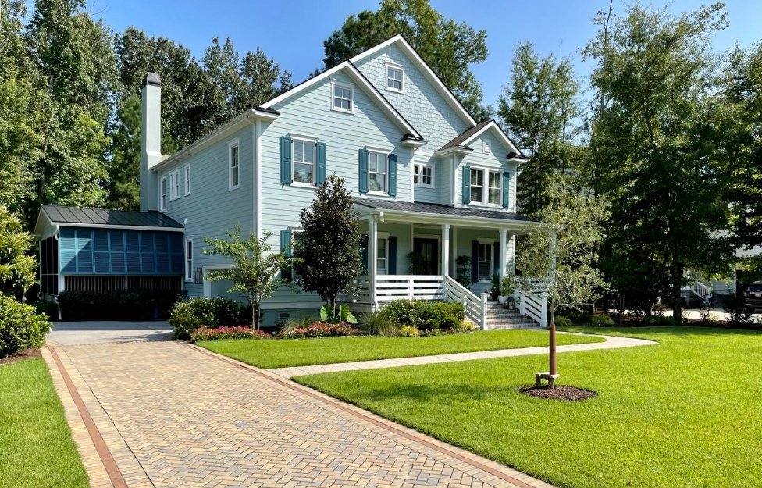
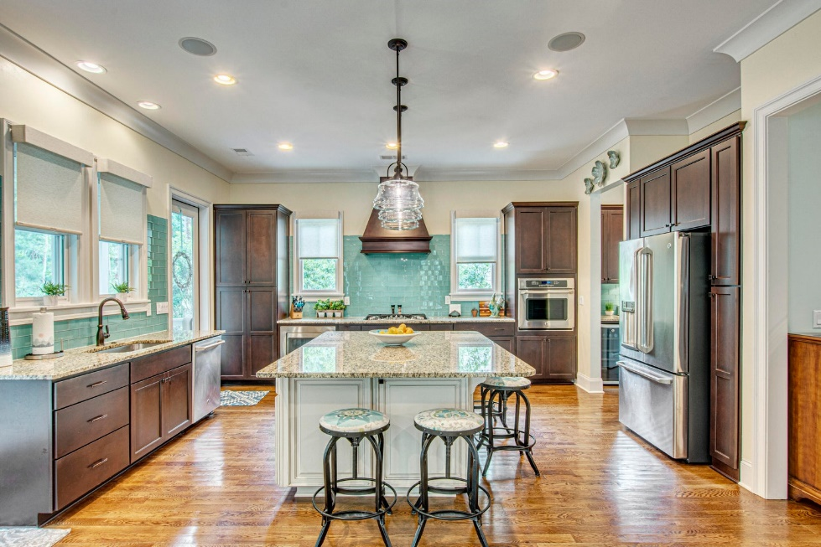






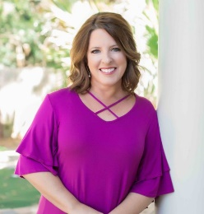


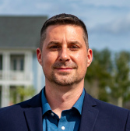
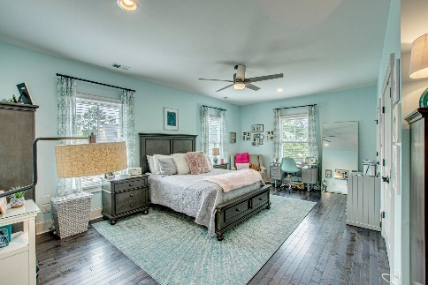
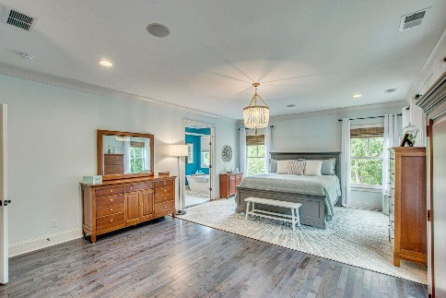
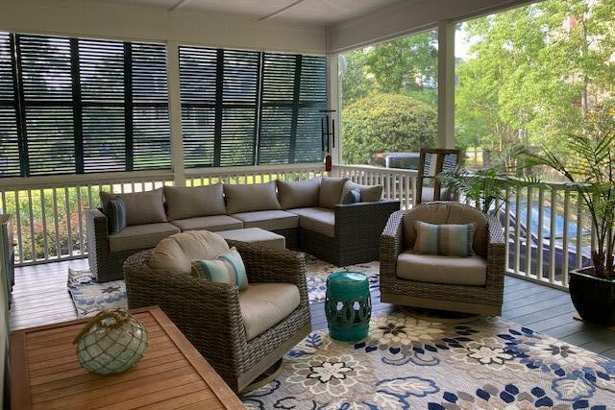
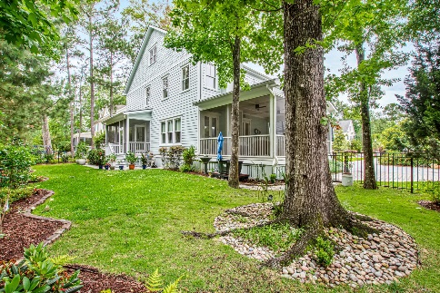
#23011340
1512 Capel Street Park West
Mount Pleasant, Sc 29466
Well Designed Coastal Farmhouse
Open House
Sat 10-12 & Sun 10-12
4 BED
3½ BATH
3,908 SF
$1,550,000
As you arrive at 1512 Capel St you will immediately notice that every inch of this gorgeous coastal farmhouse has been meticulously maintained and designed, inside and out. When you enter, you are welcomed by hardwood flooring, high ceilings and generous rooms throughout. The main floor features a formal living and dining room, open concept kitchen with butler's pantry, family room as well as a 5th bedroom/flex space. This room, currently being used as an office, can be accessed from the drop zone or the renovated half bath with space for a full bath conversion. The lanai, just off the family room is the perfect expanded living space for relaxing, dining, entertaining or just enjoying mother nature.
Need a place to escape within your home? Upstairs, the spacious owner's suite is a dream. Featuring a sitting area, fully renovated(down to the studs) bath and 2 oversized closets (one used just for storage). It doesn't stop here, there is a 2nd owner's suite on this level as well as 2 additional guests bedrooms that share a jack & jill bath. Need additional storage?? The attic has 1000 square feet. The exterior has been recently painted, new brick steps, horizontal railings, and new lighting. A new paved drive and additional parking space created with lifetime pavers, professionally landscaped, backyard paver patio, french drains and a fenced back yard is also included. A $2500 Lender Credit is available and will be applied towards the buyer's closing costs and pre-paids if the buyer chooses to use the seller's preferred lender. This credit is in addition to any negotiated seller concessions.
Michele Hudson
843-800-2069
EMAIL ME
VIEW MY LISTINGS
Carolina One Real Estate
2713 Highway 17 North
Mt. Pleasant, SC 29466
Matt Kimes
843-860-1669 | mattkimeshomes@gmail.com
www.mattkimeshomes.com

