Slide 1
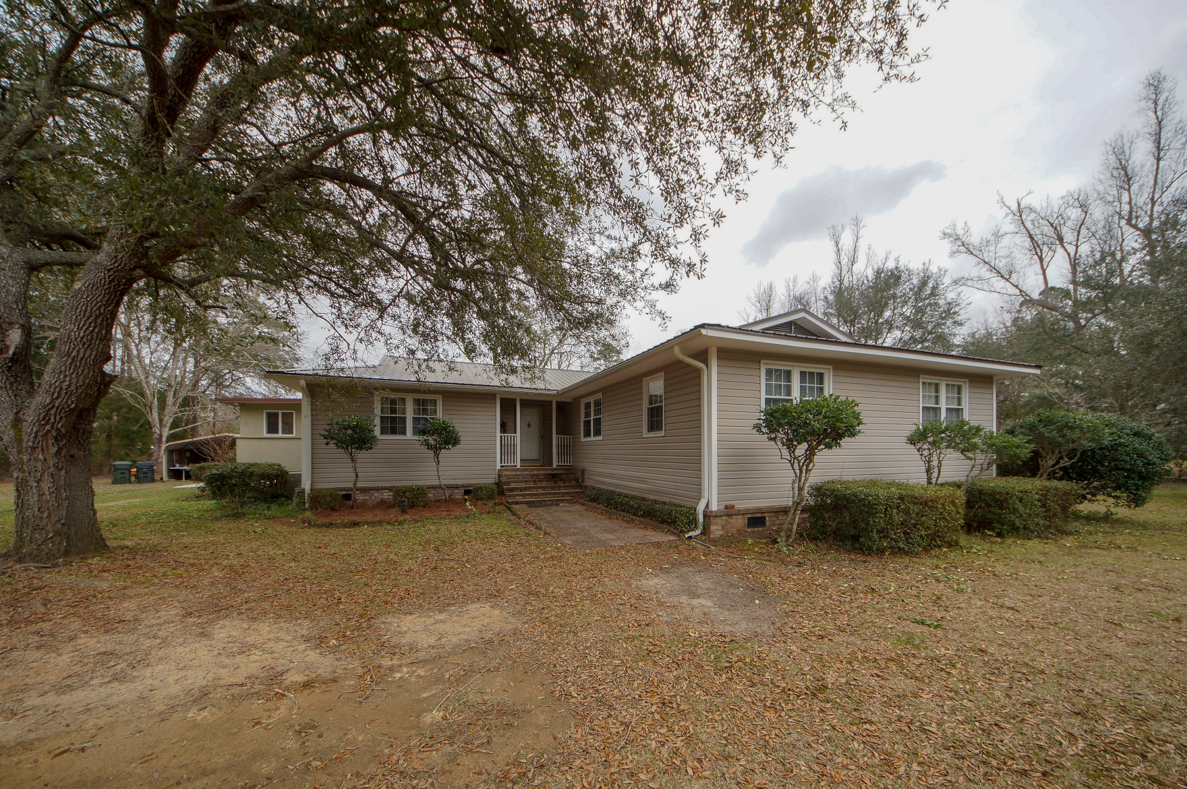
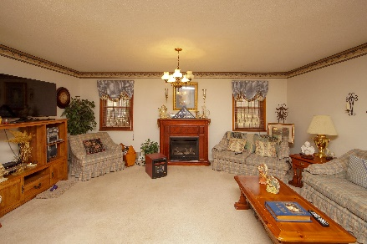
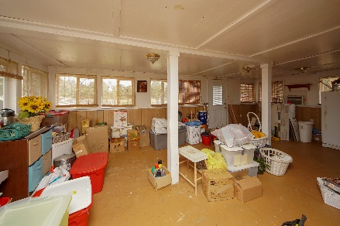
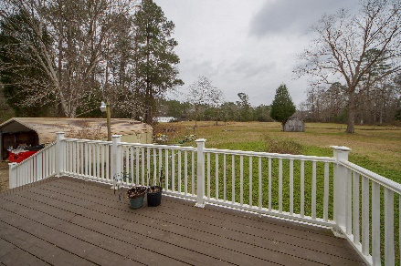


1514 E Church Street Bonneau, SC 29431 MLS# 19001500 :: $194,000 4 Bed / 2 Bath
2.67 Acres!
Charming Country Home On 2.63 Acres Of Land
4 bedrooms 2 bath, formal dining, and oversized family room offer plenty of living space.
Sunroom with deck leads to cleared acreage.
Roof is approximately 6 years old and AC is approximately 8 years old.
Pre CL100 was performed on property.
Needs repair under home.
Connie White, Broker
843-532-3356
connie@chrepros.com · conniewhiterealestate.com
Charleston Homes · 597 Old Mt. Holly Road · Suite 301 · Goose Creek, SC 29445

