Slide 1
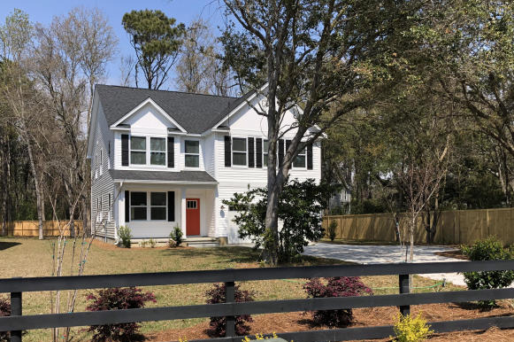
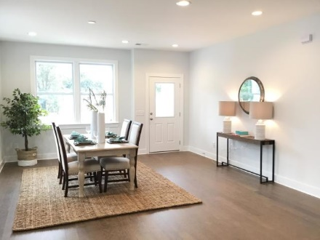
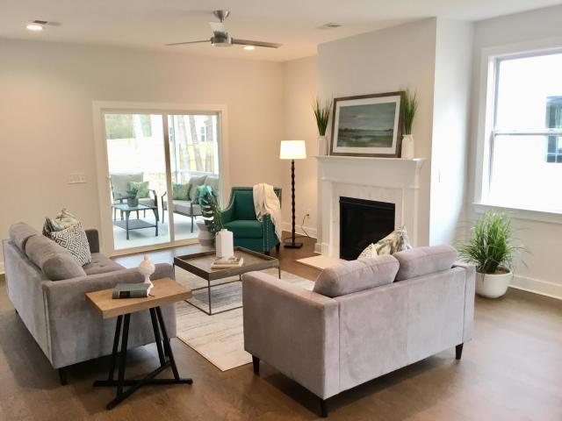
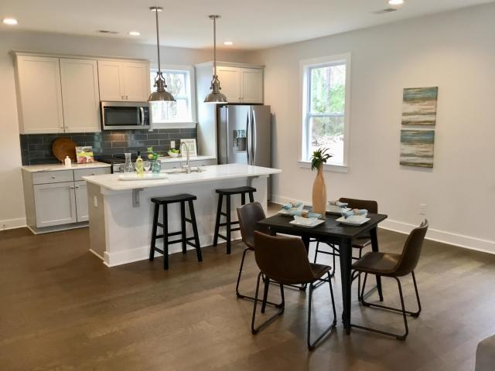
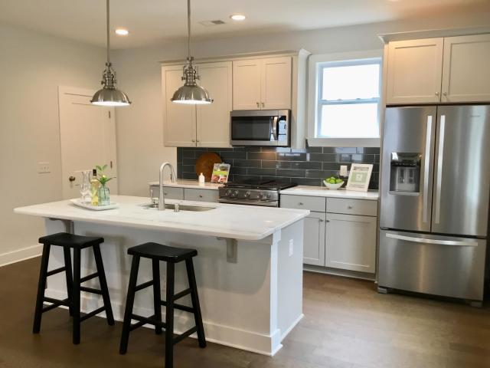
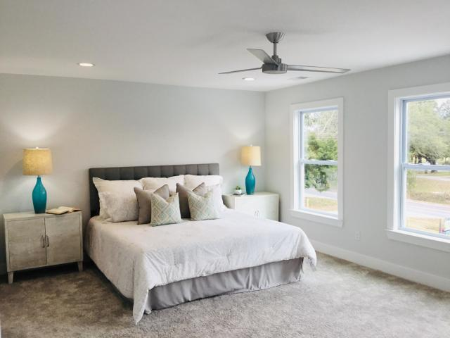
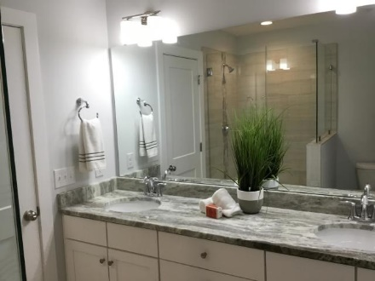
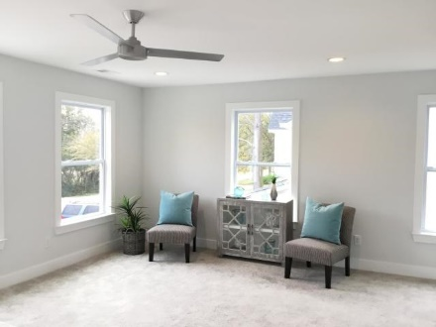
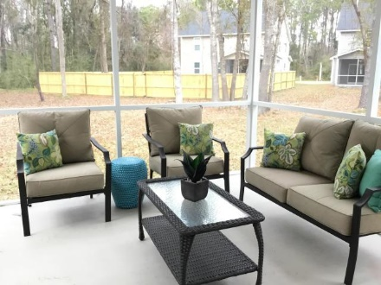



5 Minutes to Folly!
1514 Grimball Ext Road
Charleston, SC 29412
MLS# 19008207
$416,900
4 Bedrooms | 2½ Baths | 2,710 sf
New Construction - Under $420K
New Construction. 5 Minutes to Folly! This MOVE-IN READY top quality new offers the highest-quality new construction on James Island, close to downtown and minutes to Folly Beach. Seller to offer $2500 in closing costs credit! This exquisite 2,710 square foot, 4 bedroom 2 1/2 bath turnkey residence sits on an estate sized, professionally landscaped wooded lot. Outfitted with style, built using fine materials, and crafted by experienced tradesmen. Large, sunny kitchen has shaker cabinets w/soft close hinges, stone countertops, and high end stainless appliances, including refrigerator. Hardwood Floors throughout the downstairs, staircase and upstairs hallway. Bathrooms and laundry room boast Designer tile, including a Tiled Walk-in Shower with Frameless Shower Door in master bath...stone countertops too. Anderson Impact Resistant Windows (so no climbing ladders w/plywood in a storm) , natural gas fireplace, range and tankless hot water heater add to the luxury and convenience of this home! Techshield reflective roofing sheathing reduces energy costs. No lot premiums, No HOA fees and no costly upgrades. Low Flood Insurance quote estimated at $633/year! See the Included Feature List under "documents" (or ask) and compare all this home has to offer! *If square footage is important to buyer, buyer should independently measure to ensure accuracy as means and methods of measurement differ.
Stephen Kugelman
(843) 330-0403
steve@agentowned.com
www.kugelmanrealestate.com
Ashley Melton
(843) 670-2333
ashley.melton@agentowned.com
www. CharlestonPalmettoHomes.com
AgentOwned Preferred Group | 824 Johnnie Dodds Blvd | Mt Pleasant, SC 29464

