Slide 1
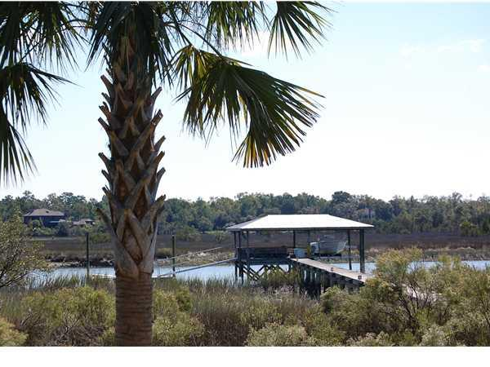
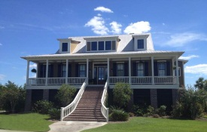
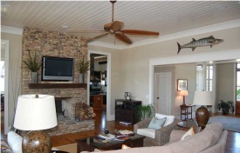
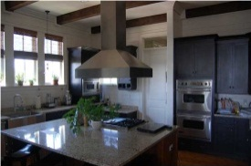
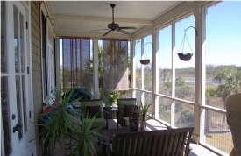
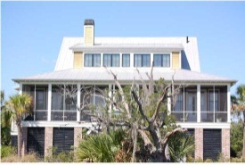
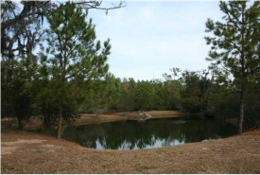
Deepwater Designer Home 1515 Creek Side Way Beresford Creek Landing Charleston, SC MLS# 1123593 $1,159,900
Steve DeMarco
843-442-1520
Margaux Kilgallen
843-670-4035
mckilgallen@gmail.com
Beresford Realty
Deepwater home in sought after Daniel Island area. This custom elevated Lowcountry style home has many features that you must see to truly appreciate...from the spectacular water view from the screened porch and clapboard walls in the gourmet kitchen to the Tennessee stone fireplace and wildlife that are yours. Located on Beresford Creek you'll enjoy fishing, crabbing and shrimping on your private covered dock, with 7000 lb boat lift and floating dock with water and electricity for easy clean up after a day in the sun. The home is designed to enjoy the beauty of the water from every room. As you enter the home you are welcomed with a grand two story foyer opening into the family room. The sun-filled family room features a spectacular wood burning fireplace custom designed and built from Tennessee river rock that opens to the kitchen, double crown molding and 12' ceiling. The doors are 10' solid wood with wrought iron hinges and knobs. The kitchen, ahhh the kitchen, this is a cooks delight with lots of counter space for easy preparation and entertaining. The Kitchen features include a walk-in pantry, custom-made cabinetry, granite countertops, Viking stove with stainless hood, Viking Sub-Zero Refrigerator, Ice machine, Viking Double Convection ovens, large center island great for entertaining and dining area open to kitchen and family room. The Master Bedroom on the first floors features a gas fireplace, walk-in closet, His-n-Hers Vanities, claw foot tub and a walk-in travertine enclosed shower. There are 3 additional bedrooms and 2 baths on the second floor and large loft area for exercising, reading or relaxing. The garage can easily accommodate 4 cars plus tons and tons of storage for all your toys. Come on home, the fish are biting and the view is spectacular!

