Slide 1
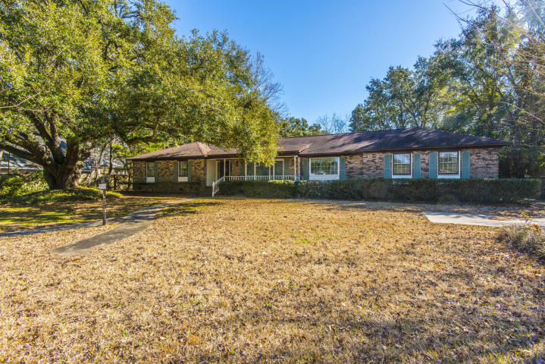
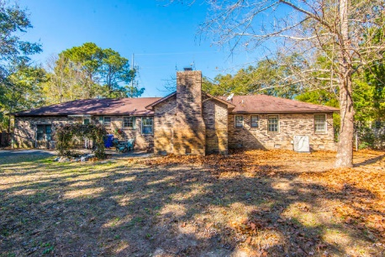
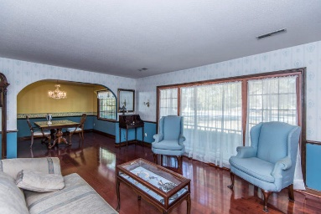
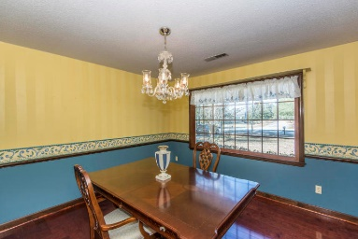
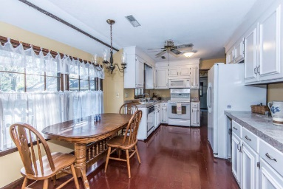
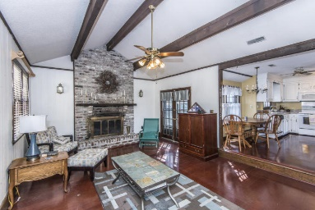
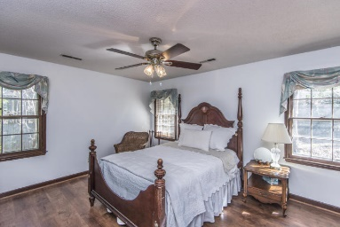
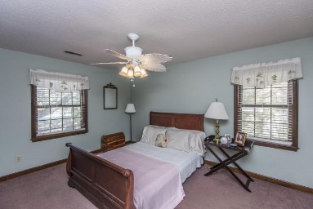
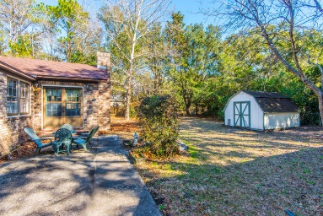
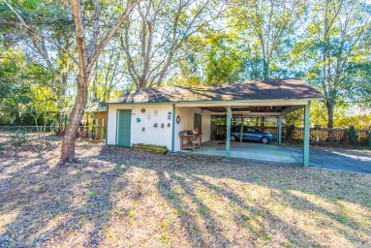


Reduced $25k
1515 Rifle Range Road
Cassina Heights ~ Mount Pleasant
MLS# 18002623 ~ $450,000
Location, Location, Location! Brick ranch style home conveniently located on Rifle Range Rd. 3 spacious bedrooms, 2.5 baths. Formal living area and formal dining room. Cabinets in kitchen have been upgraded. Master suite offers walk in closet, ceiling fan and private bath. Comfortable family room with vaulted ceiling and fireplace. Garage was converted into additional living space. Large lot!
Jennifer Frampton Pait
843-568-9509
jenniferfp@carolinaone.com

