Slide 1
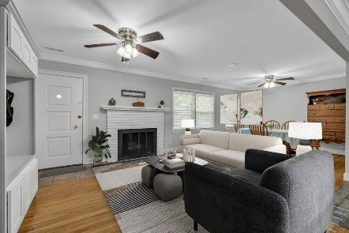
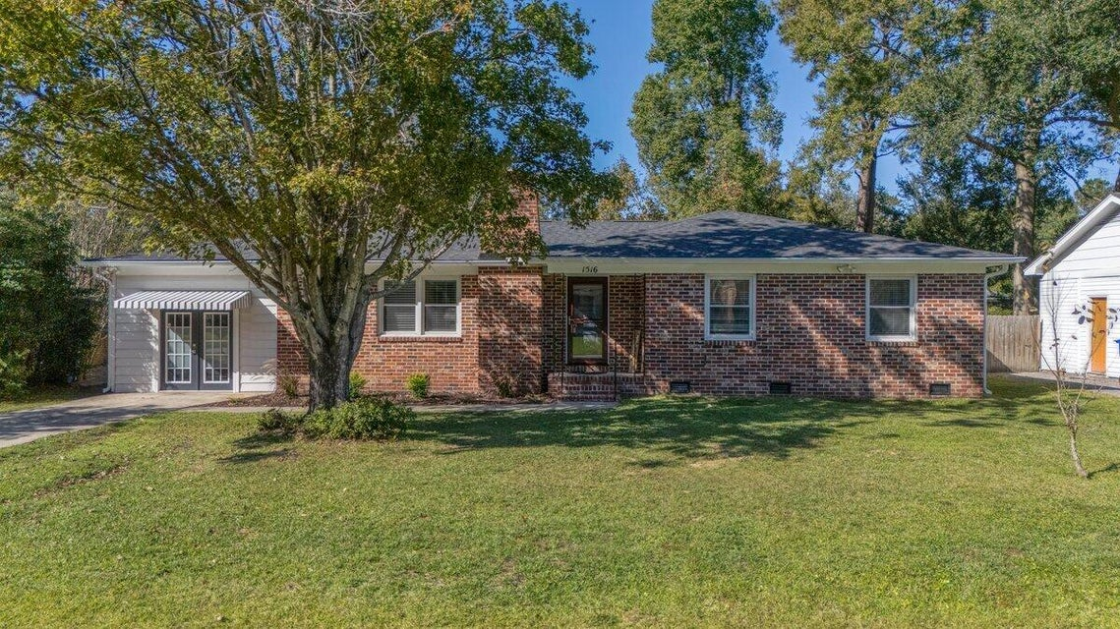
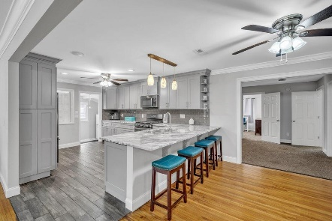
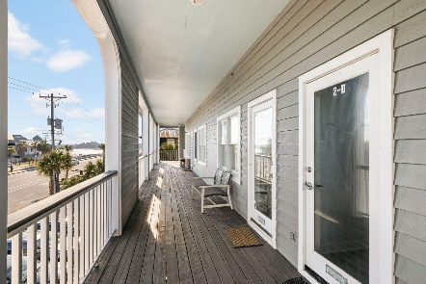
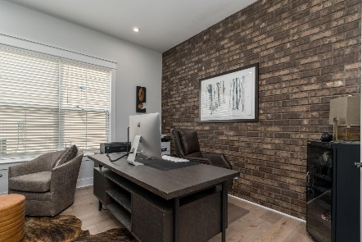
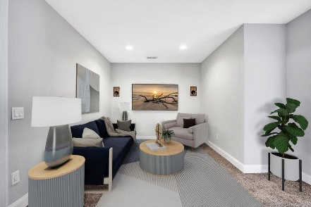
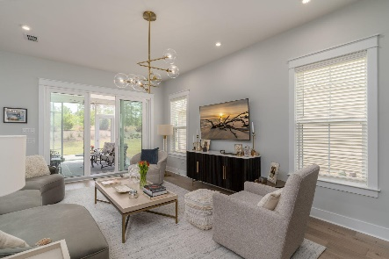
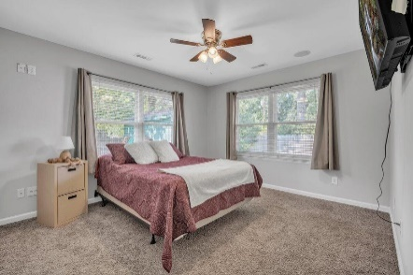

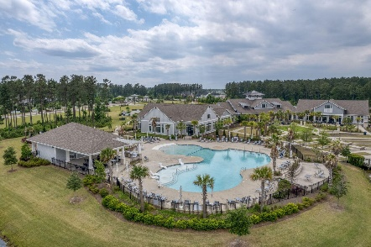
1516 Birthright Street Ashley Hall Manor | Charleston, SC 29407 MLS# 24028808 | $624,900
Darrell Creek Elevated Home With Elevator & Salt Pool
OPEN HOUSE
SATURDAY NOVEMBER 16TH from 1-3 PM
Seller now offering $5000 Buyer Credit with acceptable offer.
Offering $2500
Lender Credit
SELLER NOW OFFERING $5,000 BUYER CREDIT WITH ACCEPTABLE OFFER!
Welcome to 1516 Birthright St, an exceptional residence located in the highly sought-after Ashley Hall Manor neighborhood of Charleston, SC. This 5-bedroom, 3-bathroom home spans 2,540 square feet and is one of the largest in the area, offering unparalleled comfort and versatility. Recently updated with over $100,000 worth of upgrades, this home combines modern luxury with classic charm. Recent enhancements include a brand-new roof and an encapsulated crawlspace, both installed in 2024, alongside fresh interior and exterior paint, new gutters in 2024 and new HVAC Unit installed in 2020. The home's elegant charm is further highlighted by original ¾'' hardwood floors and crown molding in the main areas, complemented by stone tile in the kitchen, master bath, and hall bath. The original part of the home features an inviting family room, with cozy wood-burning fireplace to add to the home's inviting atmosphere. Also notice, a separate dining room, kitchen. three bedrooms, including one with an ensuite bathroom, and remodeled hall bath. The addition to the home includes a spacious media room, a guest room, and a luxurious master suite. The master suite boasts a spa-like en suite bath complete with a garden tub, a separate shower, and a brand-new vanity, creating a serene retreat within your home.
The heart of the home is the kitchen, remodeled in 2018 as part of an open floor plan renovation, featuring stainless steel appliances, granite countertops, a gas stove and oven, and soft-close cabinetry. The updated bonus room off of the kitchen boasts new luxury vinyl plank flooring, fresh paint, and new doors. Additional modern amenities include a Rinnai tankless hot water heater installed in 2018, several new ceiling fans, a wired sound system and intercom throughout the home. Another highlight of the property is the huge shed/workshop in the backyard, complete with electricity, perfect for hobbies, storage, or a personal workspace. The backyard also features privacy fencing and a wood pile with a fire pit, ideal for family campfires and outdoor gatherings.
Located just 5 minutes from the vibrant Avondale area, 10 minutes from downtown Charleston, 15 minutes from Charleston International Airport, and 20-25 minutes from the beautiful Charleston Area Beaches, this home offers both convenience and a prime location. Don't miss the opportunity to own this remarkable property with extensive upgrades and exceptional features. SELLER IS MOTIVATED, schedule your viewing today!
Video Tour
Elissa Campbell
843-853-1433 | elissa.campbell@agentownedrealty.com
AgentOwned Realty Preferred Group | 824 Johnnie Dodds Blvd | Mt Pleasant, SC 29464

