Slide 1
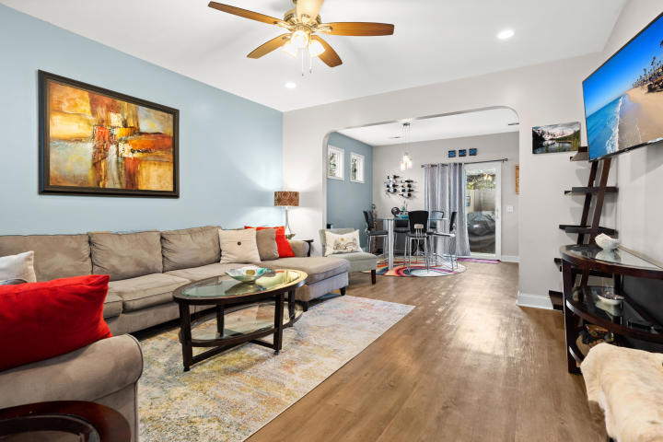
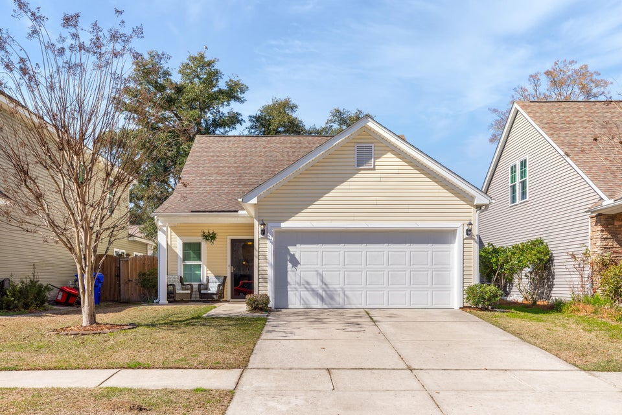
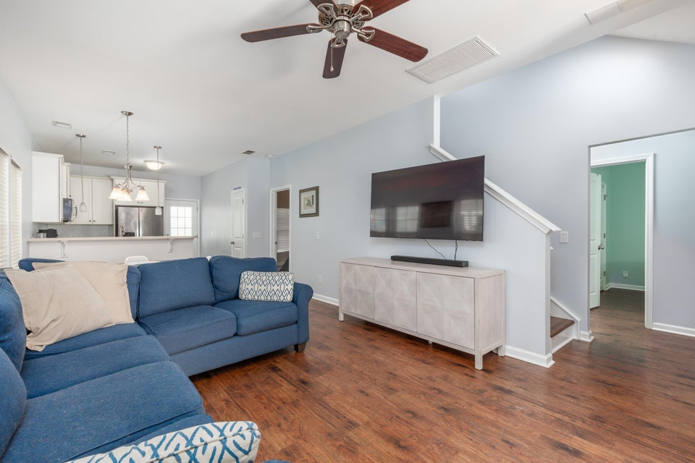
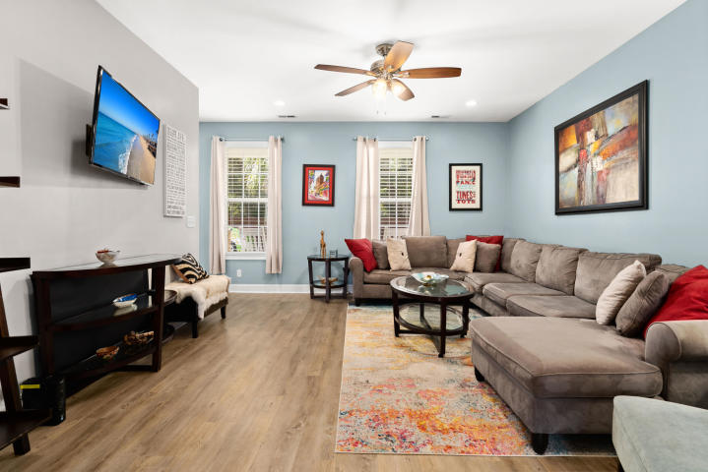
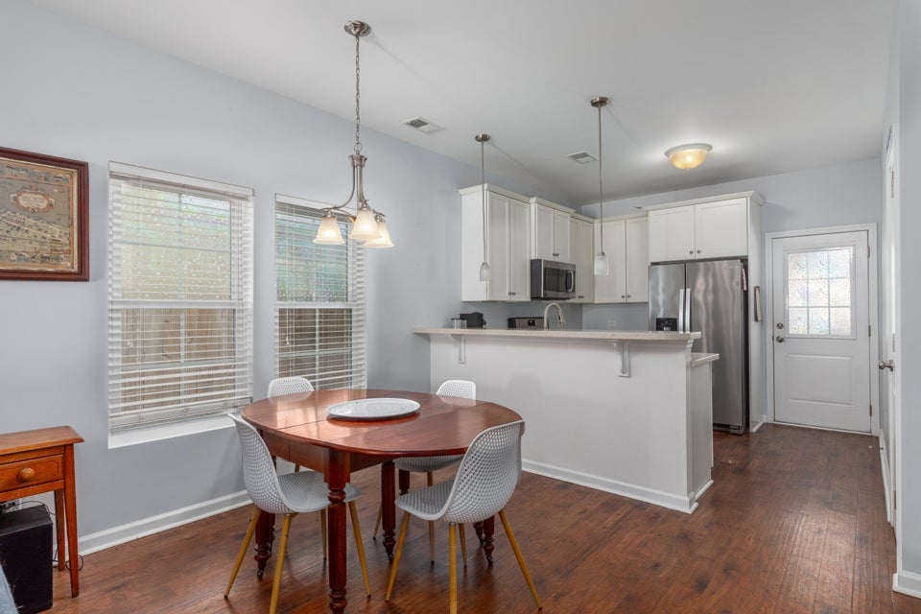
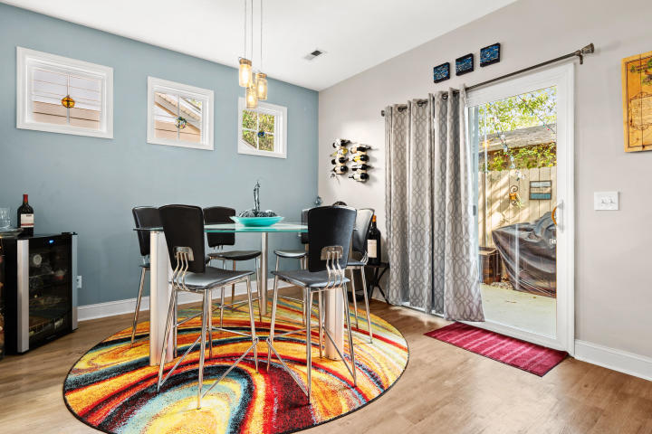
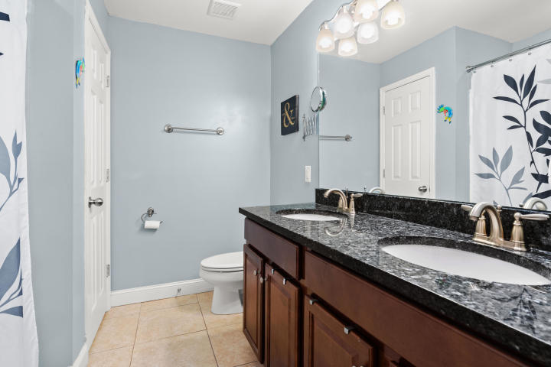
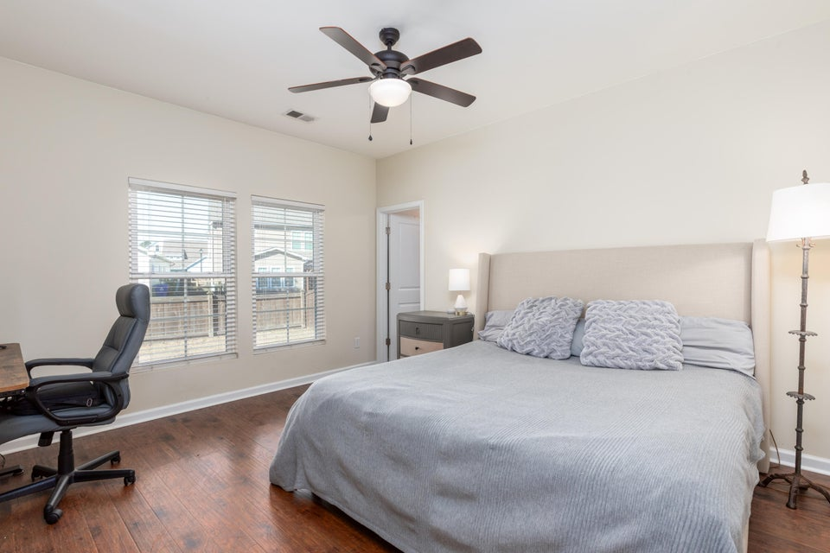
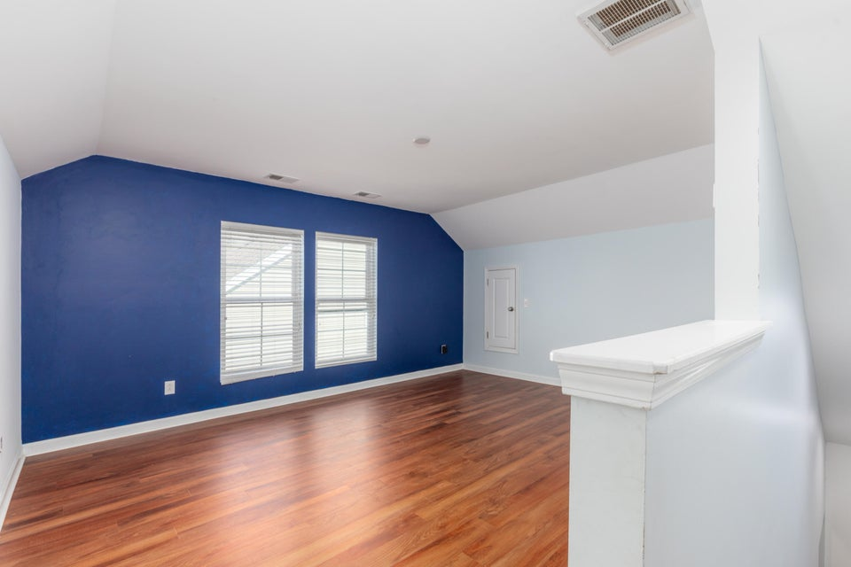
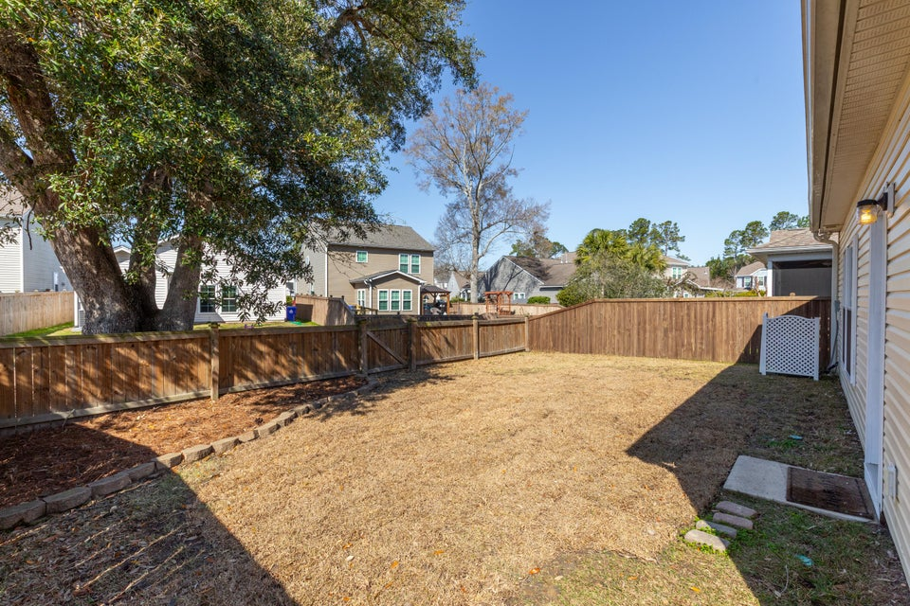
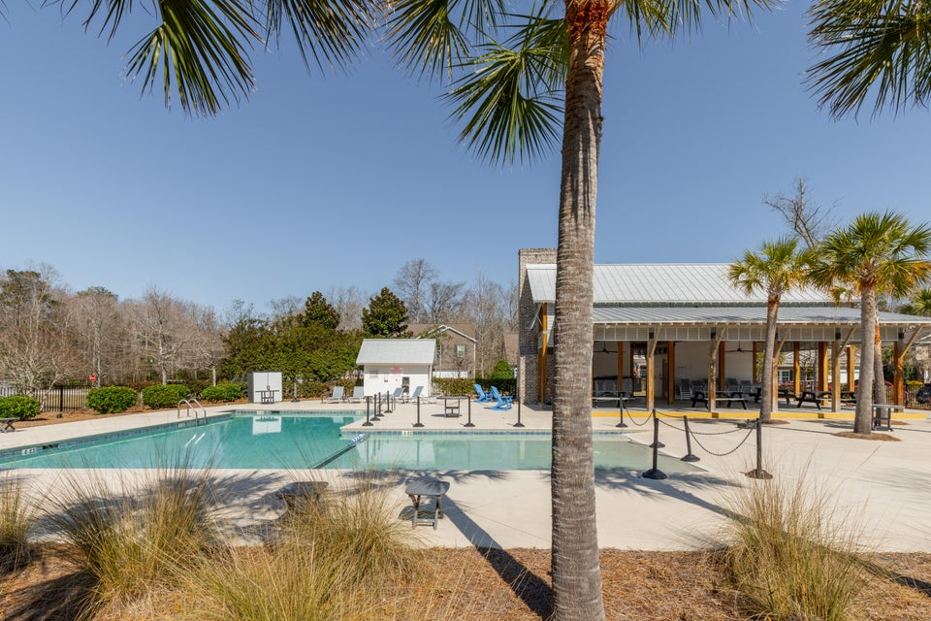


SINGLE FAMILY LOWEST PRICE IN MT. PLEASANT!!
1516 Oldenburg Drive
Tupelo Plantation · Mount Pleasant, SC 29466 · MLS# 25016769 · $549,900
Welcome Home to Easy Lowcountry Living! Tucked into the friendly and sought-after Tupelo neighborhood, this charming ONE-STORY with a spacious bonus room over the garage offers the perfect blend of comfort, flexibility, and style. From the moment you walk in, you'll love the airy, open-concept layout—where the family room, dining area, and eat-in kitchen flow effortlessly together, creating the ideal space for both everyday living and easy entertaining. A full-sized laundry room adds to the home's practical appeal. The primary suite is a peaceful retreat, complete with a walk-in closet and private en-suite bath. Two additional bedrooms on the main level provide plenty of space for guests, kids, or hobbies.
Upstairs, the versatile bonus room is ready to adapt to your lifestyle...whether you need a home office, playroom, media room, or fourth bedroom. Step out back into your fully fenced yard, just waiting for your personal touch - garden, fire pit, or just a comfy chair to enjoy the Carolina sunshine.
Tupelo offers wonderful community amenities and a location that's close to everything North Mount Pleasant has to offer: shopping, dining, top-rated schools, and more.
Don't miss your chance to make this lovely home your own. Schedule a showing today!
Keller Williams Realty
Charleston West Ashley
1180 Sam Rittenberg Ste 300
Charleston, SC 29407
Deanna Stinnett
843-708-3234
deanna.steedley@kw.com
deannasteedley.kw.com

