Slide 1
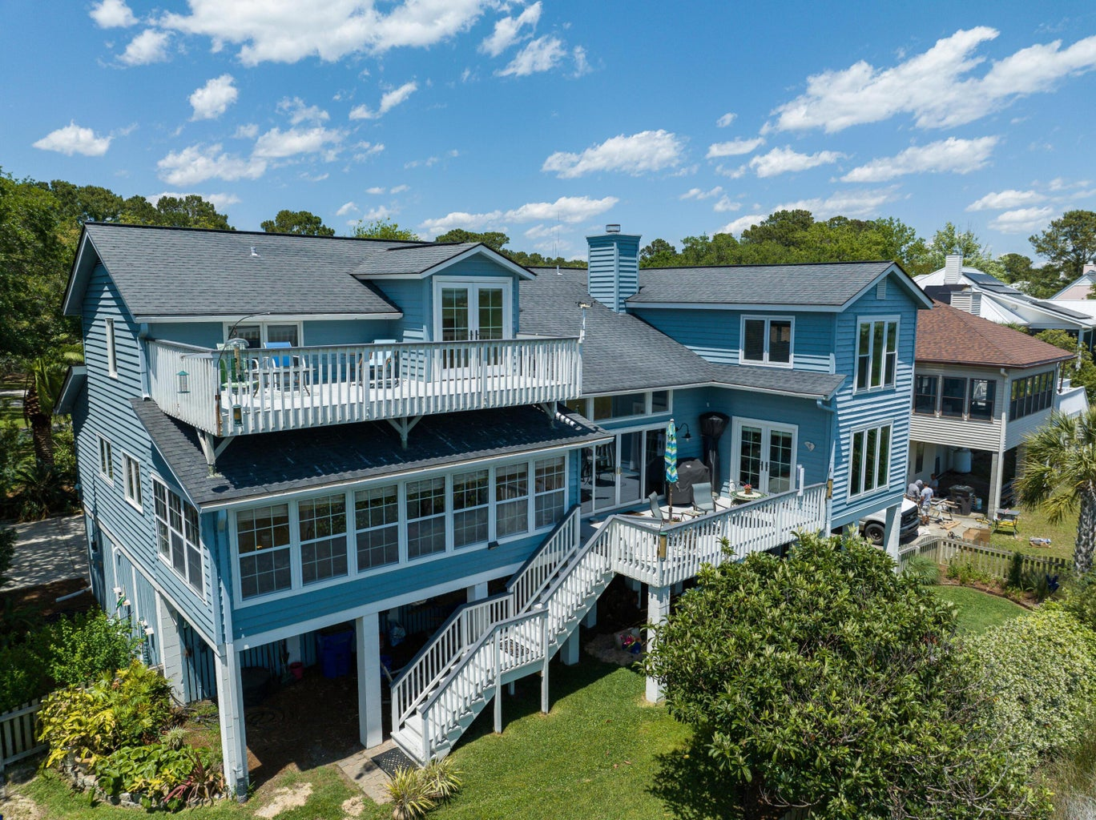
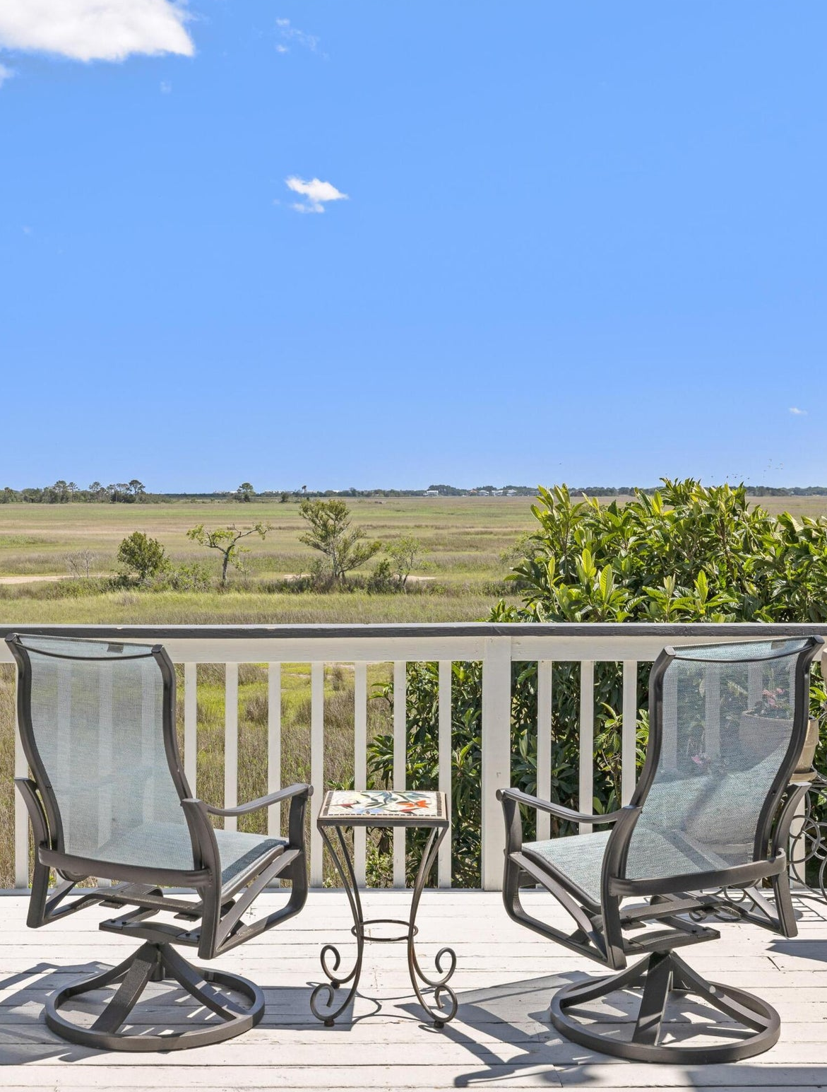
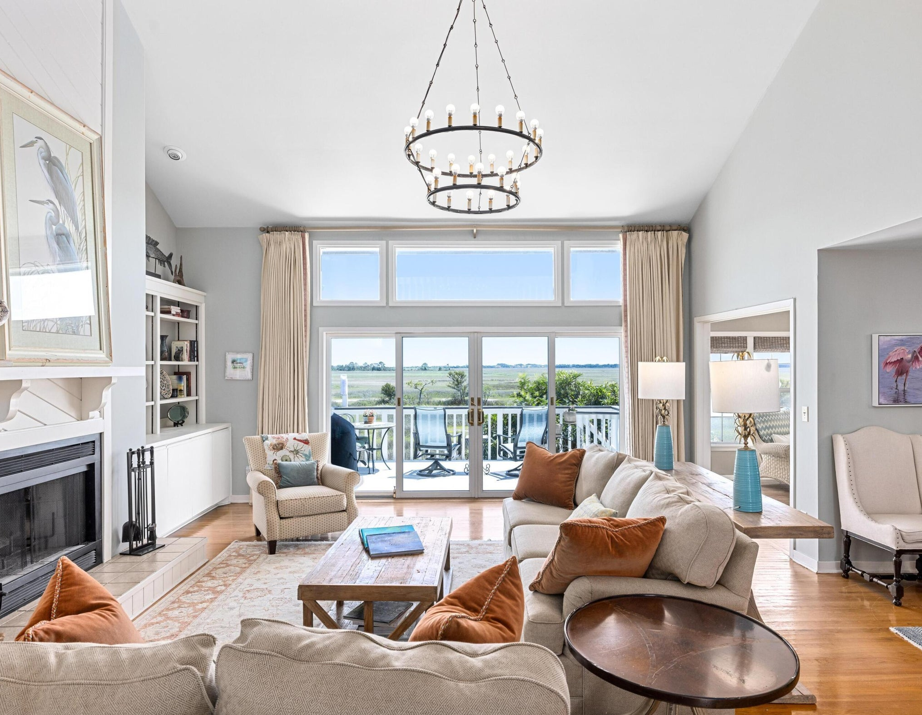

Open House Thursday May 18th 12-1:30
Catered by
Kudzu Bakery
1516 Pine Island
Oakhaven Plantation
MLS# 23009934
$1,800,000 NEW PRICE
4 Beds, 2.5 baths
3,619 SF
This stunning property boasts a spacious 3600 SF house with sensational views across the marsh to the Intracoastal Waterway in the distance. The views from almost every room are simply breathtaking, making this home an ideal retreat to appreciate the serenity of the natural beauty of the Lowcountry and the uniqueness of waking to sunrises, witnessing evening sunsets and being englobed by the night sky.
Kay E. Kennerty MBA
REALTORⓇ
843-345-5011
Kay@AgentOwned.com
AgentOwned.com
Notes:
DO NOT ALTER LAYOUT. YOUR FILE WILL BE RETURNED OR EDITED IF IT IS RECEIVED ALTERED.

