Slide 1
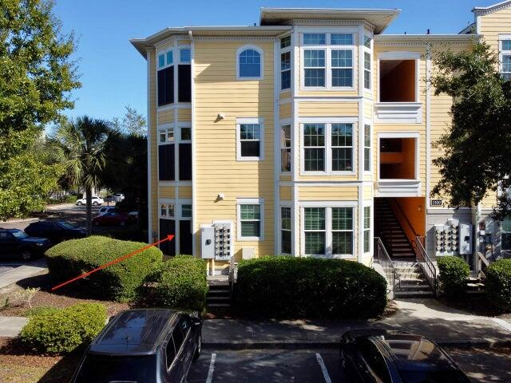
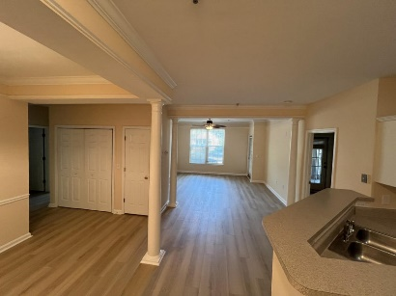
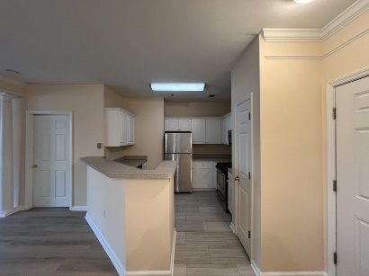
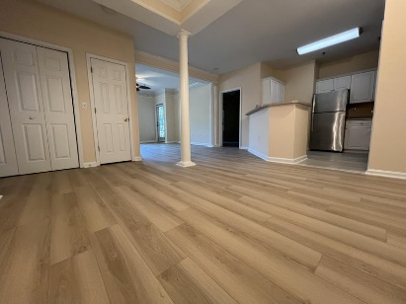
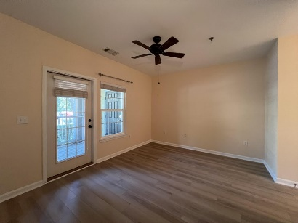
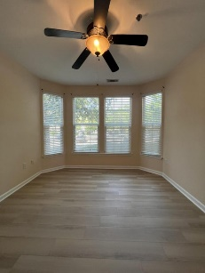
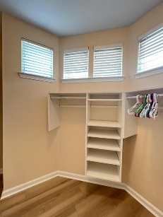
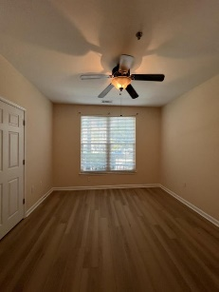
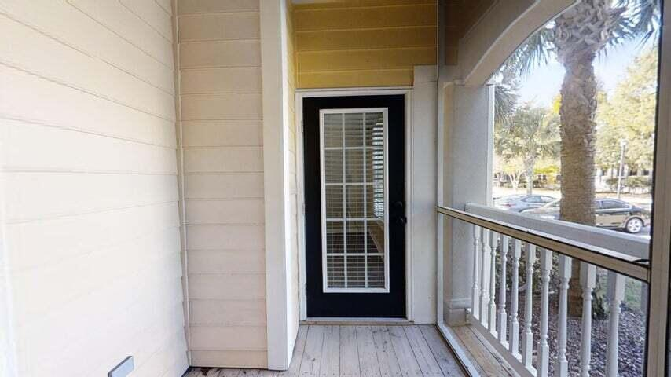
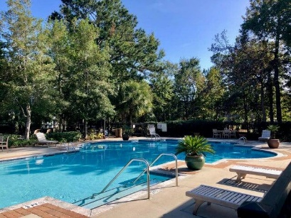



Price Drop! New LVP Floors And New Paint
1516 Telfair Way
Mira Vista
Charleston, SC 29412
MLS# 24020797
$433,000
3 Bedrooms :: 2 Baths :: 1,416 sf
3bd 2ba end unit on the first floor. Open floor plan with lots of natural light. Large walk-in closets in every room. Screened in porch. Mira Vista is walking distance to grocery shopping, dining, and retail shopping. Community pool and fitness center. Brand new LVP floors throughout and brand new paint.
Reid Adams
919-638-5618
reid@charlestonrealestategroup.com
www.charlestonrealestategroup.com
Charleston Real Estate Group | 443 Folly Road | Charleston, SC 29412

