Slide 1
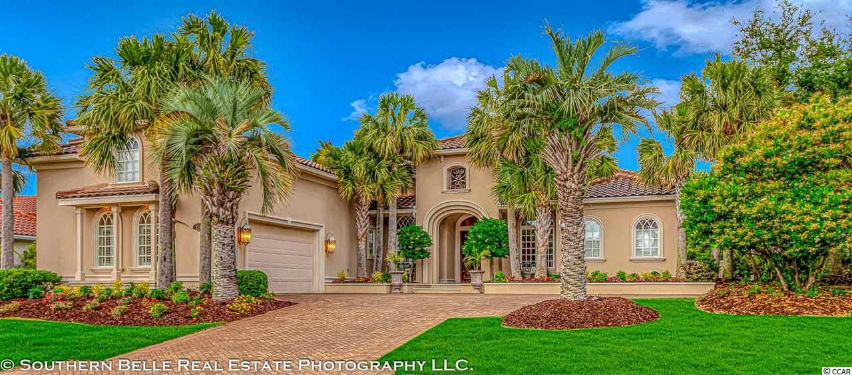
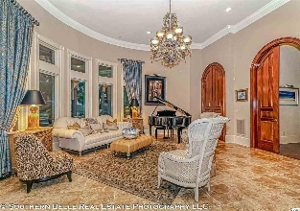
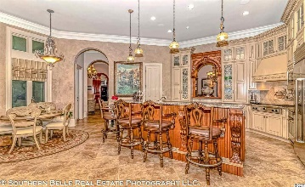
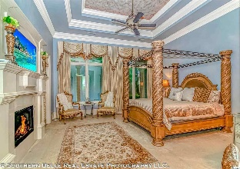
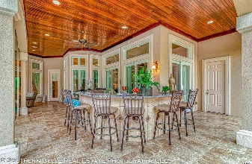
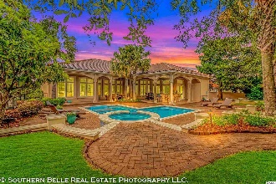
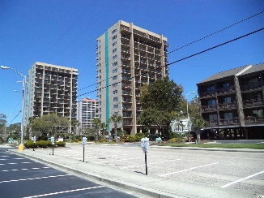
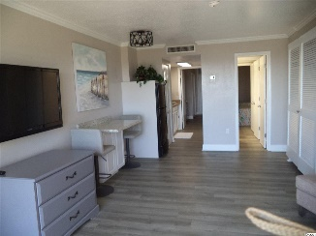
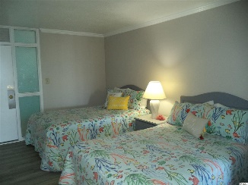
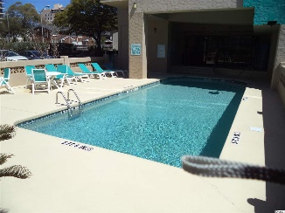
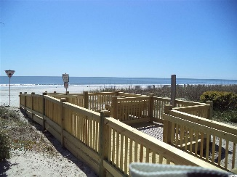

1518 Alameda Ct
Grande Dunes - Palermo | Myrtle Beach, SC 29579 | MLS# 2010131 | $1,195,000
Grand Dunes
Former Model Home
Buy One, Get One FREE!
$599,900
BUY THIS HOME AND GET A FREE FURNISHED OCEANVIEW CONDO ON 75TH AVE N WITH ACCEPTED OFFER.
Perfect to rent or for your kids or in-laws to stay in.
Perfectly maintained home by discerning owner. 3 bedrooms 4 full and 1 half bath, office and an amazing theater room. Beautiful master suite with fireplace and sitting area. Fireplace also in family room. New three-zone heat and air. New whole-house generator. Spacious kitchen with new Sub Zero fridge, breakfast nook and breakfast bar. Great home for entertaining. Pool was replastered 18 months ago. New pool, hot tub heater and saltwater system. Outdoor living lanai area with remote controlled screens, kitchen with sink, grill and bar area with seating. Hot tub, pool with built-in lounger. Gated community. Close to area shopping, dining, golf courses and hospital. HOA fee includes membership to Grande Dunes Ocean Club.
7500 N Ocean Blvd #4044
Ocean Dunes Tower 1 | Myrtle Beach, SC 29572 | MLS# 2007630 | $99,900
M.A. Peedin (843) 385-3931 |  | builderpeedin@wmconnect.com www.peedinrealestate.com
Peedin Real Estate | 876 Antigua Dr | Myrtle Beach, Sc, 29572

