Slide 1
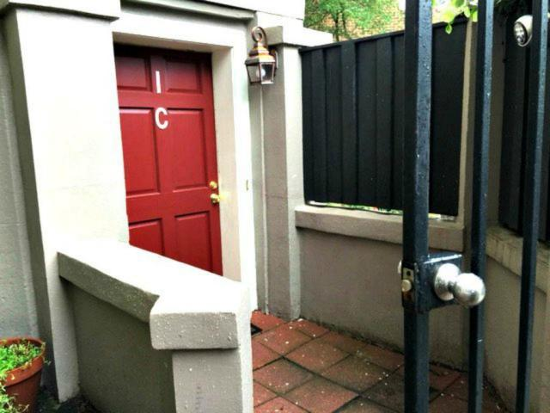
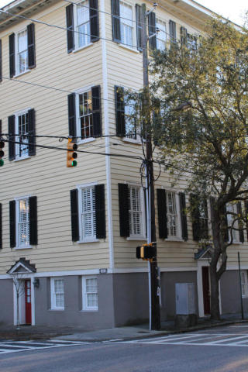
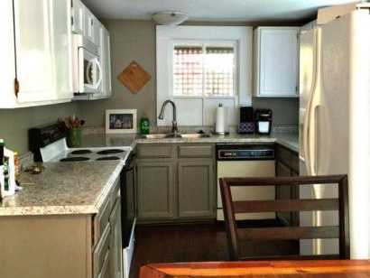
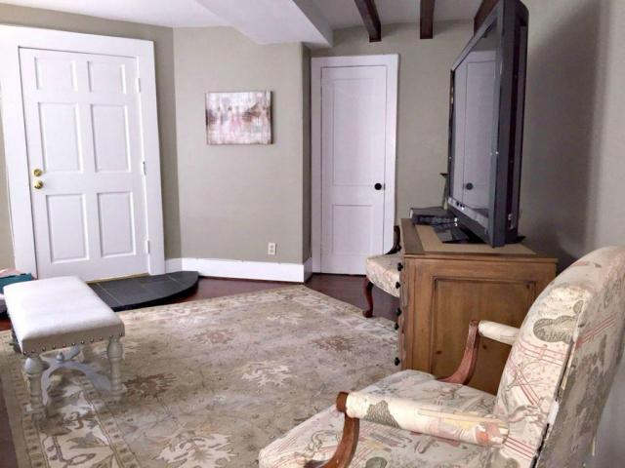
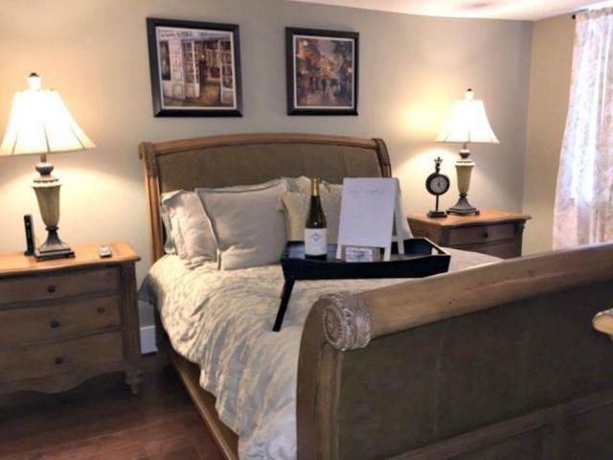
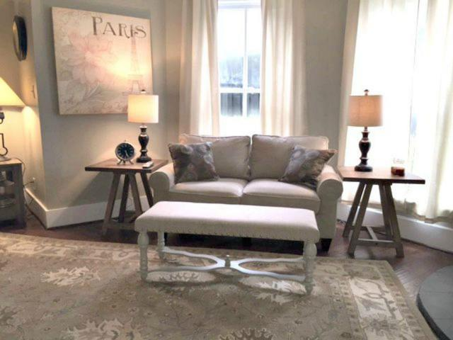

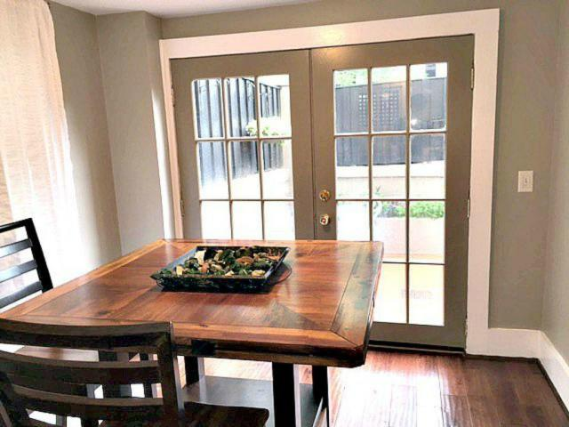
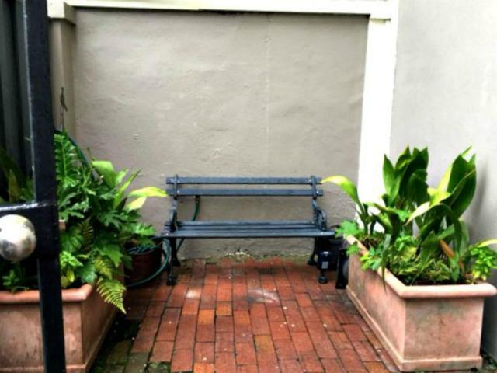


151 Wentworth Street 1C
Charleston, SC 29401 ~ MLS# 18000365 ~ $425,000
Harleston Village
High Volume Rental
Welcome to this charming downtown pied-a-terre in the heart of downtown Charleston with parking and private courtyard adjacent to the unit. The unit is located on the ground floor of a 9 unit building with private entrance.
Walking distance to almost everything Charleston has to offer such as restaurants, the Battery, Market, shopping, bars, museums, and College of Charleston. Recently updated with new hardwood floors, bathroom and kitchen. New A/C unit. One of a kind private brick courtyard perfect to enjoy a cocktail or morning coffee. Parking space is included in this price.
Mary Beth Bennett
(843) 367-1774
marybeth.bennett@agentownedrealty.com
www.chsarealiving.com
AgentOwned Preferred Group | 824 Johnnie Dodds Blvd | Mt Pleasant, SC 29464

