Slide 1
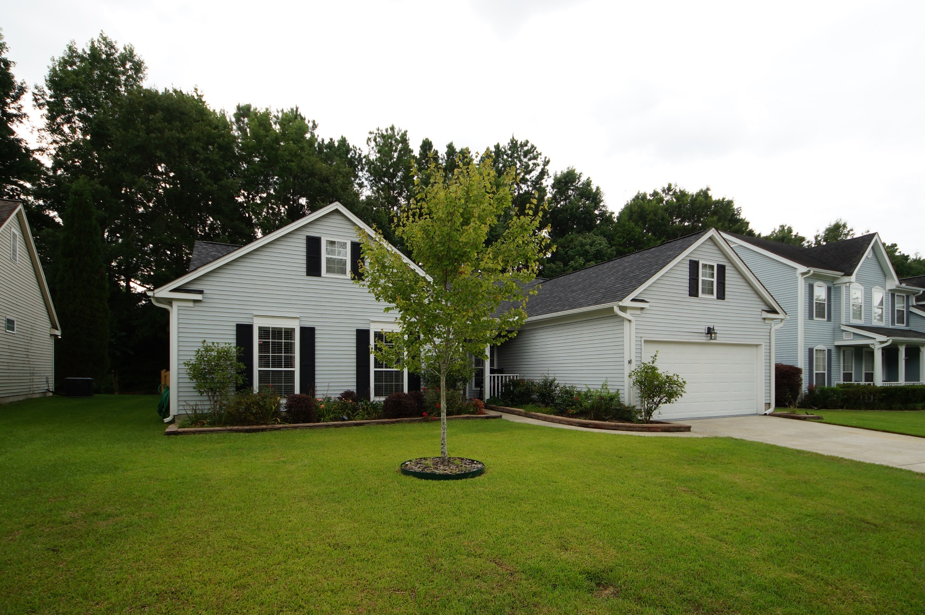
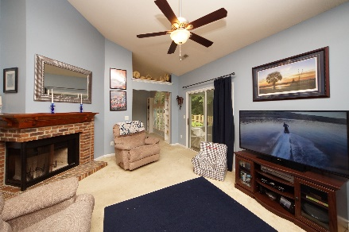
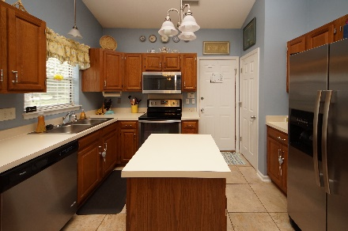
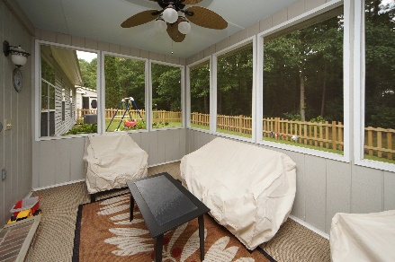


151 Isherwood Drive Goose Creek, SC 29445 MLS# 18020151 :: $235,000 3 Bed / 2 Bath
Just Listed in Crowfield Plantation
2.67 Acres!
Great opportunity to own a one story home in desirable Crowfield Plantation! This home offers plenty of space with eat in kitchen, separate dining, formal living, family room with fire place and screen porch.
Roof was installed in 2011 and NEW AC installed January 2018. This yard sits on a private lot in a cul-de-sac. We are priced to sell!
Connie White, Broker
843-532-3356
conniesyouragent@gmail.com
Charleston Homes · 597 Old Mt. Holly Road · Suite 301 · Goose Creek, SC 29445

