Slide 1
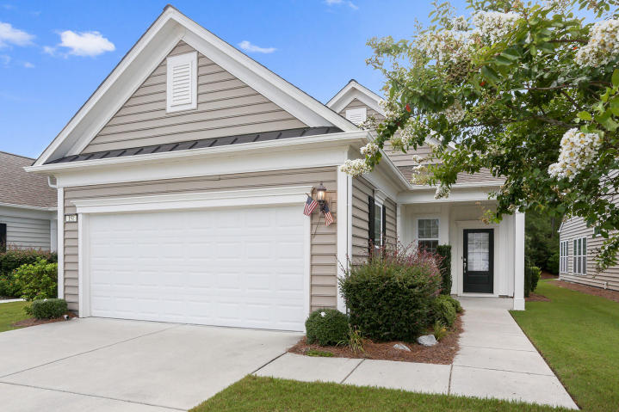
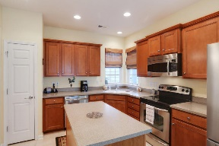
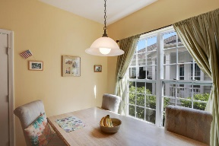
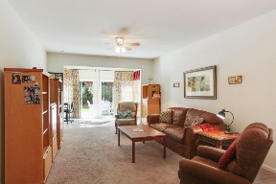
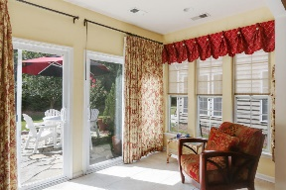
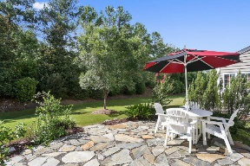
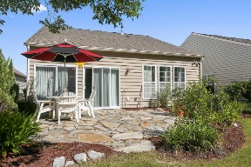

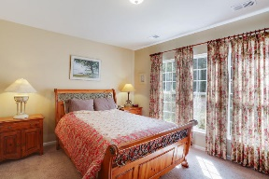
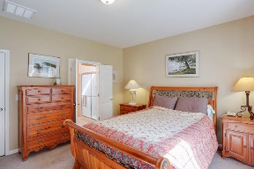
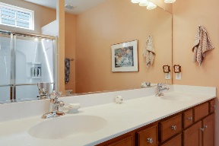
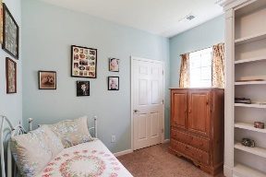
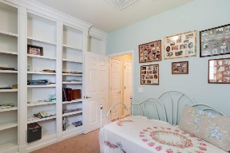
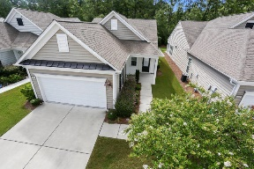


Great Price in Del Webb with Wooded Buffer
151 Sea Lavender Lane
Cane Bay Plantation
Summerville, SC 29483
MLS# 16021419
$212,900
2 Bedrooms | 2 Baths | 1,385 sf
***BRAND NEW CARPET!!! (4/17)***
It's time to relax in Charleston's largest active adult community & this adorable home will provide your low-maintenance haven. This lovely home is the perfect size to reduce stress while living comfortably & it's a quick jaunt away from the amenity center. Plus, it backs up to a private wooded buffer with NO rear neighbors! The adorable sun room has double sliding glass doors that open to a gorgeous stone patio - the perfect place to read the paper while enjoying a cup of coffee. The kitchen boasts numerous upgrades: solid surface counters, tile flooring, larger cabinets & more. The master is spacious with a generous sized en suite offering dual vanities. The guest room is delightful & can double as an office or library with spectacular built-in shelving.
The family room is spacious and comfortable and provides a great, open layout for relaxing, reading, watching or entertaining.
The 2-car garage is large and includes two handy closets for storage.
Owners are willing to convey all window treatments with an acceptable offer.
Larry Mazalatis
843-693-0529
mazteamrealty@gmail.com
Jim Brantley
(843) 412-7647
brantleyjim@gmail.com
AGENTOWNED PREMIERE GROUP | 1800 TROLLEY RD | SUMMERVILLE, SC 29485

