Slide 1
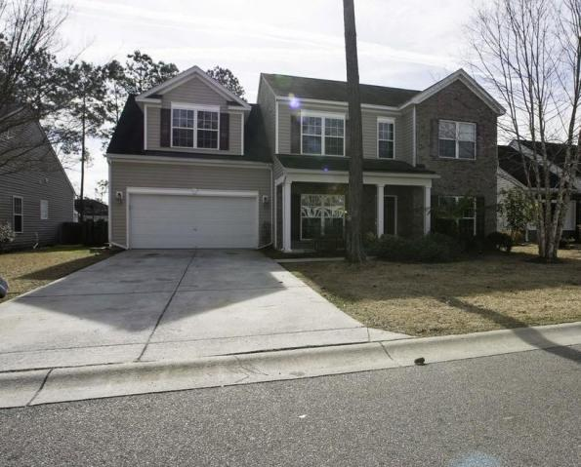
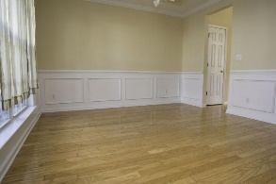
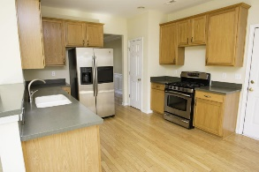
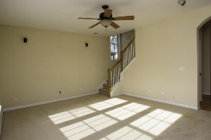
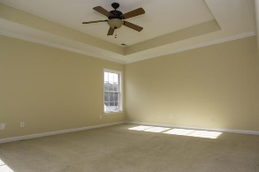
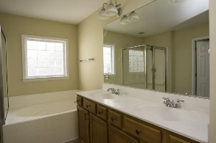
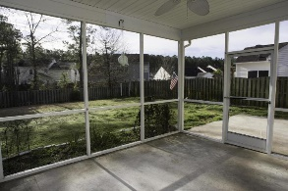
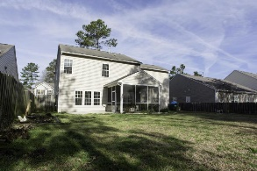
Price Just Reduced!
151 Sweet Alyssum Dr
Summer Park
Ladson, SC 29456
MLS# 15004619
$214,900
Large home with all the upgrades! New paint throughout! Crown molding and wainscoting in formal dining room. Upgraded cabinets in the kitchen along with stainless steel appliances. Oak hardwood floors downstairs. Large master bedroom with tray ceiling. Master bath has separate tub and shower, upgraded his and hers sink with plenty of space in the walk-in closet. There is also a huge den/bonus room upstairs with closet. Perfect for the pool table or game room. Screened in patio with additional space for grilling. The yard is nicely landscaped complete with irrigation system with 5 zones. Fenced in backyard that overlooks wooded area for added privacy! Dorchester District II schools! Minutes to I-26, Boeing, JB Charleston, Bosch, shopping, beaches and more!
David Hickman | 843.505.0456 | davidisyouragent@gmail.com | www.omnicarolinarealestate.com
Omni Carolina Real Estate | 126 Eston Dr | Goose Creek, SC 29445

