Slide 1
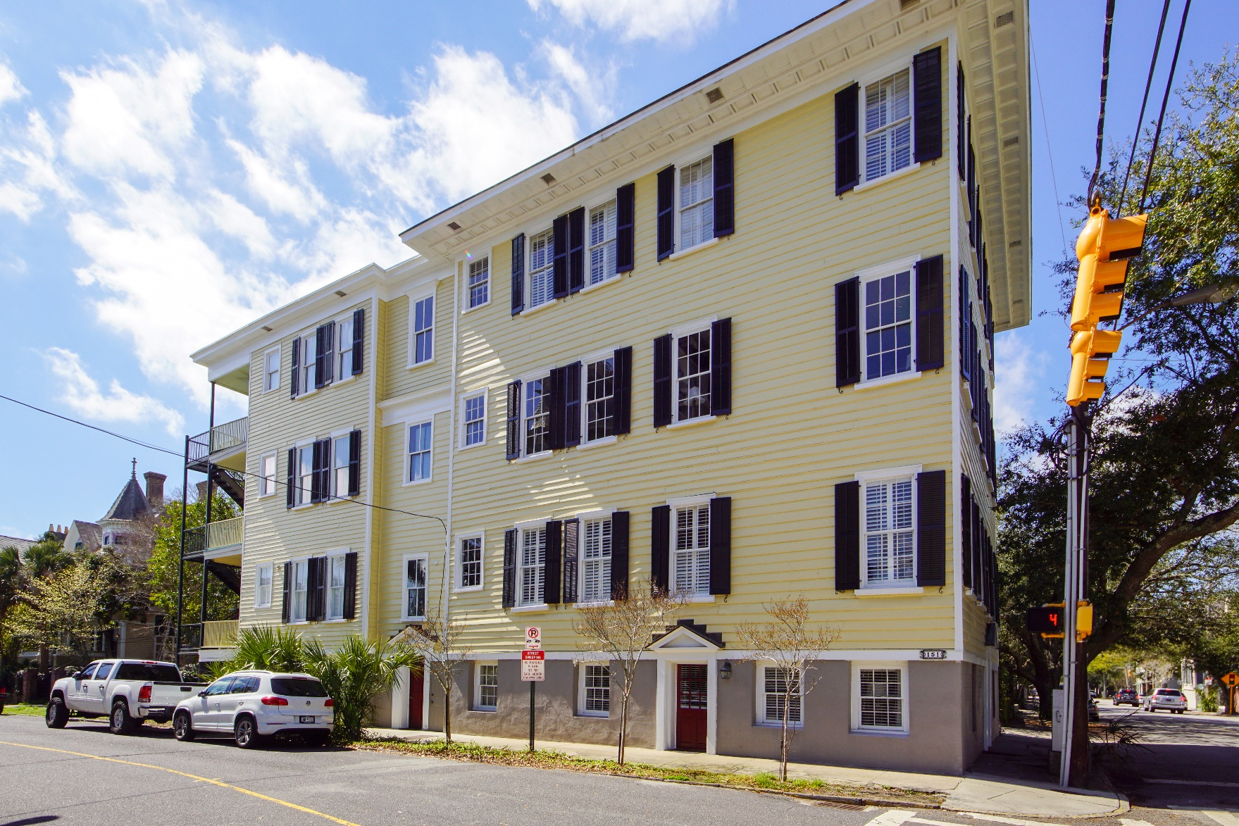
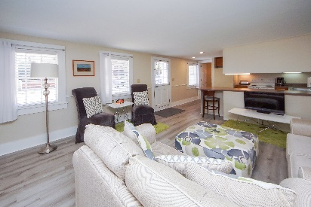
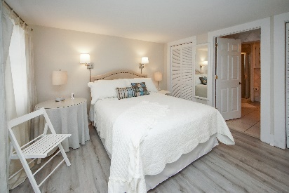
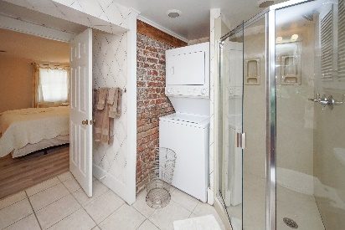
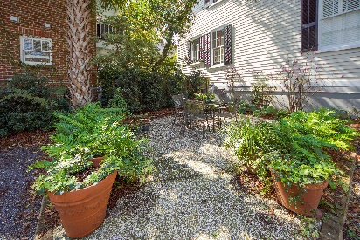

Open House
April 14th
12-2pm
151 Wentworth Street 1B
Harleston Village | Charleston, SC 29401 | MLS# 22006406 | $357,200
Historic condo in the Benjamin Lazarus home with designated parking. This historic property was originally built in 1849 by a Charlestonian and later converted into an all girls school. Walk to Colonial Lake or the Battery. Enjoy downtown restaurants or downtown events. Walk over to the Wentworth Mansion and enjoy fine dining or a massage. Dine or have drinks outside in the communal courtyard. Purchase condo furnished or unfurnished. With acceptable offer owner will pay 6 months of HOA.
Lisa Deaton
843-224-7878
lisamdeaton@comcast.net
AgentOwned Charleston Group
902 Savannah Hwy
Charleston, SC 29407-7802

