Slide 1
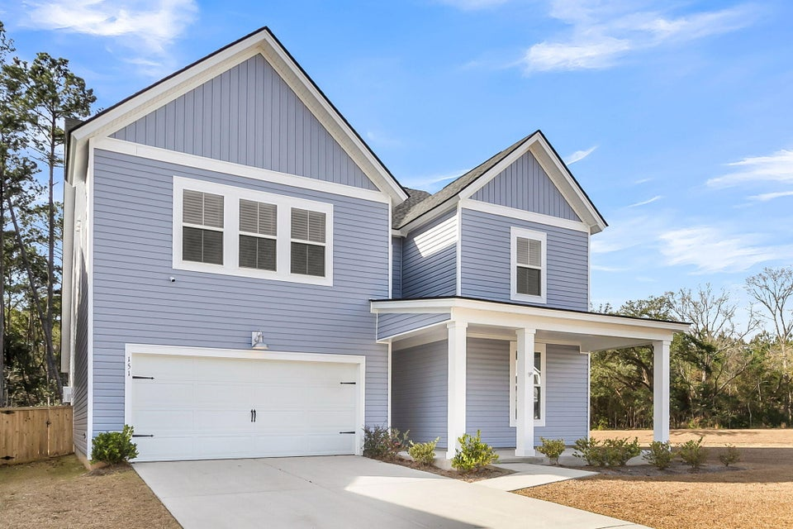
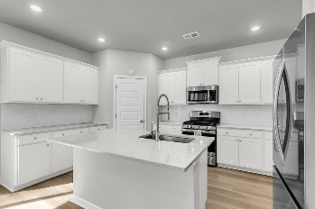
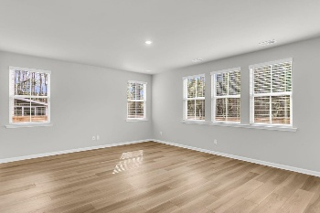
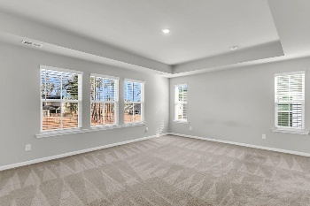
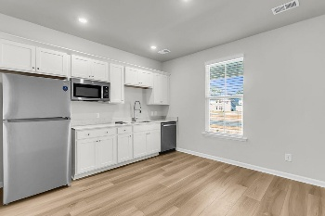
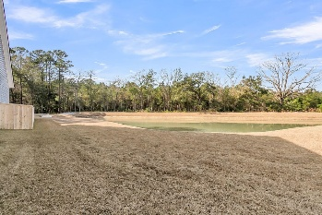

151 Osprey Ridge Lane
Limehouse Village | Summerville, SC 29483 | MLS# 26000276 | $480,000
True Mother-in-Law Suite w/Separate Entrance
Welcome to 151 Osprey Lane in Limehouse Village! Taylor floor plan offers a rare 2+1 tandem garage and a private next-gen/in-law suite featuring its own kitchenette, full bath with walk-in shower, bedroom, and separate entrance—plus interior access to the main foyer. The main home boasts a formal dining room, and an open-concept layout. The kitchen is beautifully appointed with white cabinetry, subway tile backsplash, quartz countertops, pantry, large island, and stainless steel appliances including gas range. Upstairs you'll find a spacious loft, large secondary bedrooms with a shared full bath, laundry room, and an oversized owner's suite with tiled walk-in shower, dual sinks, water closet, linen storage, and walk-in closet. Corner lot with pond views, patio and fully fenced back yard.
Tankless water heater. Limehouse Village is conveniently located off the newly opened Berlin G. Myers Parkway with community pool, dog park, walking/jogging trails, park, and trash service included.
The downstairs nextgen space could be used as a second master suite if desired.
Stan Huff
843-670-2835
stan.huff@agentowned.com
Jill Marcacci
843-297-5590
jill@agentowned.com
www.agentownedrealty.com
AgentOwned Realty Co. Preferred Group, Inc. | 824 Johnnie Dodds Blvd | Mt Pleasant, SC 29464

