Slide 1
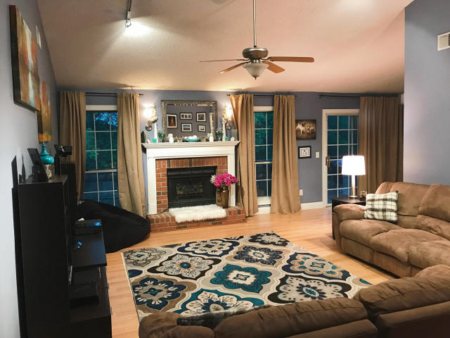
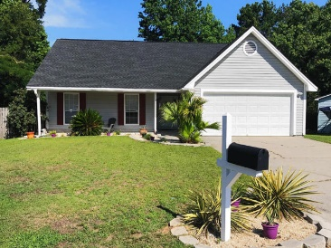
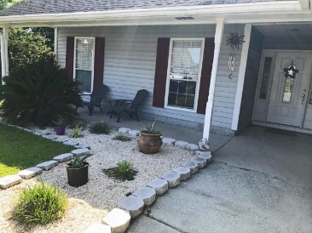
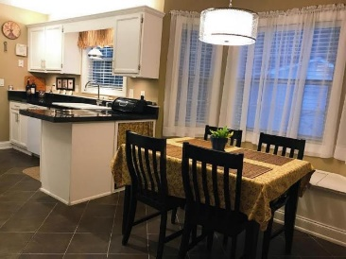
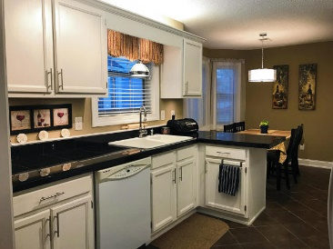
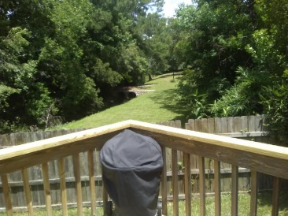
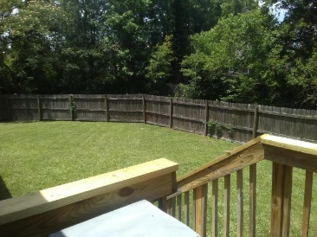

1520 Linden Lane St James Estates MLS# 17015488 $178,000
Goose Creek Beauty
$25K Price Reduction!
MOTIVATED SELLERS Sellers offering $3,000 in closing costs and an American Home Shield Home Warranty!!
Well Maintained one story on a cul-de-sac in a quiet neighborhood with no HOA fees and a two (2) car garage. Enjoy the large private fenced in backyard overlooking the park. Modern features inside include tile and laminate flooring throughout the house, granite counter tops, upgraded lighting, wood burning fireplace, wiring for surround sound, decorative glass front door with matching sidelights, floor-to-ceiling windows and vaulted ceilings. Also a large master bedroom with a tray ceiling and walk-in closet. Close to the hospital, Naval and Air Force bases. Centrally located - just about 20 minutes to Summerville, Park Circle, Mt. Pleasant, West Ashley and Downtown.
Gerri Sandford
(843) 817-8762
gsandford29455@gmail.com
Anchor Line Realty LLC
1619 Samuel Rd
Charleston, SC 29412

