Slide 1
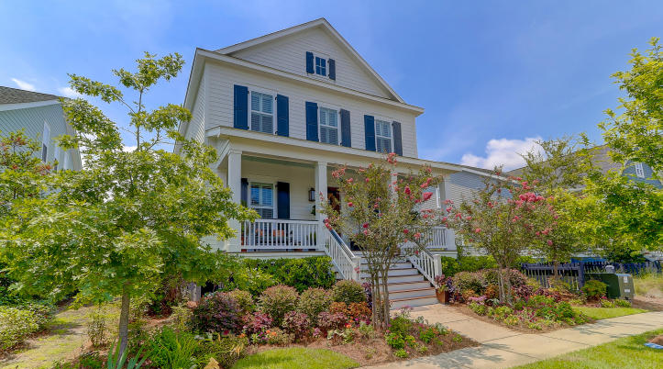
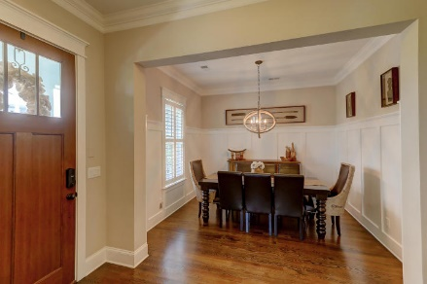
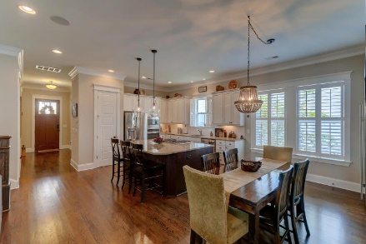
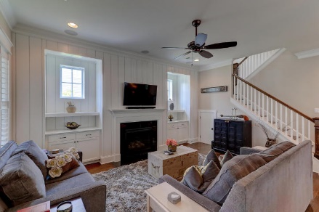
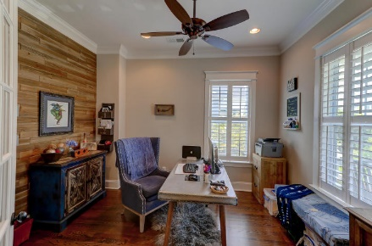
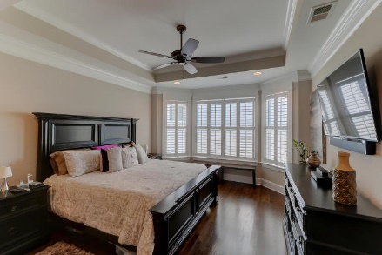
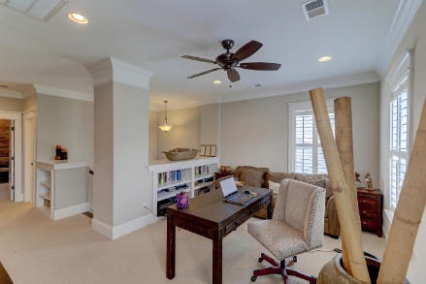
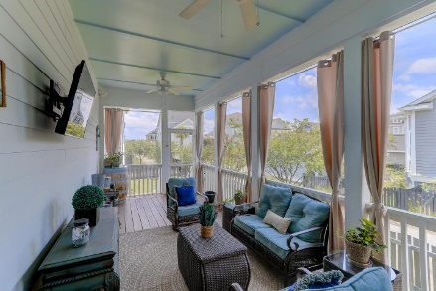
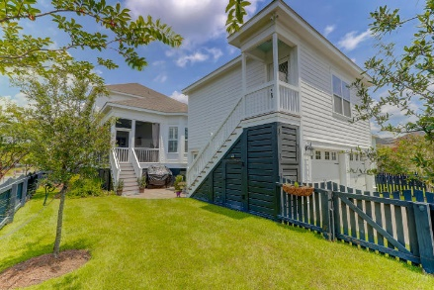


1521 Willtown Street
Daniel Island, SC 29492
MLS# 18020374
$849,000
Just Listed
Move Right In
Condo in Oceanside on IOP, Private Pier/Pool,
Well Maintained and Great Rental History
Easy to Show
April 6th-April 13th
Beautiful and spacious Smythe Park home with gorgeous hardwood floors, mouldings, trim, plantation shutters and Shiplap. You'll love the open, bright feel of the great room, dining and kitchen. The great room offers a gas fireplace and with ample living space. Enjoy the kitchen GE, Stainless steel appliances, granite counters, subway tile back splash and a 5 burner gas cook top. The over sized island is spectacular. The master bedroom is downstairs with a luxurious master bath as well as the office. A loft space for additional living, play or work. The detached 2 garage can be an apartment or additional living space. This home is very well maintained and is beautiful from the interior to the lush exterior landscaping and Charleston style screen porch.
Darlene Smith
Office - (843) 886-8110
Mobile - (843) 696-7824
darlenesmith@carolinaone.com
DarleneSmithTeam.com
Carolina One Real Estate
1503 Palm Blvd Ste
Isle of Palms, SC 29451

