Slide 1
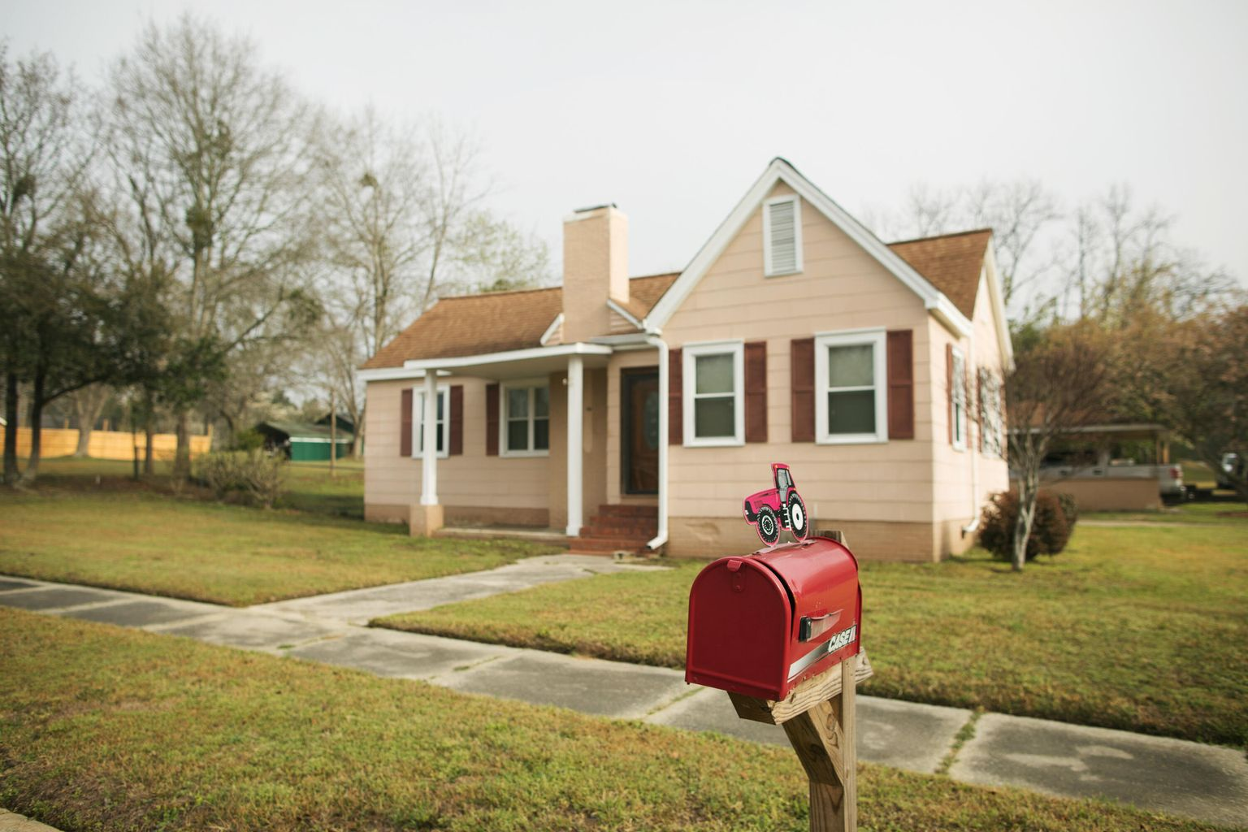
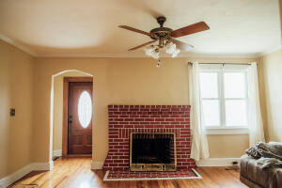
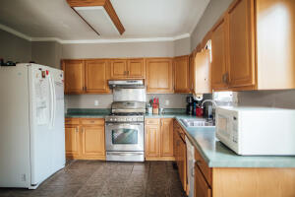
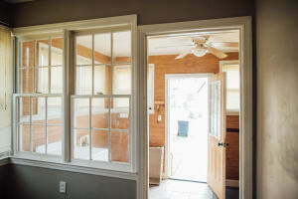
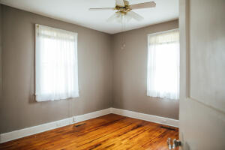
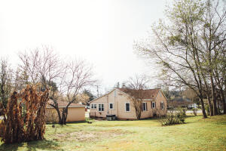
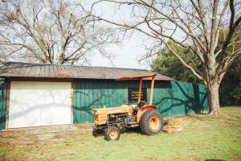
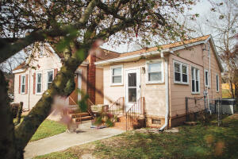


15234 Low Country Highway
Olar, SC 29843 | MLS# 22007051 | $150,000
Amazing
Opportunity!!!
Own your home for less than rent AND with property also. This home has 3 bedrooms and 2 bathrooms, and is located in the quiet town of Olar, SC. Enjoy the southern charm of friendly neighbors and open spaces. The hardwood floors, and gas fireplace lend to the charm of this home and is perfect for the person that wants to escape all the noise and traffic. A nice size dining area, kitchen, and family room makes this home the perfect size. Entering the home from the carport accesses a large, desirable mud room Situated on .92+ acres you have more than enough room to enjoy a garden, add a swimming pool, or just enjoy the lush green grass. This home also features a workshop with power and water and a two car carport with storage. Come experience true country living.
Darren Mills
843-696-3598
dmills@century21properties.com
www. century21properties.com
Century 21 Properties Plus | 1090 Park West Blvd; Ste 103 | Mount Pleasant, SC 29466

