Slide 1

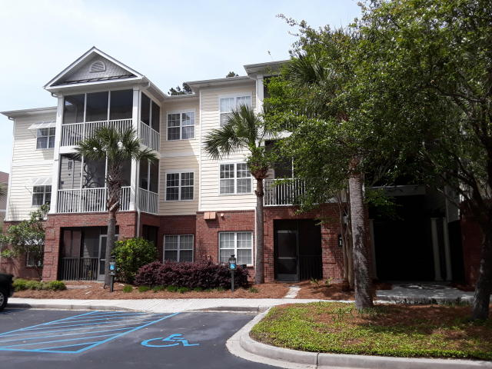
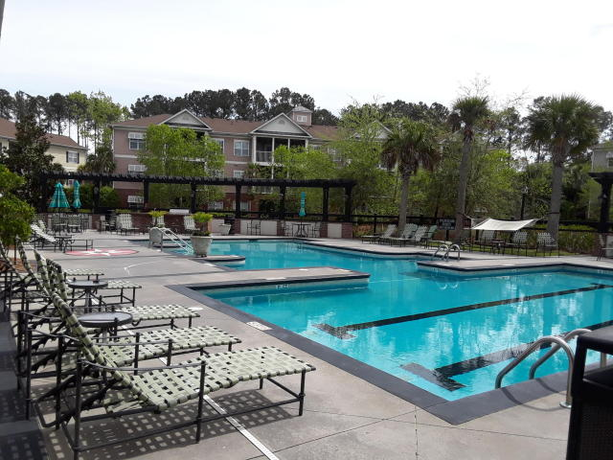
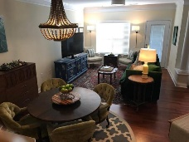
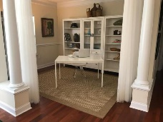
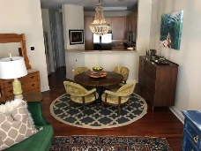
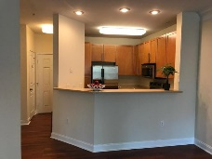
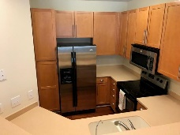
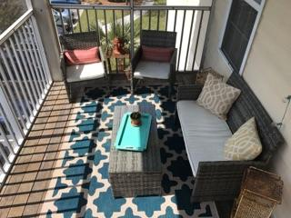
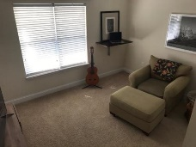
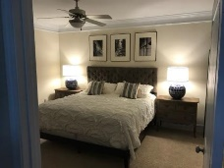
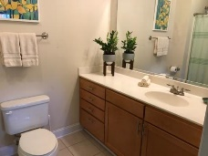
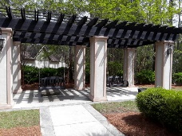
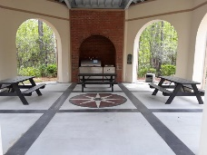
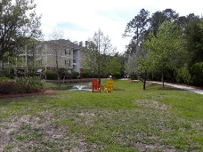

Motivated Seller, Bring Us An Offer!
1523 Basildon Road
The Battery @ Park West | Mount Pleasant | MLS# 18009406 | $235,000
DON'T wait to see this SPACIOUS and LIVABLE 2 bedroom, 2 bath condominium in the prestigious gated community of The Battery @ Park West. This QUAINT neighborhood offers all the amenities of a single family community and more! PRIVATELY tucked off of Grey Marsh Drive you'll find a PRIVATE POOL with outdoor grilling, kids play ground, 2 GARDEN plots for planting fresh veggies and herbs, a garden shed, FITNESS CENTER, clubhouse, FISHING POND and DOG RUN! Directly across from the unit/building is the community OYSTER PAVILION! How FUN! The home itself offers beautiful WOOD floors, CORIAN counter tops, upgraded light fixtures, newer hardware and a Reverse OSMOSIS WATER filter!
This layout is the larger of the two 2 bedrooms offered in The Battery and the building is equipped with an ELEVATOR! This is a THIRD FLOOR END UNIT, no one above you and a great view from your RELAXING screen porch! In addition to the two bedrooms there is a flex space that can be used for any number of purposes.....formal dining, media, office, exercise area or possible 3rd bedroom space. Fresh new paint and professionally cleaned, this home has been well cared for by ONE owner and is now ready for YOU!
Shelley Monahan
(843) 241-0695
shelleymonahan@kw.com
Keller Williams Realty Charleston
496 Bramson Ct Ste 200
Mt. Pleasant, SC 29464

