Slide 1
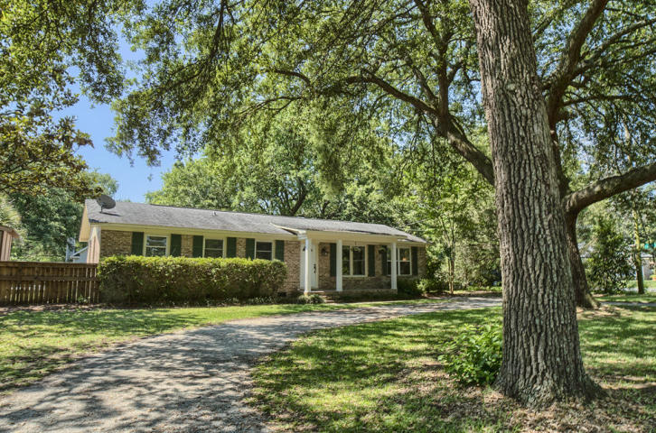
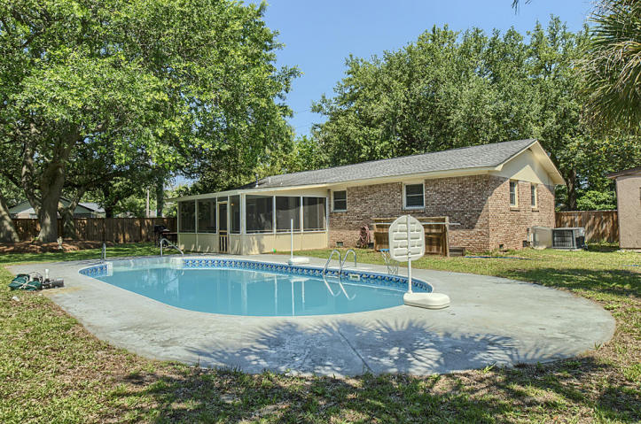
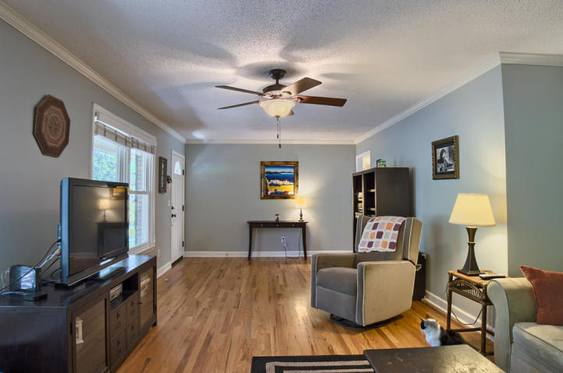
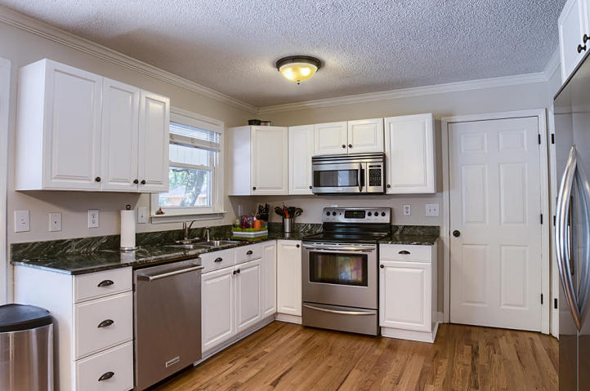
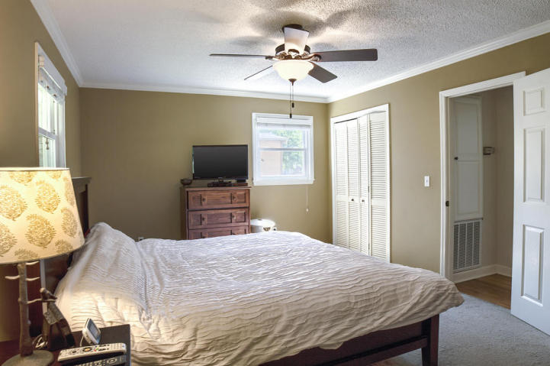
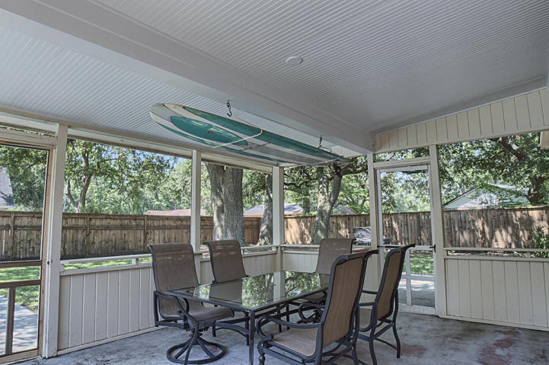
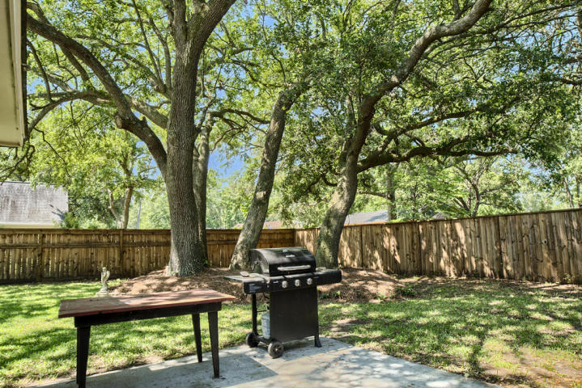


1523 Fort Johnson Road
Charleston ~ MLS# 17015855 ~ $329,500
This One Won't Last Long…
3 Bed / 2 Bath
1,430 Sq Ft
Renovated
Upgraded Kitchen
Hardwood Floors
Screened Porch
In-Ground Pool
IN GROUND POOL WITH PRIVATE BACKYARD!!!! HOT, HOT PRICE POINT ON JAMES ISLAND, MAKE AN APPOINTMENT NOW!! This 3BR/ 2BA Ranch style home was renovated inside when buyers purchased the home. As you enter, you walk into a spacious living room that offers hardwood floors and plenty of natural light. The kitchen boasts white cabinets, upgraded counter-tops and stainless appliances. The inside also offers an oversized laundry room that offers plenty of extra storage along with Custom Hunter Douglas wood blinds, ceiling fans in each bedroom and living room and oiled bronzed hardware. As you walk outside you enter your own private oasis, oversized screened porch, in ground swimming pool and a custom built privacy fence. Circular driveway makes for easy access and parking.
Leah M. Rust
843-709-9211 Mobile
843-856-8800 Office
leahmrust@gmail.com
Coldwell Banker RESIDENTIAL BROKERAGE

