Slide 1
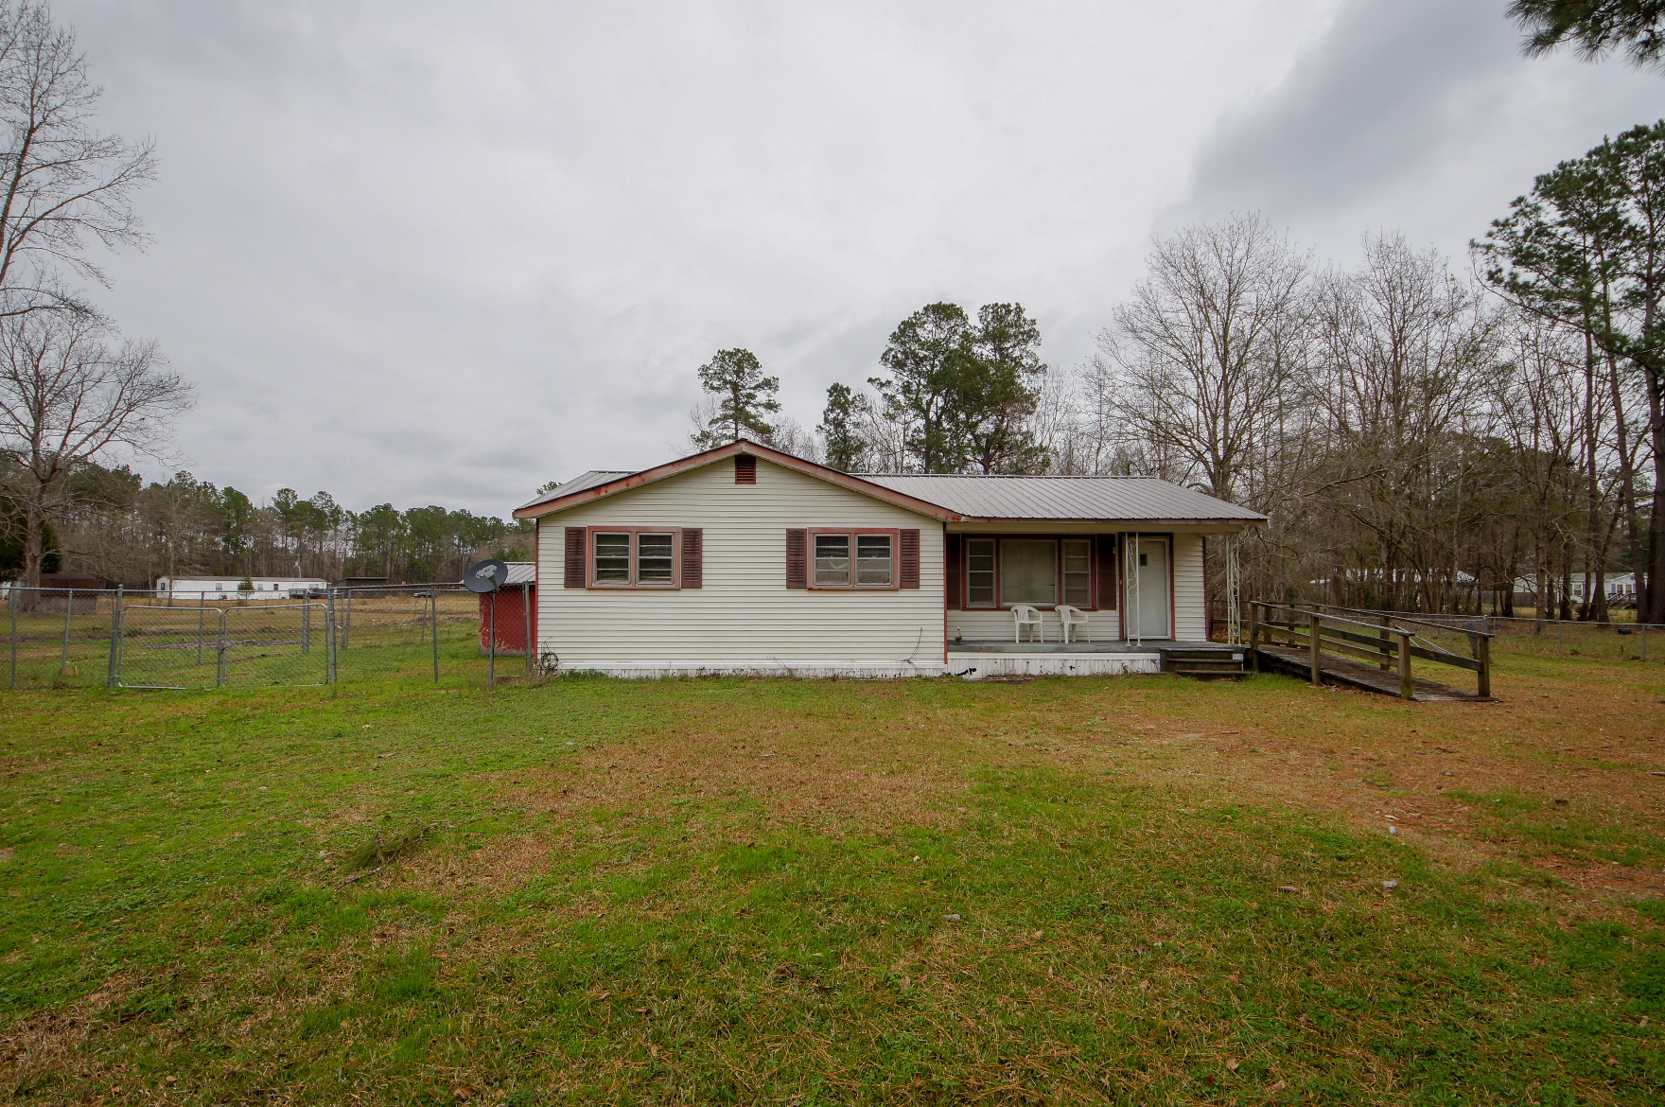
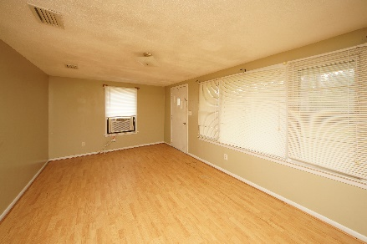
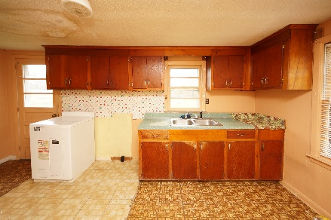
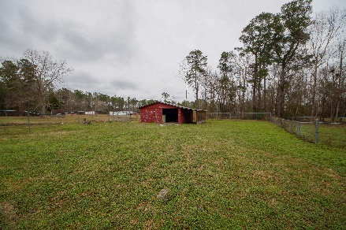


1524 E Church Street Bonneau, SC 29431 MLS# 19001513 :: $165,000 3 Bed / 1½ Bath
Investors Welcome!
2.67 Acres!
This 3 bedroom home has plenty of potential with a lot size of 2.52 acres. Owner installed New Roof in 2017 on the house and barn!!! Work appears to be interior cosmetic upgrades.
AC/Heat window unit is in place. Seller believes coils for AC may need to be replaced to operate. The seller removed old appliances so this home is a fresh pallet for the new buyer.
Barn is 30x24 and we are priced to sell!
Home is sold as is. Pre CL100 completed.
Connie White, Broker
843-532-3356
connie@chrepros.com · conniewhiterealestate.com
Charleston Homes · 597 Old Mt. Holly Road · Suite 301 · Goose Creek, SC 29445

