Slide 1
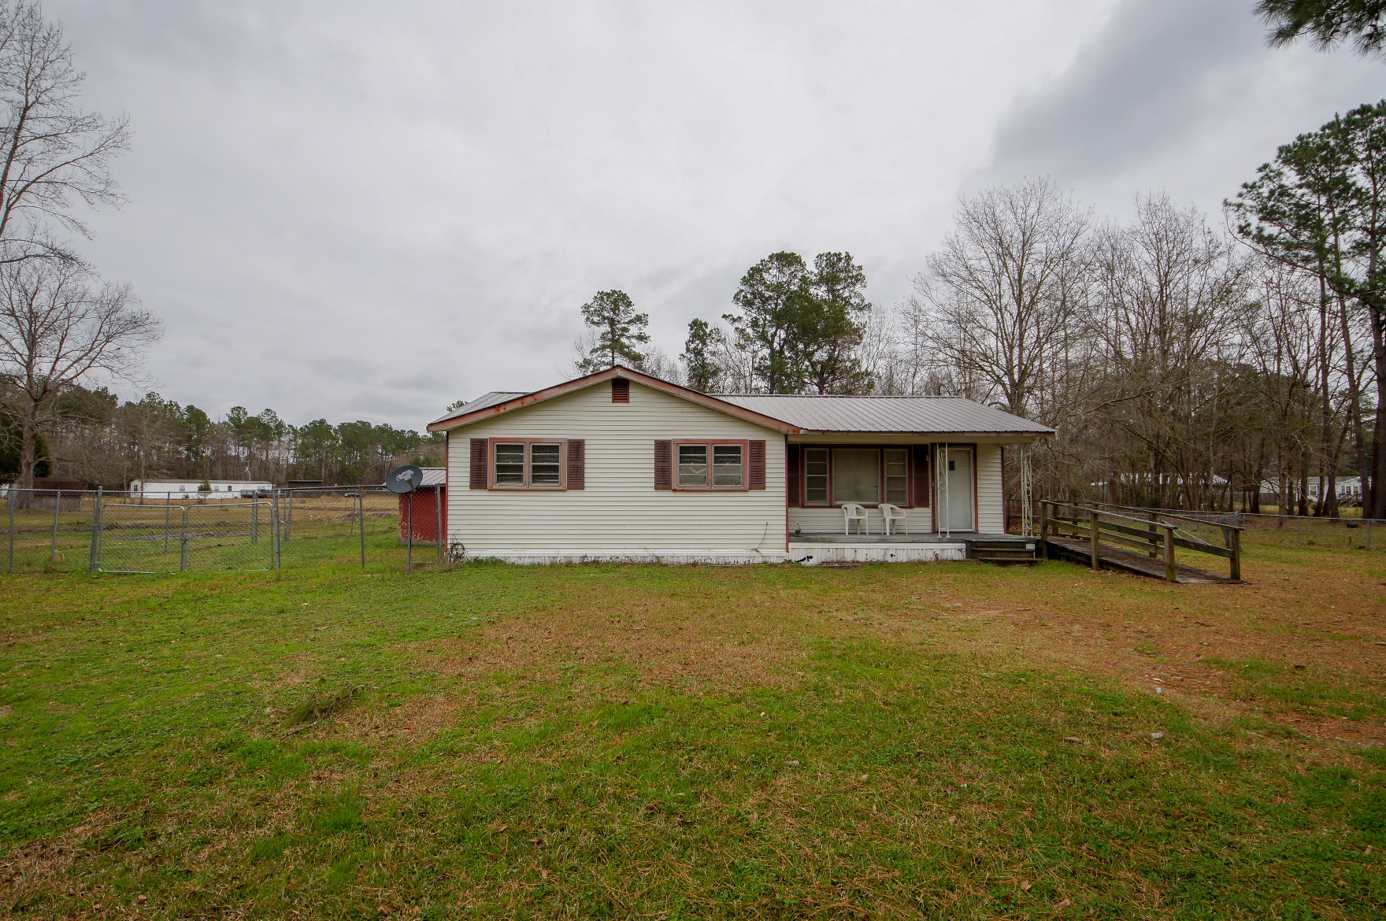
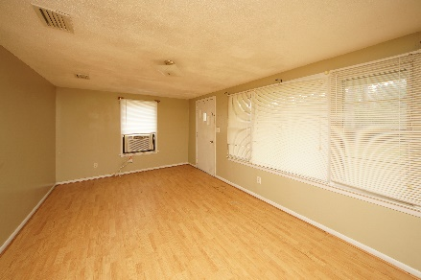
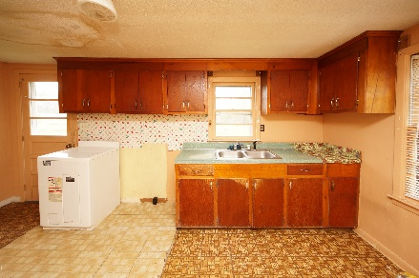
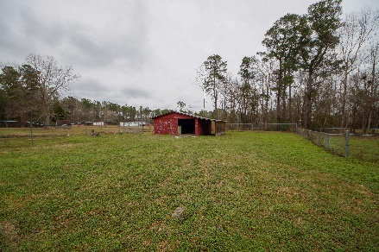


1524 E Church Street
Bonneau, SC 29431
MLS# 19001513 :: $138,000
3 Bed / 1½ Bath
Own a Home with Acreage!
New Price!!
This 3 bedroom home has plenty of potential with a lot size of 2.52 acres. Owner installed New Roof in 2017 on the house and barn!!! Work appears to be interior cosmetic upgrades.
AC/Heat window unit is in place. Seller has agreed to service/replace AC. The seller removed old appliances so this home is a fresh pallet for the new buyer. New stove will be installed.
Barn is 30x24 and we are priced to sell!
Home is sold as is. Pre CL100 completed.
Connie White, Broker
843-532-3356
connie@chrepros.com · conniewhiterealestate.com
Charleston Homes · 597 Old Mt. Holly Road · Suite 301 · Goose Creek, SC 29445

