Slide 1
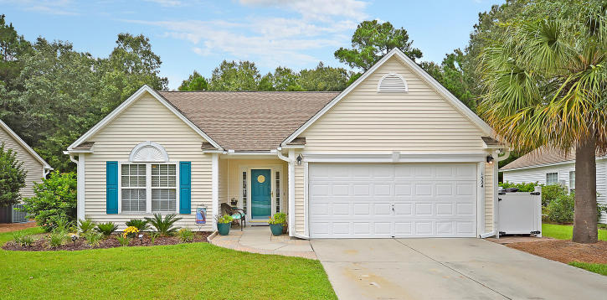
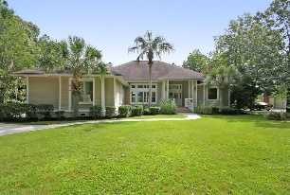
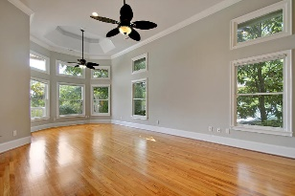
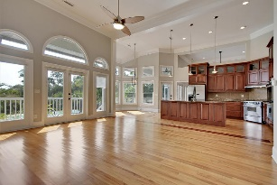
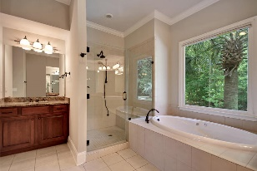
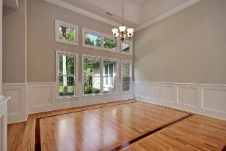
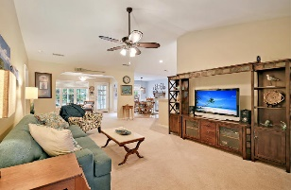
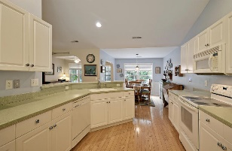
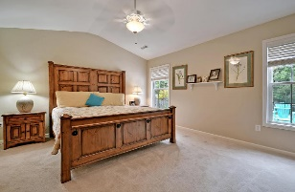
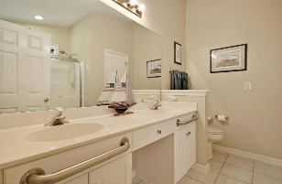
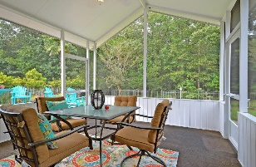
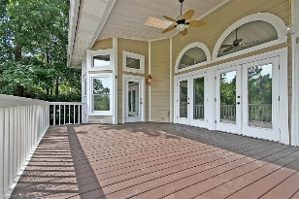
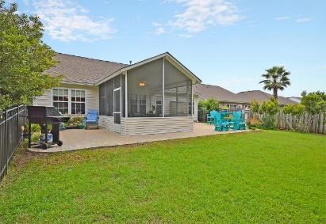
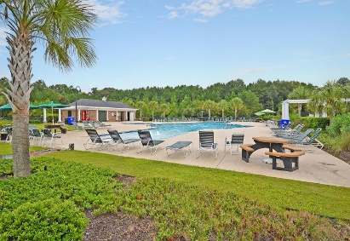
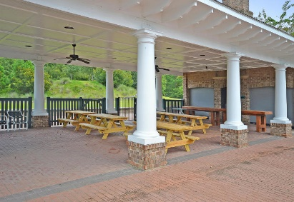
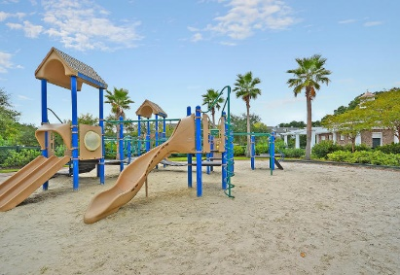

1524 Wellesley Circle ~ $310,000 Park West | Mount Pleasant, SC 29466 | MLS# 15024737
Soaring Ceilings, Open Concept & Dock
New On The Market!
Single Story living in one of Mt Pleasant’s most desirable Locations - Park West! This beautifully maintained 3 bedroom home backs up to protected woods that will never be built on! Lots of Wild Life to enjoy on one of the neighborhood’s biggest lots! Spacious screen porch with soaring ceilings and brand new ceiling fan allows family & friends to enjoy your Quarter Acre Lot with Double Brick Patios. The Open Concept living boasts Fresh Paint, New A/C, New Designer Kitchen Faucet, New Garbage Disposal, Upgraded Ceiling Fans, Updated Lighting with Edison bulbs, Hardwood Floors in the Kitchen, Eat-in area & 2 Bedrooms, as well as chair rails. The Kitchen has fantastic views of the back yard. Solid surface counter-tops, Tons of Counter Space & an Extra-Large Pantry make this kitchen a delight. The Spacious Master bedroom overlooks the backyard as well, has Double Sinks, Walk-in Closet, Ceramic Tile and Expansive Shower with the sweetest window inside! The carpet is only 2 years old. The extended living room can be used for an office, playroom or dining room. The owner has so many thoughtful details in the home: the aluminum fence has 3 gates for easy access, the screen porch as two doors & LED lighting to make entertaining a snap (it also has a transferable warranty), all the Venetian Blinds convey, the garage has attic storage & pull-down stairs, extra plugs have been added both in the garage and outside, the front walkway is even flanked by brick pavers! Sit on your back patio and be soothed by your very own small water feature! This home really is Charleston Outdoor Living at its Best! My favorite feature of the home is the long driveway that can accommodate 4 cars! This home has a Termite Bond for your peace of mind, is NOT in a wind zone and comes equipped with an ADT alarm system (not currently activated). Termite bond just renewed!
Come see this special home today!
Call or email for details: (843) 214-8451 or Robin@ThePhillipsRealtyGroup.com

