Slide 1
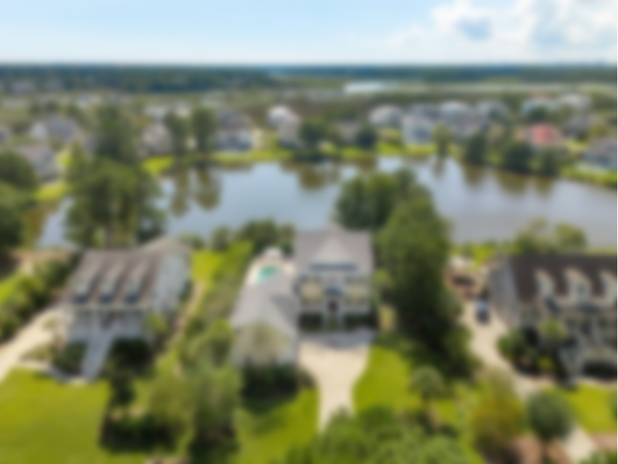
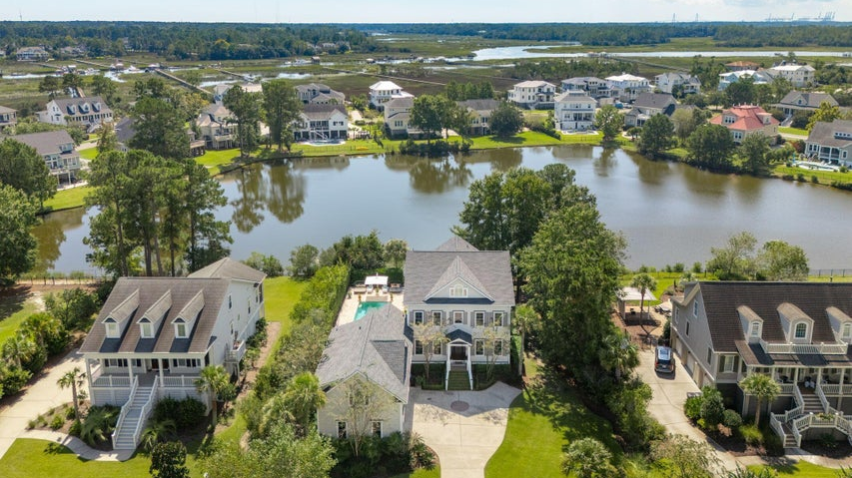
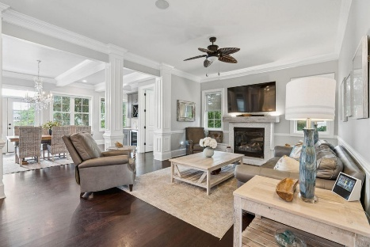
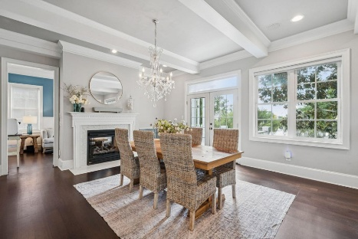
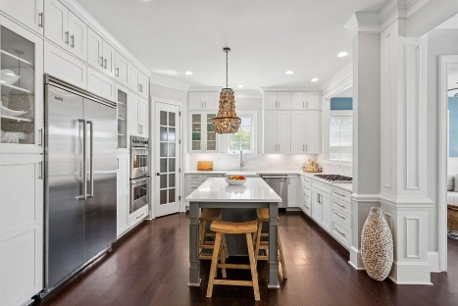
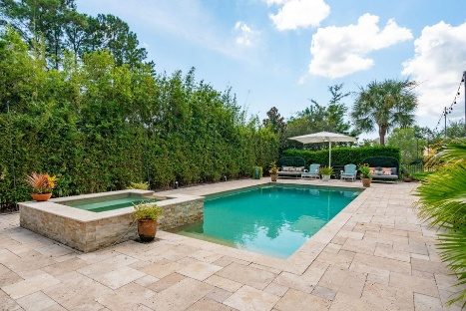
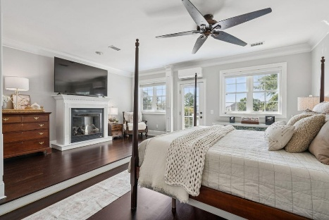
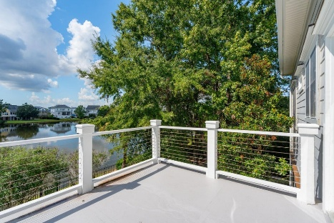
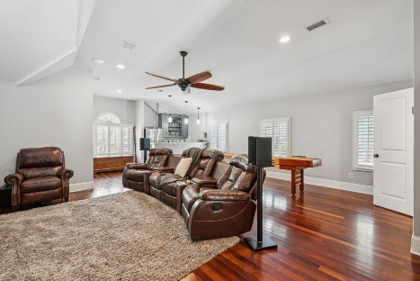
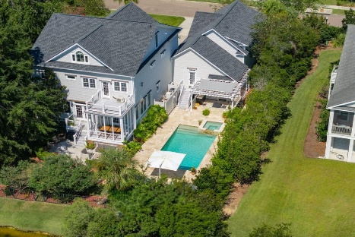


Just Listed in Parker's Landing!
1524 Rivertowne Country Club Dr
Rivertowne Country Club
Mount Pleasant, SC 29466
MLS# 25028038 | $2,400,000
Located in the exclusive Parkers Landing enclave of Rivertowne Country Club, this custom-crafted Lowcountry estate offers the best of luxury living in Mount Pleasant. Savor serene pond views and indulge in resort-style outdoor living with your own private saltwater pool and hot tub, surrounded by elegant travertine tile. The backyard retreat also features a fully equipped outdoor kitchen with premium Fire Magic appliances and grill, a charming gazebo, and a spacious, fenced yard—ideal for entertaining guests or unwinding in peaceful privacy.
Step inside the foyer, and you will immediately feel the home's blend of comfort and sophistication, with new hardwood flooring and a natural light-filled open floor-plan that flows effortlessly from room to room. The living area offers a welcoming ambiance and flow to the kitchen and dining spaces. Gather around the double-sided fireplace for cozy meals and conversation in the breakfast or sitting room, then extend the evening to the porch and deck, ideal for entertaining throughout the year. At the heart of the home lies a chef's kitchen that was completely renovated in 2021, complete with custom cabinetry which extends to the ceiling, expansive quartz island, upgraded kitchen gas range and Viking appliances; and walk-in pantry elevating the kitchen's functionality and ideal for hosting or everyday convenience.
With over 5,400 square feet of expertly designed living space across three levels, this 6-bedroom, 6 full and 1 half-bath home highlights sophisticated design, premium finishes, and a seamless flow between indoor comfort and outdoor luxury.
Designed with functionality in mind, this home offers abundant storage, including multiple attic access points, upgraded ductwork beneath the home, and full spray foam insulation added in 2021. Outdoor living is equally well-appointed, featuring a dedicated storage shed for pool equipment, along with a poolside entertainment setup complete with a TV, stereo system, and premium Bose outdoor speakers with subwoofer. A new 50 year roof was installed in 2023.
Take full advantage of the exceptional amenities offered by Rivertowne Country Club, including a championship golf course, resort-style pool, scenic parks, and a welcoming clubhouse all conveniently located near popular grocery stores, dining destinations, and award-winning Mount Pleasant schools.
VIDEO TOUR
Virginia Landon 803-493-9202
vlandon.realestate@gmail.com
The Boulevard Company | 806 Johnnie Dodds Blvd Ste 100 | Mount Pleasant, SC 29464

