Slide 1
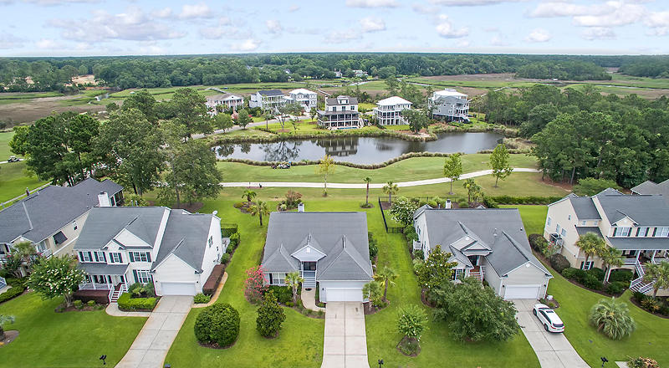
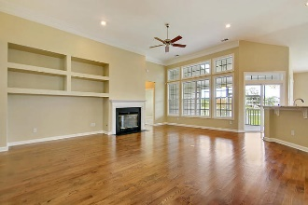
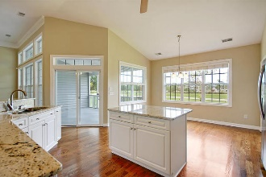
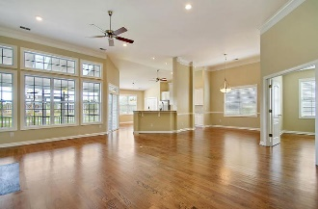
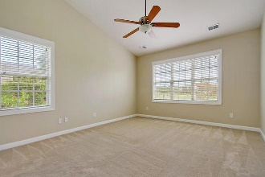
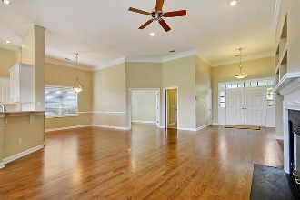
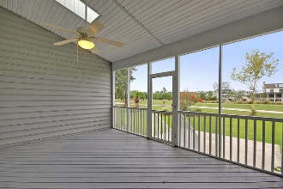
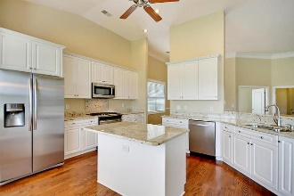
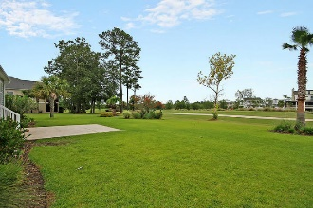


Golf Course Living
Starbucks card to first 10 agents
1525 Oakhurst Drive
Rivertowne Country Club ~ Mt Pleasant ~ MLS# 18018657 ~ $450,000
Incredible opportunity to own a single-story home in pristine condition situated on the 12th Tee of Rivertowne Country Club in Mount Pleasant. This home has been meticulously maintained and is truly move in ready! Solid Oak hardwood floors greet you upon entering and encompass the main living areas. An entire wall of windows on the rear of the home overlooks the golf course and provides abundant natural sunlight throughout the living room and kitchen, accented with soaring 12 foot ceilings. The kitchen has been updated with granite countertops, stainless steel appliances, including a natural gas range, 42-inch cabinetry, large pantry, center island, ceiling fan, and recessed lighting. The private master bedroom offers a high cathedral ceiling, dual vanity sinks, stand alone shower, jetted jacuzzi tub, and walk-in closet with custom shelving for extra storage. The other two bedrooms are located on the opposite side of the home and share a full bathroom. A fourth room, currently with a door, could be used as a home office, study, library, play room, or even converted into a 4th bedroom if needed. The entire home has plenty of storage including multiple linen closets, attic access, and extra overhead storage built in the garage. Additional valuable upgrades include a new 4 Ton Energy Efficient HVAC system and gas furnace in July of 2017, Rinnai R94 Energy Efficient tankless hot water heater in July 2017, fresh touch up paint throughout, whole house gutters, 250 foot deep-water irrigation well and submersible pump with Hunter Pro-C lawn irrigation system with remote control throughout front and back yards, and multiple exterior well faucets (saves money on your water bill using the well water instead of city), backyard grilling patio with exterior natural gas hook up for your gas grill, mature landscaping, large 2 car garage that is fully sheet rocked, painted and complete with built-in overhead storage. 1525 Oakhurst Drive is quietly situated on the Rivertowne Country Club Golf Course and offers great privacy with the benefit of a single story floor plan. One of the best features about this house that you will surely enjoy is that the back of the home faces East. This allows you to enjoy a beautiful sunrise every morning from your screened porch and is also nice during hot afternoons because the setting sun is not 'in your face' when relaxing on the porch, grilling on the patio, or working in the backyard. Home comes with a transferable termite warranty, all appliances including the washer/dryer convey, and existing Ring Doorbell security system. Excellent community amenities including membership available for the Arnold Palmer award winning masterpiece 18-hole golf course, neighborhood pool, playground, sidewalks, and tennis courts. Rivertowne is very convenient to a local Marina, deep-water boat ramp, and multiple boat storage facilities located just outside the neighborhood on Hwy 41. Grocery store, dry cleaning, and restaurant are just a short golf cart ride away!
Jerod Coulter, ABR, REALTOR
(843) 513-3741
jerod@realtor.com | www.HomesOfMountPleasant.com
The Boulevard Company, LLC | 35 Broad Street | Charleston, SC 29401

