Slide 1
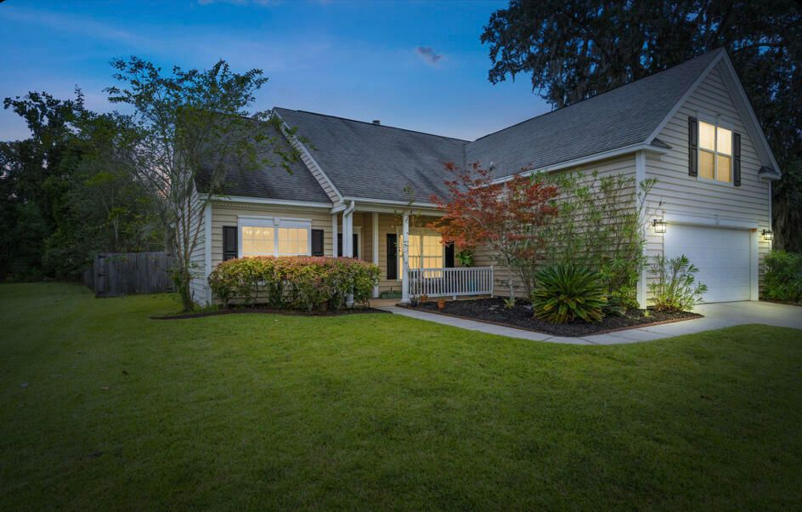
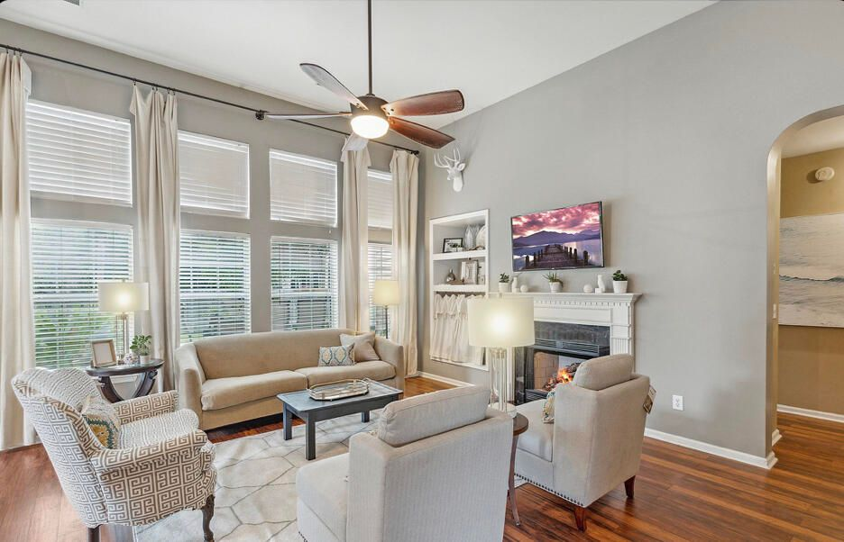







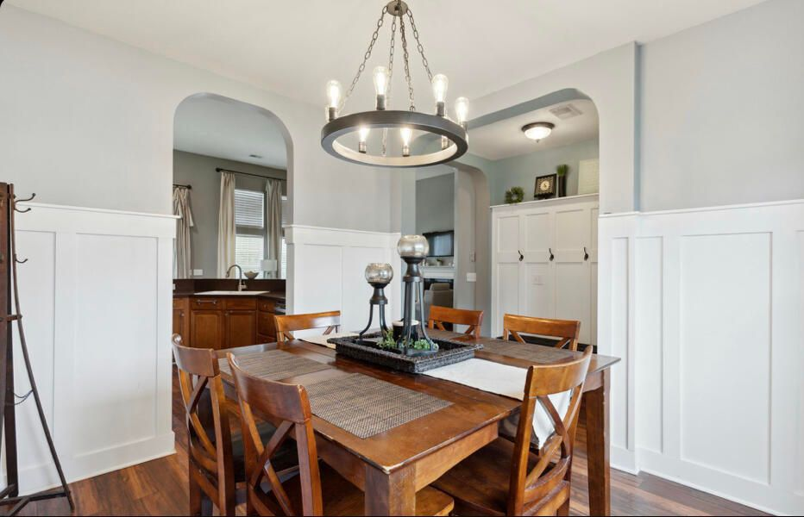
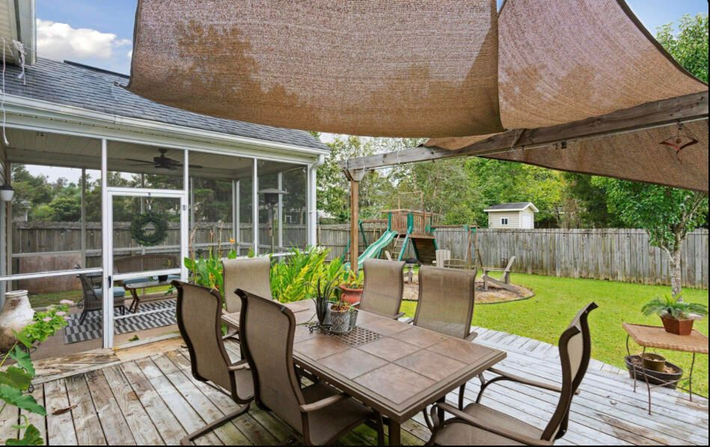
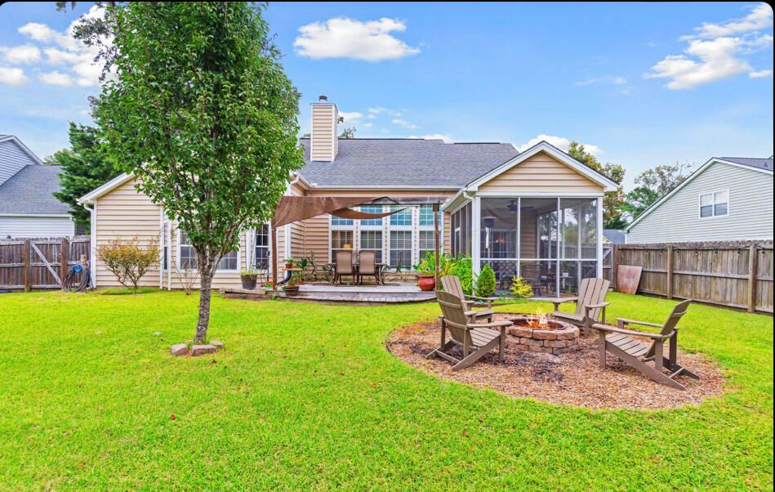
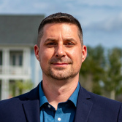
#22025741
New Listing!
1525 Ashley Garden Boulevard
Grand Oaks Plantation
Charleston, SC 29414
Open House
Sat 10-12 & Sun 10-12
4 BED
2 BATH
2,053 SF
$499,990
This awesome home is well maintained and located in the most popular subsection in Grand Oaks: Hamilton Grove! This enclave consists of only 255 homes yet you have the conveniences of a master planned community including the City Recreation Center with multiple ball fields, 6 tennis courts, a dog park, a huge gym with basketball courts, exercise classes, summer camps and more! The West Ashley Circle Shopping Center is a short walk away with the new Harris Teeter, Starbucks, Roper Urgent Care, gym, Veterinarian, many restaurants, gas stations, nail salons and more. The Palmer floor plan has dramatic 12' ceilings in the common areas and owner's suite! The arches add a nice architectural touch, and the transom windows add extra natural light! There are 3 bedrooms and a bonus room upstairs that can double as a 4th bedroom! The kitchen has 42" raised panel maple cabinets with crown molding and recessed lights! The owner's suite has an enormous walk-in closet, separate double sinks, garden tub, shower and a separate water closet for the ultimate privacy. The secondary bedrooms are spaced apart so everyone has their own space. The bonus room / 4th bedroom is absolutely enormous and has built-in bookshelves which can easily be made into a closet! The backyard is completely fenced and the home has an incredible screen porch with vaulted ceilings and a huge deck off of that for more entertaining space. The homesite is adjacent to an HOA space that leads to a pond where one can go fishing. There are ponds throughout the community, and it is common to see several people fishing on any given day! Grand Oaks Plantation is also a sidewalk community. Each subsection has their own amenities, so the pool is only accessed by Hamilton Grove residents! Come tour today!
Meg H. Kandik
843-814-5137
Meg@HolyCityRE.com
www.holycityre.com
Brand Name Real Estate
4 Carriage Ln
Charleston 29407
Matt Kimes
843-860-1669 | mattkimeshomes@gmail.com
www.mattkimeshomes.com

