Slide 1
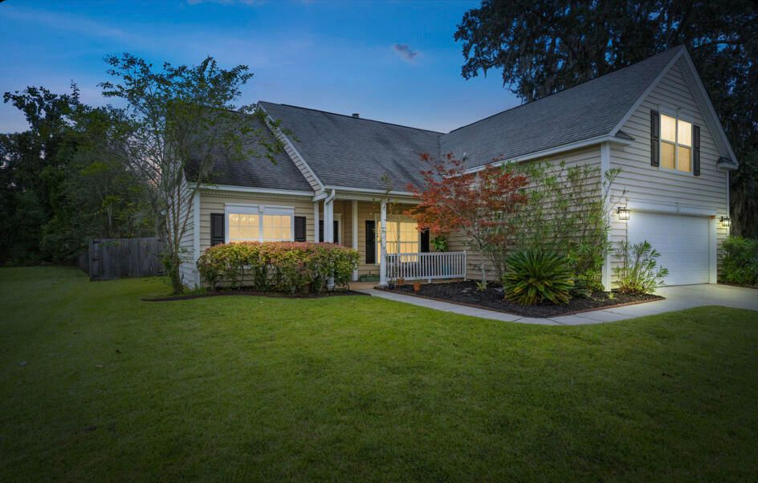
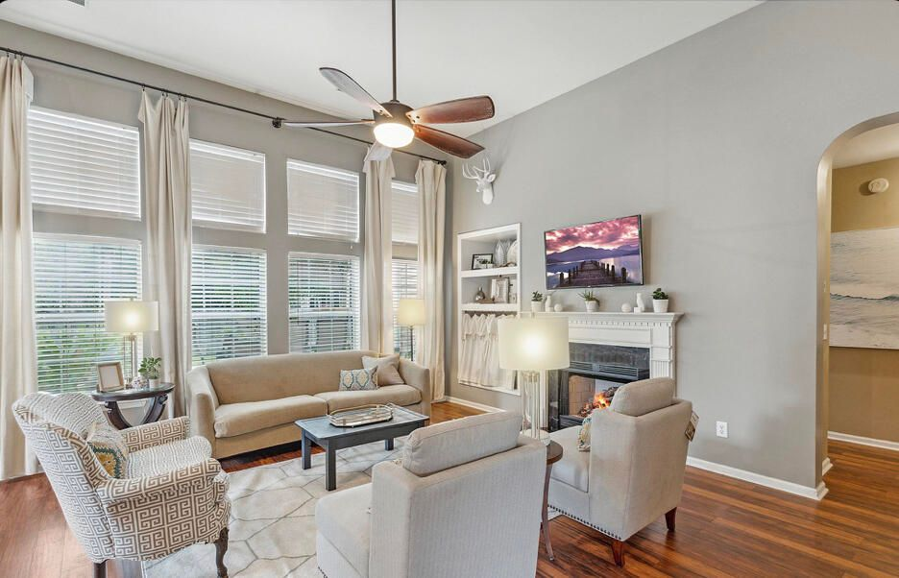







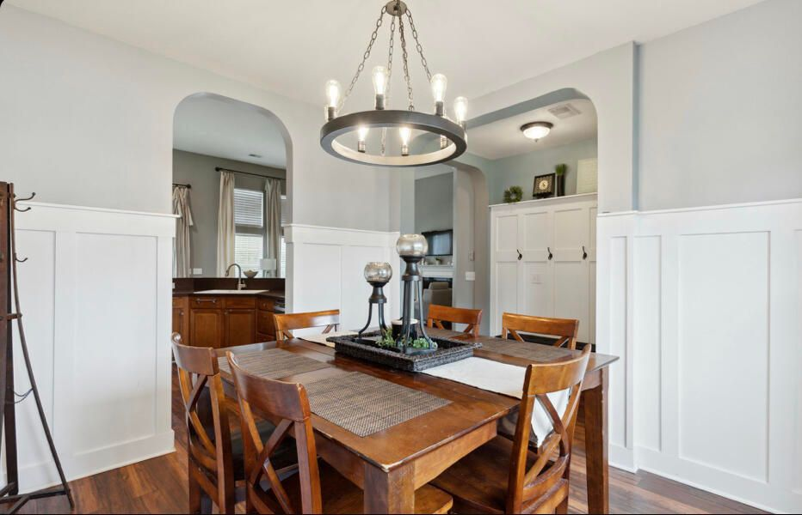
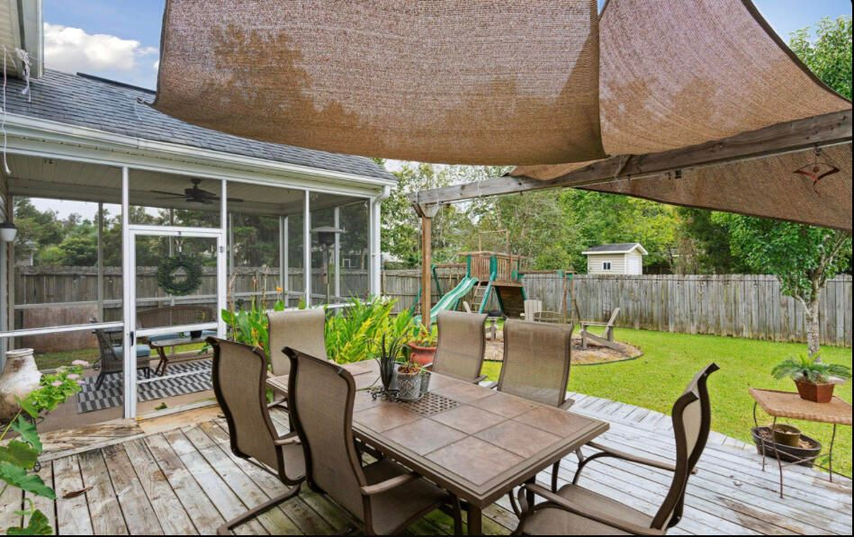
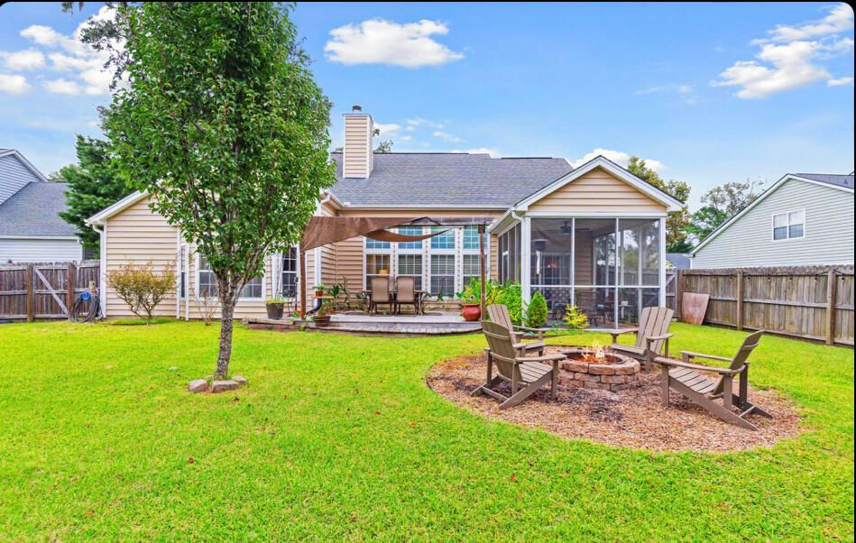
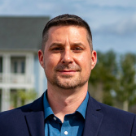
#22025741
Bring All Offers!!
1525 Ashley Garden Boulevard
Grand Oaks Plantation
Charleston, SC 29414
Open House
Sat 10-12 & Sun 10-12
4 BED
2 BATH
2,053 SF
$425,000
This 4 bedroom home is stunning and located in the most popular subsection of Grand Oaks: Hamilton Grove! This enclave consists of only 255 homes yet you have the conveniences of a master planned community including the City Recreation Center with multiple ball fields, 6 tennis courts, a dog park, a huge gym with basketball courts, exercise classes, summer camps and more! The West Ashley Circle Shopping Center is a short walk away with the new Harris Teeter, Starbucks, Roper Urgent Care, Veterinary Office, gym, many restaurants, gas stations, nail salons and more! The Palmer floor plan has dramatic 12' ceilings in the common areas and the owner's suite. The arches add a unique architectural touch, and the transom windows allow for more natural light! There are 3 bedrooms downstairs and a bonus room upstairs that can double as a 4th bedroom. There are 42" raised panel maple cabinets in the kitchen with new hardware. You'll love all of the recessed lights as well! This home has gas cooking and a gas fireplace! The owner's suite is huge with a bay window and a double door entrance into the deluxe bath with separate sinks, garden tub, walk-in shower, linen closet and a water closet for the ultimate privacy! Just off of the bathroom is an enormous walk-in closet with custom shelving. The secondary bedrooms are spaced apart, so everyone has their own space. The bonus room / 4th bedroom is huge and has built-in bookshelves which can easily be made into a closet! The backyard is completely fenced and includes two gates. You'll likely spend the majority of your time on the incredible screen porch and a huge deck just off of it - perfect for entertaining or winding down at the end of the day! The homesite is adjacent to an HOA space that leads to a pond where one can go fishing. There are ponds throughout the community, and it is common to see people out biking, walking, running or fishing throughout the day! Grand Oaks is a sidewalk community. Each subsection has their own amenities, so the pool is accessed only by Hamilton Grove residents!
Meg H. Kandik
843-814-5137
Meg@HolyCityRE.com
www.holycityre.com
Brand Name Real Estate
4 Carriage Ln
Charleston 29407
Matt Kimes
843-860-1669 | mattkimeshomes@gmail.com
www.mattkimeshomes.com

