Slide 1
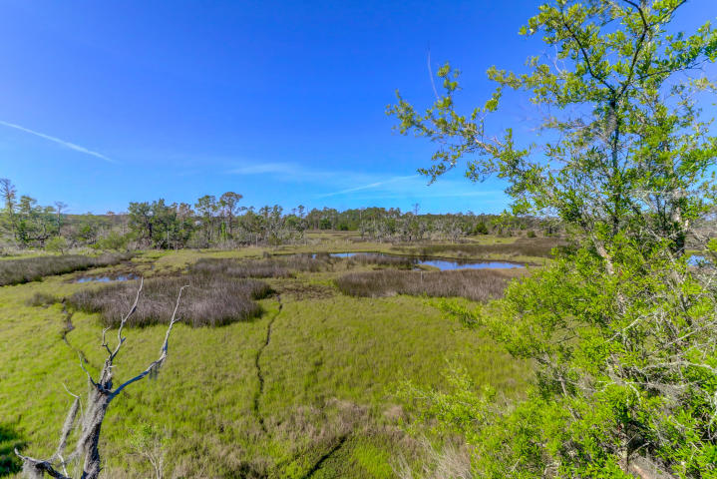
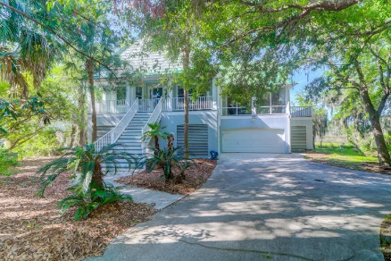
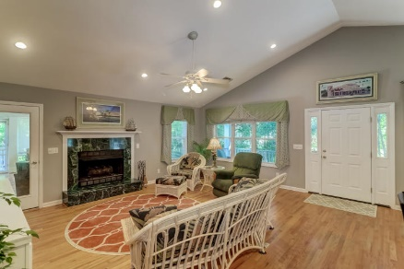
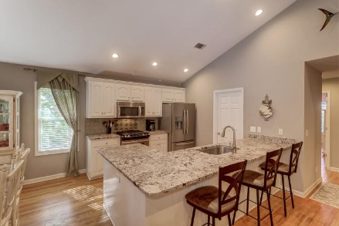
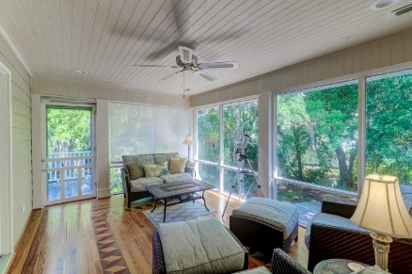


1526 Regimental Lane Headquarters Plantation | Johns Island, SC 29455 | MLS# 20011792 | $615,000
MOTIVATED SELLER!! REDUCED 150K!
Convenient To Downtown ~ A Must See!
Stunning Marsh Views from this peaceful and private lot in Headquarters Plantation. Convenient to downtown, shopping and historic sites of Charleston. 1526 Regimental offers a Stately presentation with hurricane shutters and Southern style entry stairs with the front porch running the width of the home making for quiet evenings on the front porch. The open plan is perfect for family and friends. Enjoy your time cooking with beautiful appliances such as a gas range, plenty of cook space with the over sized island/bar area and granite counters. Relax in the Master Suite offering a walk in closest and master bath with jetted tub. Step out into the Sun Room and enjoy the fabulous marsh views or sun on the attached deck. You will be wowed by all this home offers. A must see!
Darlene Smith Office - (843) 886-8110
Mobile - (843) 696-7824
darlenesmith@carolinaone.com
DarleneSmithTeam.com
Carolina One Real Estate
1503 Palm Blvd Ste
Isle of Palms, SC 29451

