Slide 1
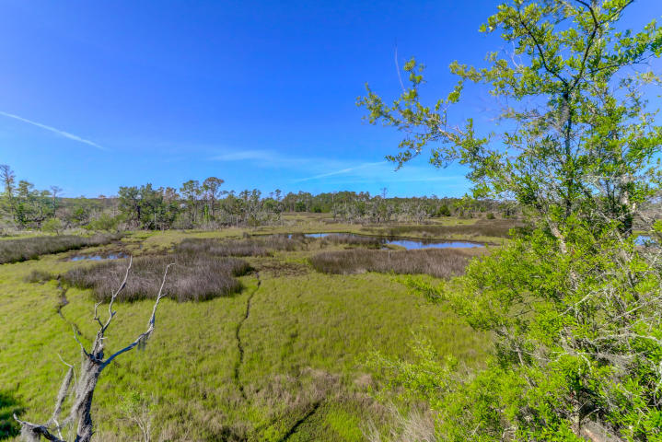
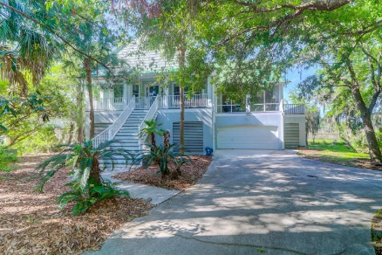
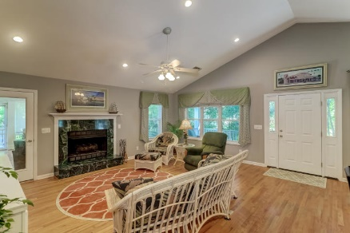
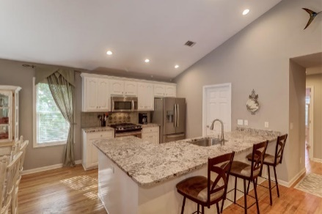
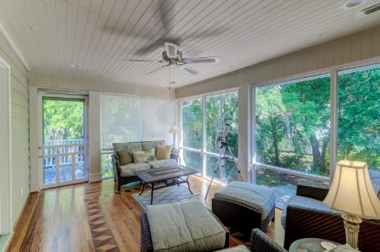


1526 Regimental Lane Headquarters Plantation | Johns Island, SC 29455 | MLS# 20011792
Very Close To Downtown...Gated With Marsh Views
NEW PRICE $585,000 ~ $2000 AGENT SELLING BONUS!
Marsh Views from this peaceful and private home in gated Headquarters Plantation. A quick 7 miles to downtown via the Stono Bridge (1st exit off Charleston Stono bridge),close to shopping and historic sites of Charleston. 1526 Regimental offers a presentation of relaxation and quiet with hurricane shutters and Southern style entry stairs with the front porch running the width of the home. The open kitchen to living space offers a gas range, plenty of cooking space with the over sized island/bar area and granite counters. Relax in the Master Suite offering a walk in closest and master bath with jetted tub. Step out into the Sun Room and enjoy the fabulous marsh views or sun on the attached deck. You will be wowed by all this home offers. Boat Slips available for purchase. A must see!
Darlene Smith Office - (843) 886-8110
Mobile - (843) 696-7824
darlenesmith@carolinaone.com
DarleneSmithTeam.com
Carolina One Real Estate
1503 Palm Blvd Ste
Isle of Palms, SC 29451

