Slide 1
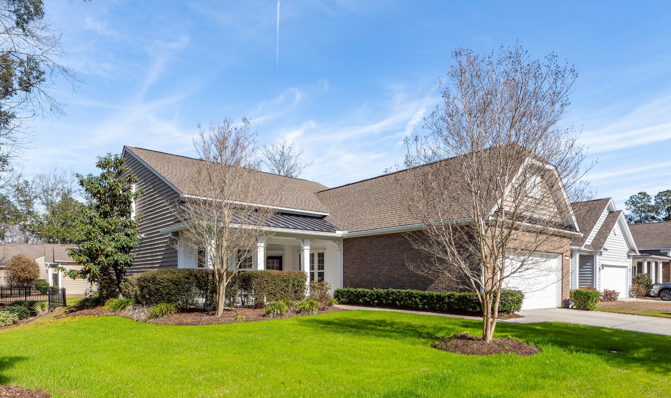
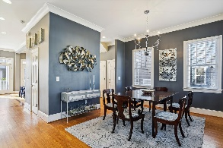
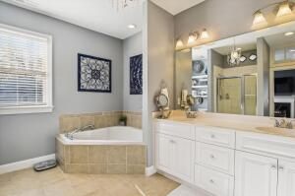
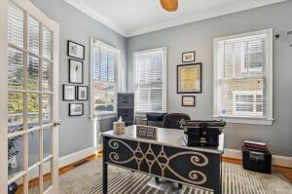
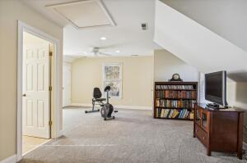
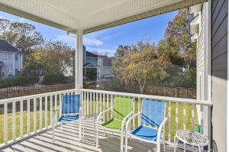
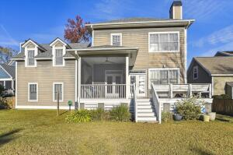
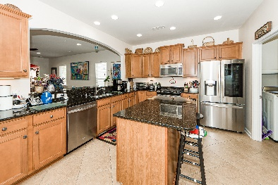
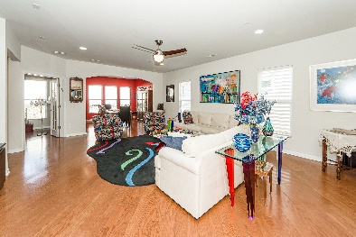
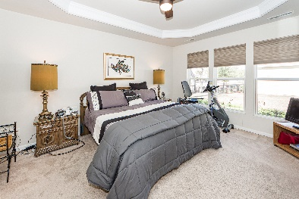
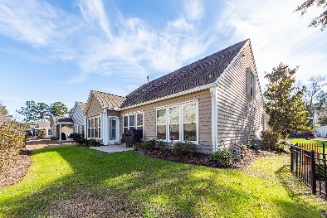


1526 Pixley Street
Carolina Bay • Charleston, SC 29414 • MLS# 23003053 • $589,000
Open House Saturday 2-4 & Sunday 1:30-3:30
Sellers built 1526 Pixley St. in 2012 and added many special features. The corner lot provides lovely landscaping designed and installed by Angel Oak Nursery. The elevated island with 3 beautiful palm trees and expansive side yard includes a designer flower bed with oak trees and small palms. Walking toward the backyard, you'll see other landscaping and a view of the pond. An inground irrigation system with separate meter allows for easy maintenance. Before entering the home, note the bricks lining the driveway which effectively widen it and the front porch which is perfect for enjoying the lovely views. A heat shield over the front porch helps cool the porch and attic. Inside the house, off the foyer is the kitchen and eat-in area. The many cabinets and drawers with pull out shelves along with two upgraded pantries, granite countertops, instant hot water faucet, dispensers for dishwashing and hand soap, a casual eat-in area and ceramic tile floors complete the kitchen. Appliances include a natural gas stove with convection oven and a built-in microwave. The utility room off the kitchen features several built-in cabinets. There are hardwood floors in the entryway, great room, office and dining room. The office has a custom built-in desk, wall-to-wall bookcases and file cabinets designed and installed by Inspired Closets. The master bedroom on the ground floor has a walk-in closet. The master bath has two sinks with granite countertops, a walk-in shower and full vanity. The bedroom opposite the kitchen has a 3-piece entertainment center which is not built in and will be going with the sellers. Upstairs is a spacious loft. It has a large separate bedroom and full bath. This light-filled multi-purpose room has a view of the pond and wooded area beyond the pond. The sellers included many upgrades which are not readily seen but enhance the value and function of the home. Some of these include hurricane tracks with removable shutters and a motorized shutter on the front door. These items may allow for a substantial reduction in the cost of home owner's insurance. The garage has been extended 4 ft. allowing for a professionally designed and installed bank of floor to ceiling cabinets across the back wall. There is an ADT alarm system and Nest doorbell. The sellers have given attention to every detail.
Click here to take a virtual tour!
Susan Garfinkel
843-696-5838 | susanrealtor44@gmail.com
Elaine Brabham and Associates, LLC • 1890 Sam Rittenberg Boulevard, Suite 217 • Charleston, SC 29407

