Slide 1
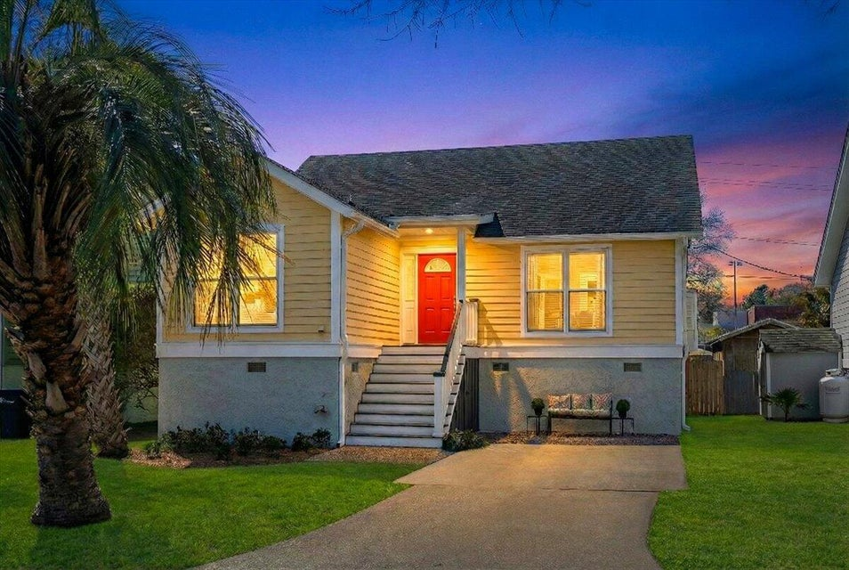
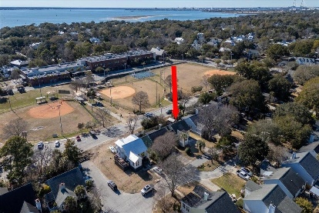
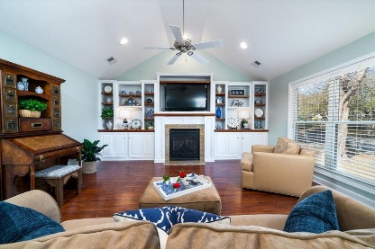
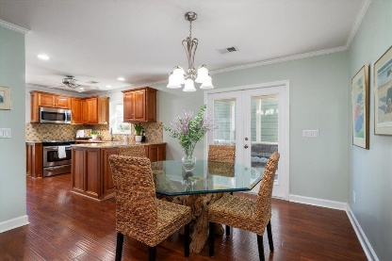
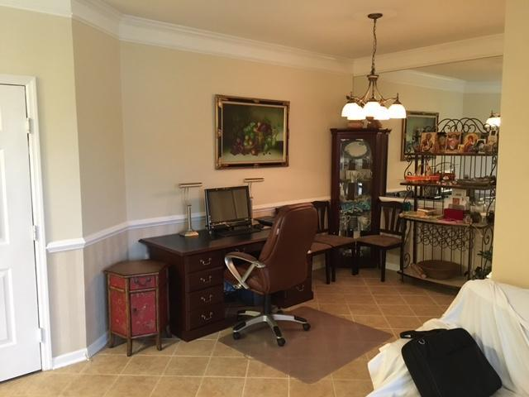
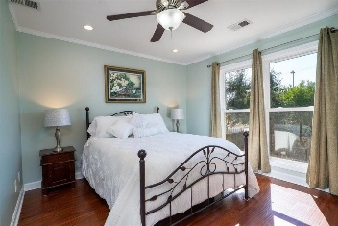
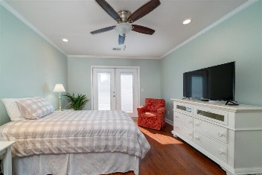
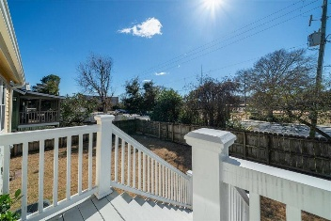
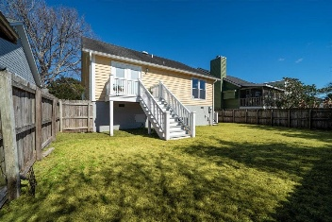
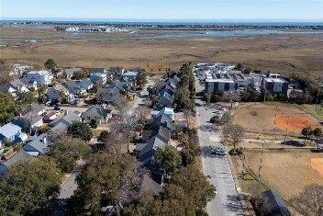



Charming Mt Pleasant Home Near Iconic Coastal Views
OPEN HOUSE FRIDAY, MARCH 6TH, 12:30-2 | DRAWING FOR $100 GIFT CARD
1527 Barquentine Drive
Pirates Cove | Mount Pleasant, SC 29464 | MLS# 26004799 | $1,225,000
Welcome to this beautifully maintained single-family home in the heart of an area commonly called Old Mount Pleasant...just outside of the Old Village Historic District , offering a comfortable, open floor plan designed for easy everyday living and effortless entertaining. Step inside to find a light-filled living space that flows seamlessly into the kitchen, complete with granite countertops, stainless steel appliances, custom cabinets with pull outs. The thoughtfully designed layout provides both openness and privacy, making it ideal for families, guests, or working from home. Enjoy peace of mind with an HVAC that is only 3 years old, adding long-term value and durability to this move-in ready property.
Located just a short walk from the iconic Pitt Street Bridge, you'll experience exceptional views of wildlife, including migratory birds, along with sweeping vistas of Charleston Harbor, the Charleston skyline, neighboring Sullivan's Island, and the surrounding coastal beauty.
Spend weekends soaking up the sun with a bike ride or a quick 10-minute drive to the pristine beaches of Sullivan's Island and Isle of Palms, or explore the rich history and renowned dining of downtown Charleston. The neighborhood offers wonderful walking opportunities for families and their four-legged friends, making it a perfect setting for an active coastal lifestyle.
This home in a neighborhood with no HOA, is also zoned for two award-winning schools: Mount Pleasant Academy and Moultrie Middle School, adding to its exceptional appeal.
With its unbeatable location, thoughtful updates, and access to some of the Lowcountry's most iconic views and beaches, this is a rare opportunity to enjoy the very best of Mount Pleasant living.
Schedule your private showing today and experience coastal charm at its finest. It is a lovely place to come home to.
TAKE A VIRTUAL TOUR
Cheryll Woods-Flowers
843-442-2219
cflowers@woodsflowers.com
www.woodsflowers.com
Coldwell Banker Realty | 1127 Queensborough Blvd | Suite 103 | Mt Pleasant, SC 29464

