Slide 1
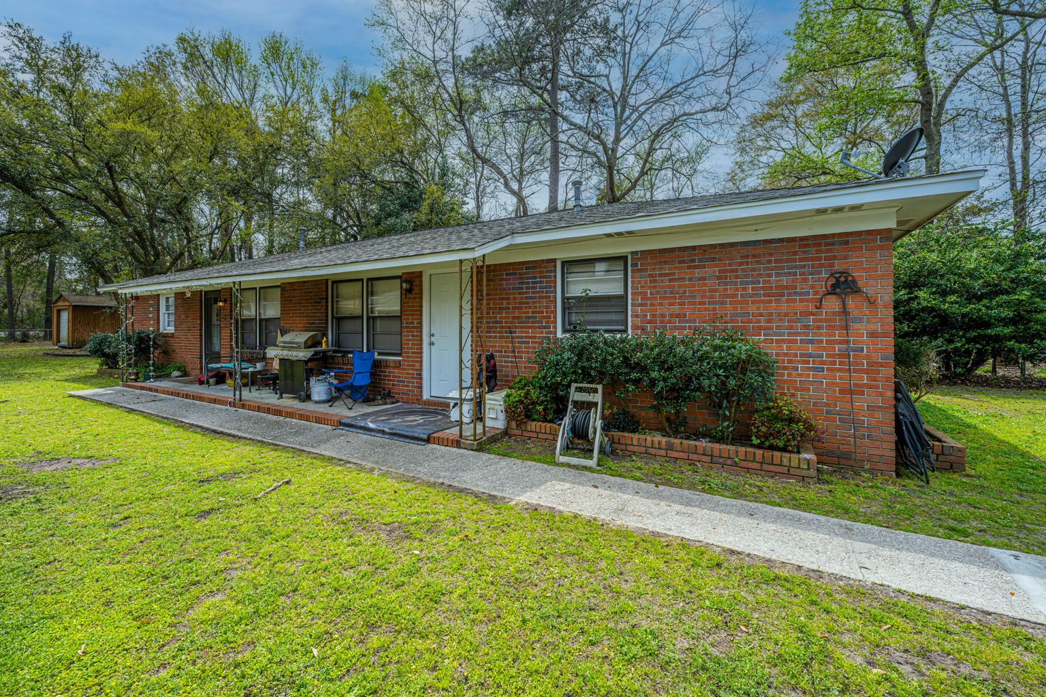
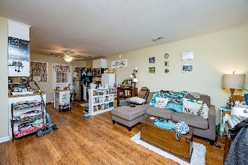
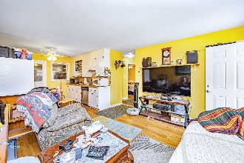
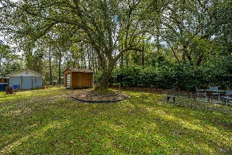
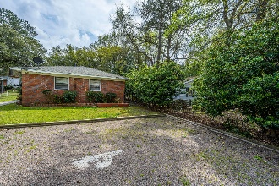


Rare Brick Duplex in West Ashley
1527 Joan Street C & D
Orange Grove | Charleston, SC 29407
MLS# 21008576 | $297,500
Very rare opportunity for a Brick Duplex cash flow property in the middle of West Ashley! Great investment opportunity! Many options abound in its use: Owner can live in one unit and pay a large part of their mortgage with rent from the other, (with substantial tax benefits too), rent both units as they are now, or upgrade the units upon tenant turnover for a substantial increase in rental income and excellent return on your investment. Major features are an all Brick exterior, a good roof, (30 year architectural shingles installed in the mid 2000's), recent HVAC systems, (one installed in 2018), updated electrical panels for both units, 4 parking spaces and 2 big storage sheds.
Two side by side units each have: Nice wood flooring throughout the living areas and bedrooms. 2 Bedrooms with nicely sized closets. 1 Bathroom with an adjacent linen closet. A spacious main living area with coat closet and a perfect wall space for a large TV. An open and flexible Kitchen and Dining area, and there is a separate area in the back for washer, dryer and storage.
Situated on a large, near quarter of an acre lot, with a large backyard enhanced by a Majestic Oak Tree. Of note, there are two very useful and sizeable storage outbuildings in the rear yard, and these can bring definite added value to the rental income obtainable.
Tenant and Income status: Tenants pay all utilities. Unit D, rented at $1050 a month since June 2019, has a $1050 security deposit, and is leased through July 31, 2021. It was rented under market value in 2019, and has been without rent increases due to excellent tenant payment history. Unit C is rented for $800 a month, on a month to month basis, with no lease, to a family acquaintance who has lived there for 4 years. The favorable rate is due some work done on other properties and yard care. Fair market rental value for both units, without upgrading, is $1250 to $1300 a month, or $30,000.00 to $31,200.00 a year. Location, parking, yard space, nice wood floors, open floor plan, and the use of the storage outbuildings drive this rental income.
Note: The open living and kitchen area floor plan allows these units to be easily and cost effectively upgraded to modern looks and finishes, and increasing rental income.
Property is in a great location with nearby restaurants, sports pub, shopping and entertainment, very convenient to 26 and 526 and about 15 minutes to downtown Charleston!
Located in an X flood zone, no flood insurance is required, this adds to the bottom line cash flow value of the property. Some advanced tenant notice is needed to view, this won't last long, if interested, contact your agent asap to set an appointment to view.
Tony Schimek
M 843-270-2358 | F 832-202-8496
tschimek@carolinaone.com | www.TonySchimekRealtor.com
Carolina One Real Estate | 191 Rutledge Ave | Charleston, SC 29403

