Slide 1
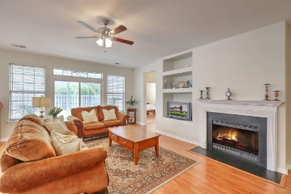
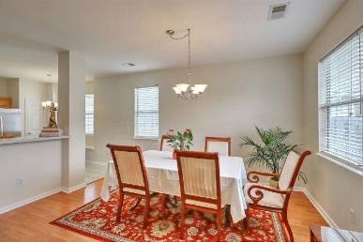
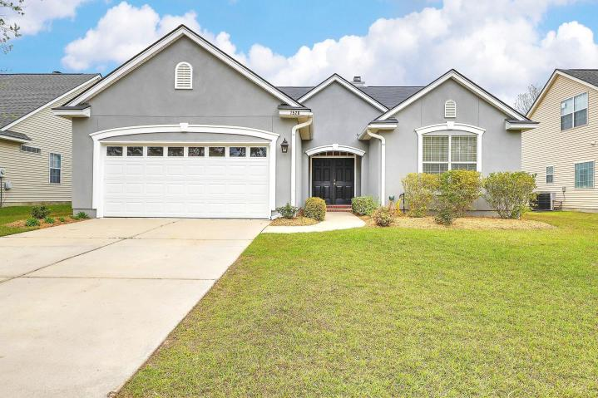
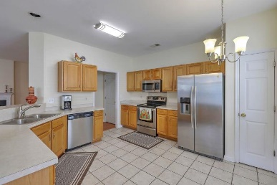
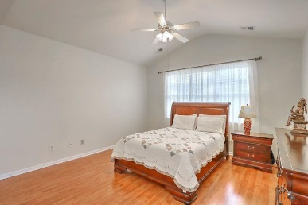
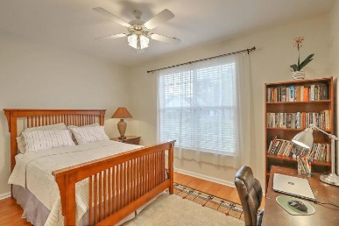
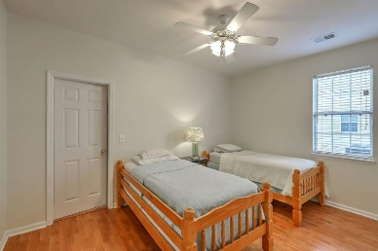
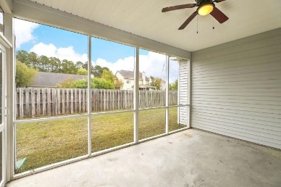
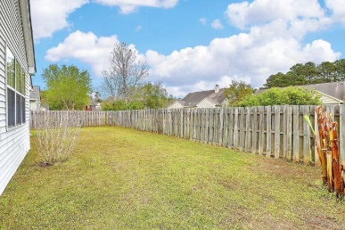
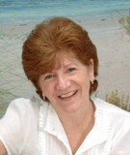

1528 Clarendon Way Park West ~ Mount Pleasant, SC 29466 MLS# 19009463 ~ $354,900
One Story Home In Mt Pleasant For Under $355K
Limited Time Only - $1,000 Buyer's Agent Bonus
(with BIC approval and paid at transfer of deed)
Come see this Charming Move-in ready one story home today! Freshly painted, new HVAC, new Roof, new patio doors etc. This Open, airy & bright floorplan is a ''Must See''! Large sunlit eat-in kitchen with lots of counter space is open to the dining area and large family room with cozy fireplace - perfect for entertaining. Family room also overlooks the screen porch and private backyard. The Master bath features a vaulted ceiling, Large garden tub, separate shower with large walk-in closet The generously sized secondary bedrooms are at the front of the home. This home is conveniently located near the pools, tennis courts, playground, schools etc. Also located close to shopping, restaurants, hospital, doctors, child care, professional services etc.
Maggie Curtis
REALTOR, EPRO, LMC, ABR
(843) 693-8207
maggiecurtis@comcast.net
Debra Whitfield
ABR, SRES
(843) 367-4845
debra.whitfield@coldwellbanker.com
Coldwell Banker Residential Brokerage | 1127 Queensborough Blvd. 103 | Mt Pleasant, SC 29464

