Slide 1
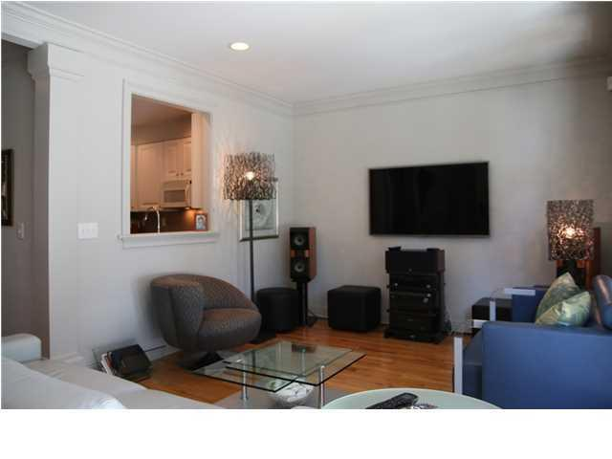
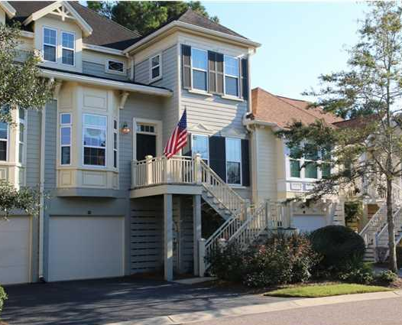
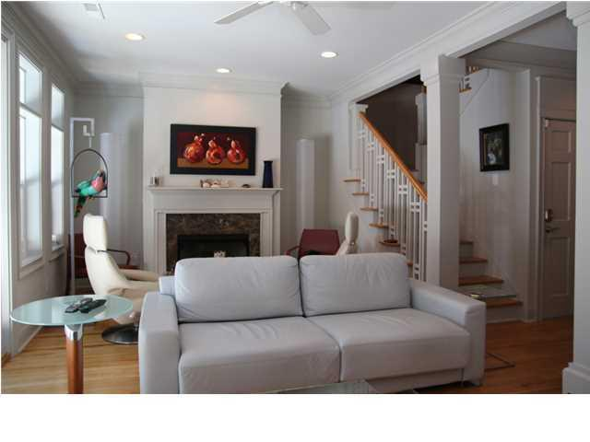
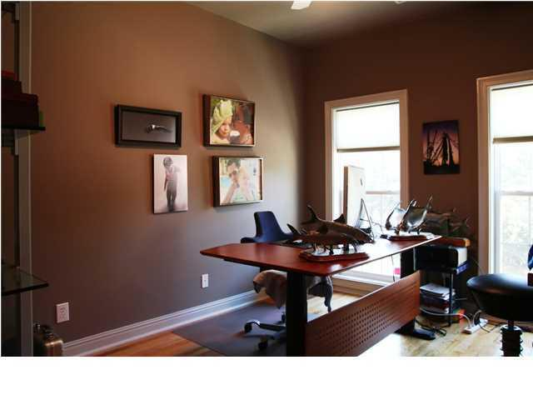
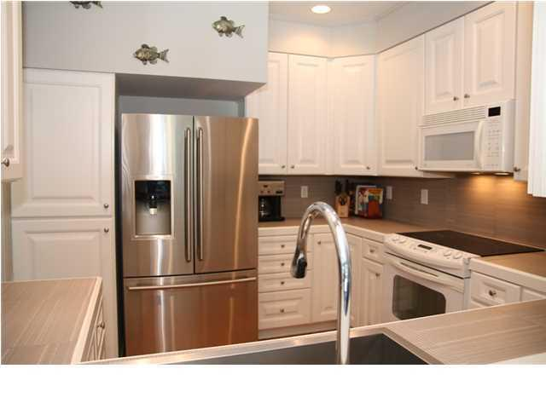
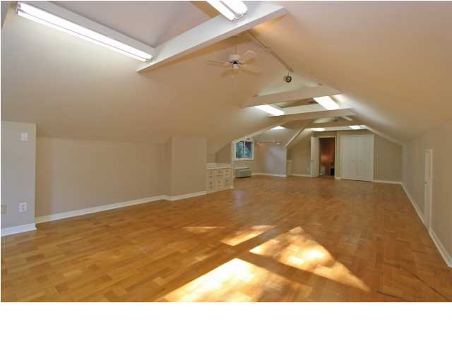
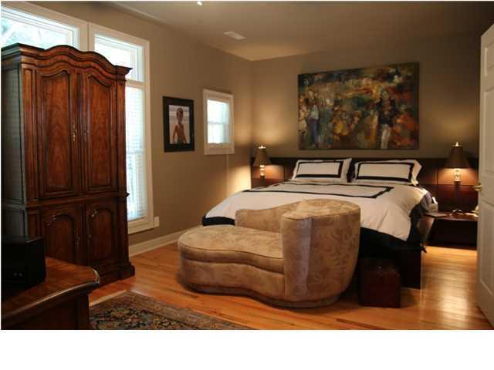
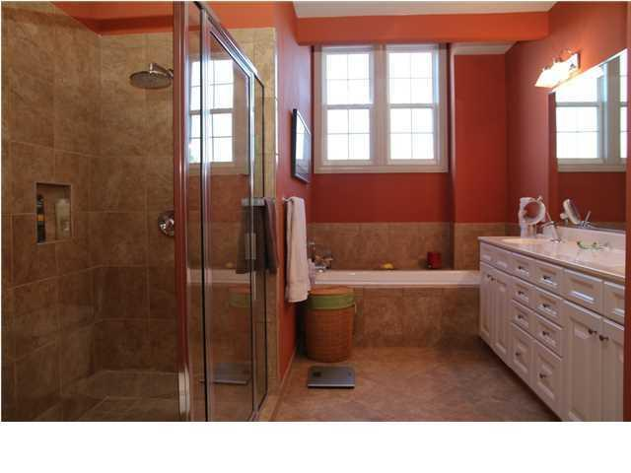
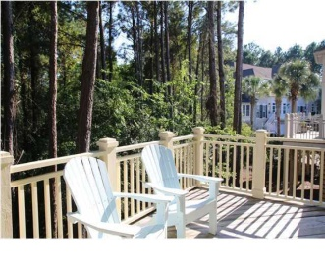
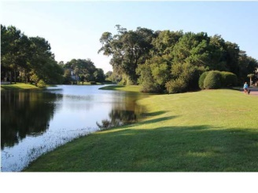


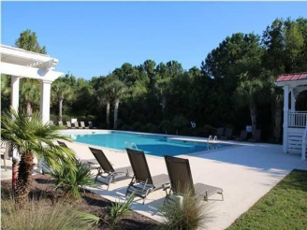
1528 Sea Palms Crescent Marais @ Seaside Farms ~ Mount Pleasant MLS# 1426249 ~ $415,000
See more at www.2161shellring.com
Location. Location .Location.. 1528 Sea Palms Crescent is a three bedroom, three bathroom luxurious townhouse in the highly desirable subdivision of Marais in the Seaside Farms community. This particular townhome backs up to a protected wetland for extreme privacy. The first floor of this popular Pinckney floor plan boasts a large living area with fireplace, separate dining area, a light and cheery kitchen with Electrolux stainless refrigerator and unique countertops and backsplash from Germany. There is a guest bedroom (currently used as office) and full bath on the main floor and a wonderful deck off the living area that is accessed by an extra large Anderson eight foot high door opening that allows for a ton of light. Upstairs has the spacious master suite with a great tiled bath with double vanity, large soaking tub and separate shower. There is another guest bedroom / bath upstairs and a laundry area. There are 9 foot ceilings on both floors, red oak hardwood floors throughout entire home other than the tiled baths. There are high end upgrades throughout that enhance the utility and comfort of this deluxe and well appointed residence. The garage has room for two cars, golf cart or boat as well as additional storage. The Marais community has a private pool and in only a short drive over the IOP Connector to the beaches. Great shopping, fine dining, coffee and more within a quick stroll or golf cart ride through the neighborhood. Also, Marais just received FEMA approval for AE flood designation beginning Nov 20, 2014.
Clay Cunningham
Office - (843) 886-8110
Cell - (843) 345-4647
Fax - (843) 202-2921
clay@carolinaone.com
Carolina One Real Estate
1400-E Palm Boulevard
Isle of Palms, SC 29451

