Slide 1
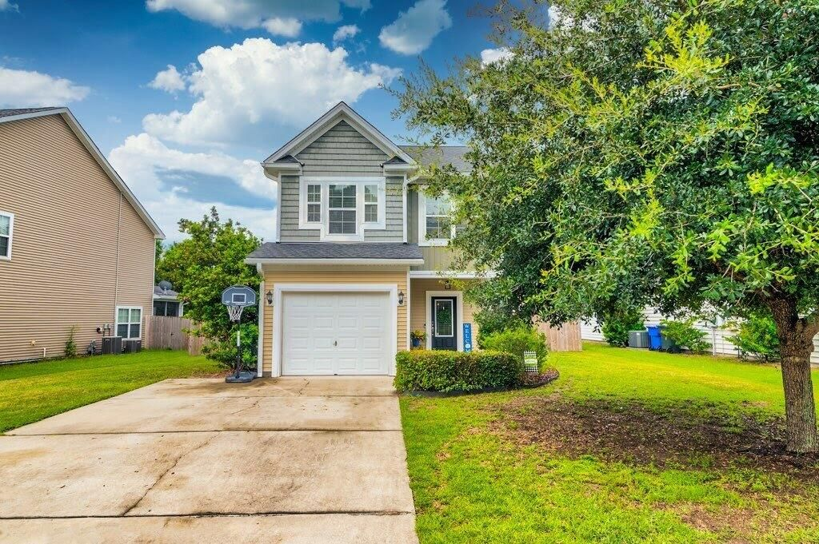
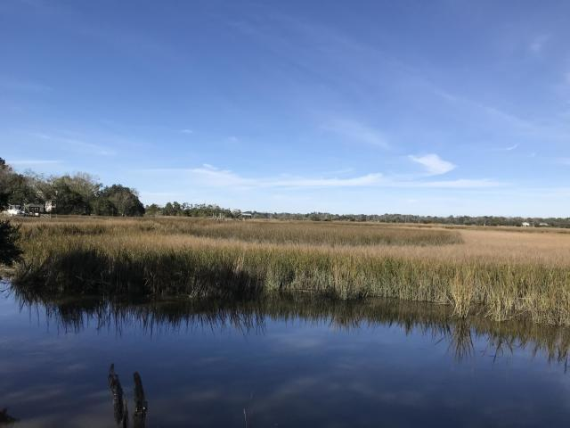
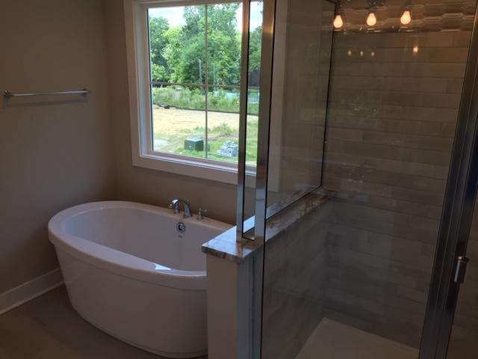
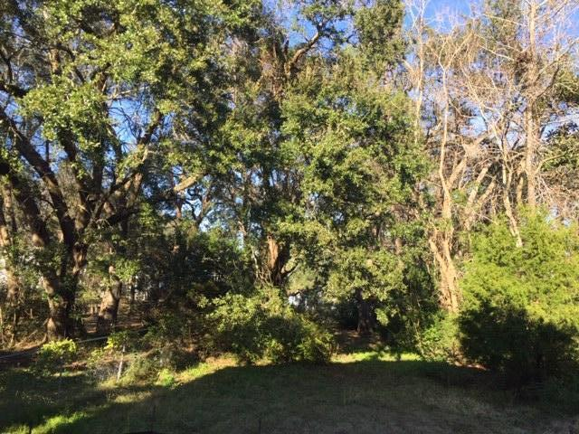
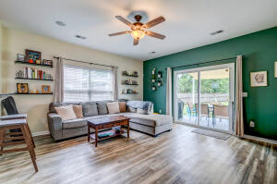
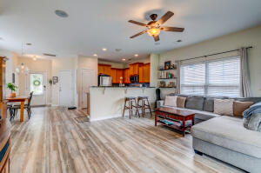
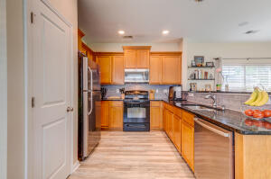
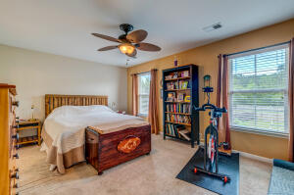
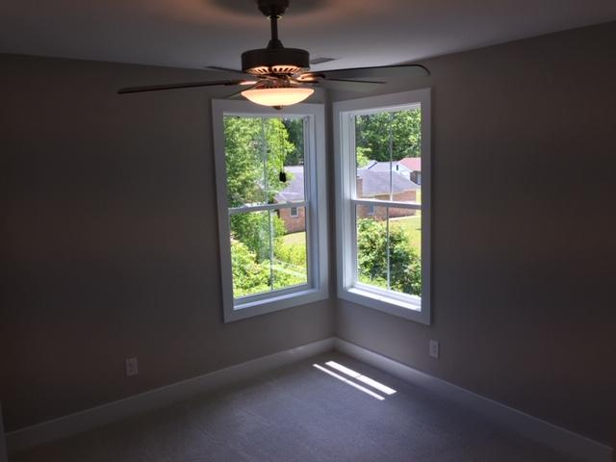
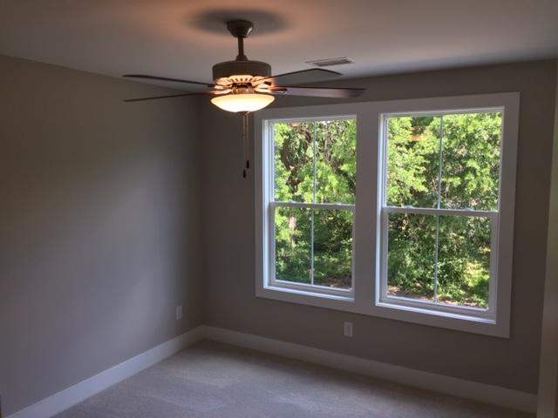
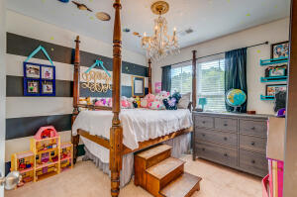
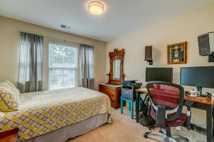
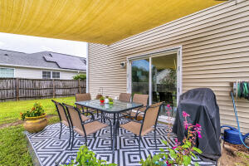
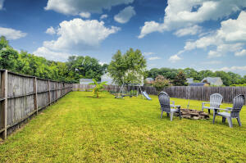




JOHNS ISLAND | NEW PRICE $405k!!!
1528 Thoroughbred Boulevard
Brownswood Farms
Johns Island, SC 29455
MLS# 22022289
$405,000
3 Bedrooms :: 2½ Baths :: 1,505 sf
Charming, bright, and functional Johns Island home in a great established neighborhood! Embrace Johns Island living with this 3 bedroom, 2.5 bathroom home that was built in 2012. There are beautiful new LVP floors on the bottom level, inviting you into this spacious and open concept home. The living area is equipped with in-ceiling speakers also! Your family can move right in with fresh paint and modern features. Upstairs, a hallway meanders guiding you to 3 bedrooms. The master, has dual vanities and a walk in closet, with a garden tub. The hall bath is convenient for guests. There is a half bath downstairs also! The MASSIVE, private fenced back yard allows for activities and outdoor enjoyment of our nice Low Country weather. Park in the 1-car garage or use it for storage and projects!
Eric Draper
(843) 442-7118
eric.draper@gmail.com
Jon Moore
(843) 732-3365
jon@charlestonrealestategroup.com
www.charlestonrealestategroup.com
Charleston Real Estate Group | 443 Folly Road | Charleston, SC 29412

