Slide 1
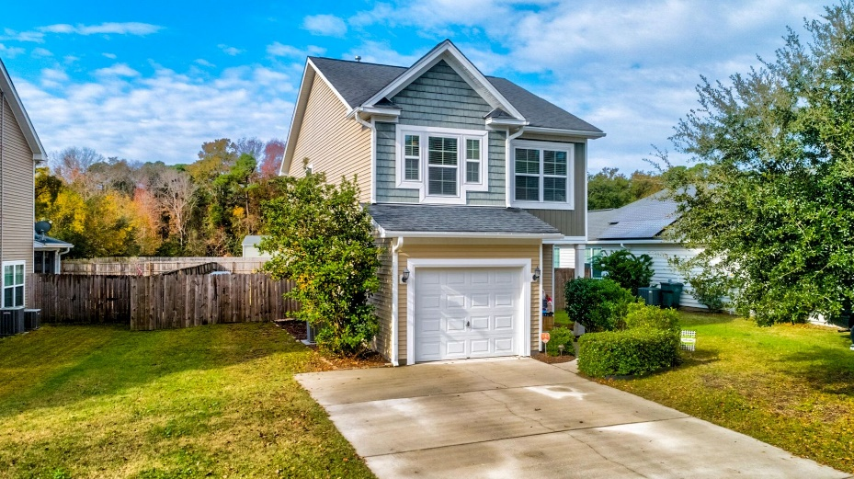
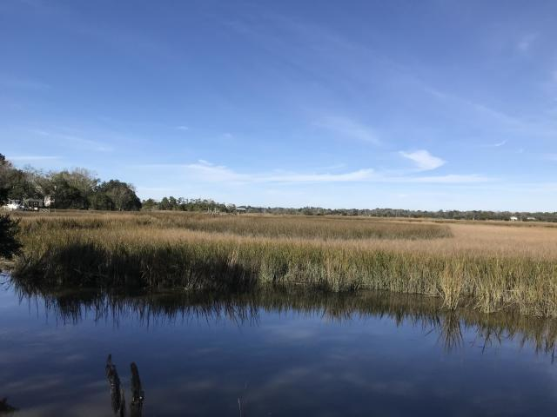
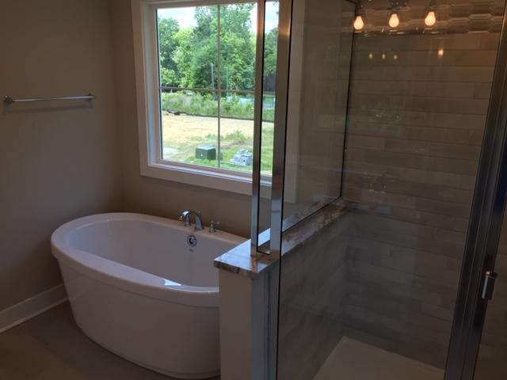
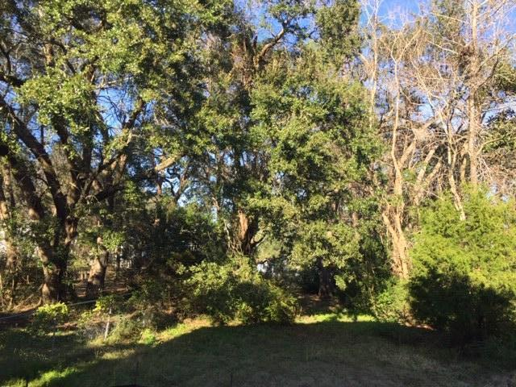
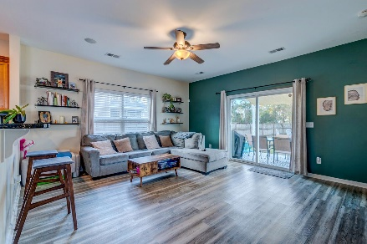
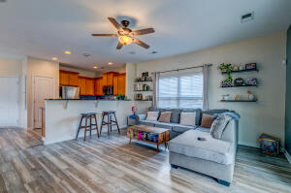
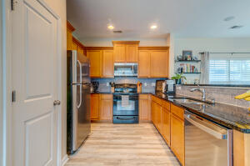
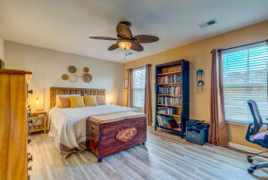
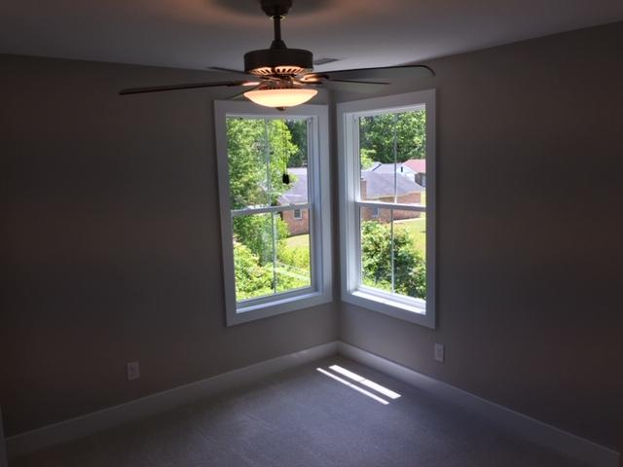
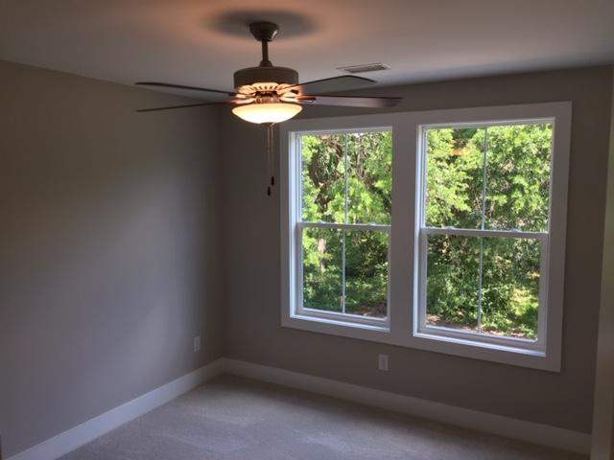
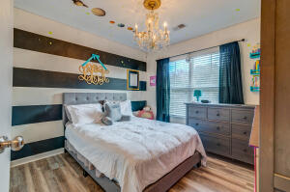
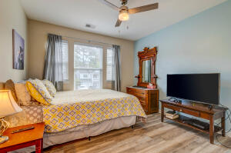
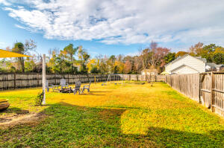
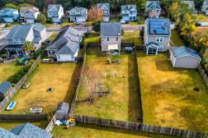




Open House Sunday from 12-2 PM
1528 Thoroughbred Boulevard
Brownswood Farms
Johns Island, SC 29455
MLS# 22030226
$385,000
3 Bedrooms :: 2½ Baths :: 1,505 sf
Charming, bright, and functional Johns Island home in a great established neighborhood! Embrace Johns Island living with this 3 bedroom, 2.5 bathroom home. NEW LVP floors THROUGHOUT invite you into this spacious and open concept home. The living area is equipped with in-ceiling speakers! You can move right in with fresh paint and modern features. Upstairs, a hallway meanders guiding you to 3 bedrooms. The master bath has NEW TILE, NEW LIGHTING, dual vanities and a walk in closet, with a garden tub. The hall bath is convenient for guests. There is a half bath downstairs also! The HUGE, private fenced back yard allows for activities and outdoor enjoyment of our nice LowCountry weather. Park in the 1-car garage or use it for storage and projects!
Close to everything Charleston has to offer!
Eric Draper
(843) 442-7118
eric.draper@gmail.com
Jon Moore
(843) 732-3365
jon@charlestonrealestategroup.com
www.charlestonrealestategroup.com
Charleston Real Estate Group | 443 Folly Road | Charleston, SC 29412

